Slide 1
Lateral Stability of
precast concrete beams
David Fernández-Ordóñez
fib Secretary General

Slide 2


2

Slide 3
Commission 6. Prefabrication
Task Groups:
TG 6.1 Precast floors
Conveners: Maas (Belgium), Klein-Holte (Netherlands)
TG 6.2 Quality control for precast concrete
Convener: Karutz (Germany)
TG 6.3 Sustainability of structures with precast elements
Conveners: De la Fuente, Josa (Spain)
TG 6.4 Precast concrete towers for wind power generators
Convener: Lancha (Spain)
TG 6.5 Precast concrete bridges
Convener: Waimberg (Brazil)
3

Slide 4
Commission 6. Prefabrication
Task Groups:
TG 6.6 Retrofitting of precast seismic structures
Convener : Pampanin (Italy)
TG 6.8 Terminology for precast concrete
Convener: Krohn (USA)
TG 6.9 Precast Parking Structures
Conveners: van der Zee (Belium),
Sennour (USA), Doniak (Brazil)
TG 6.11 Vision of precast concrete on social challenges
Convener: Falger (Netherlands)
TG 6.12 Precast concrete modular buildings
Convener: Julio (Portugal)
4

Slide 5

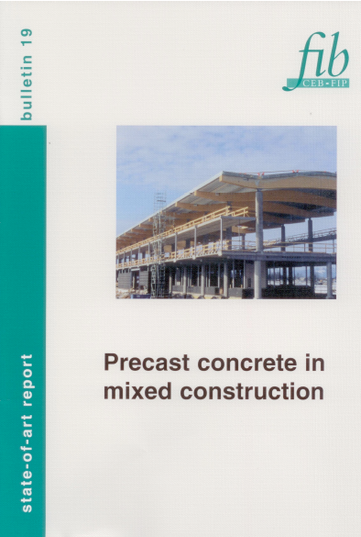


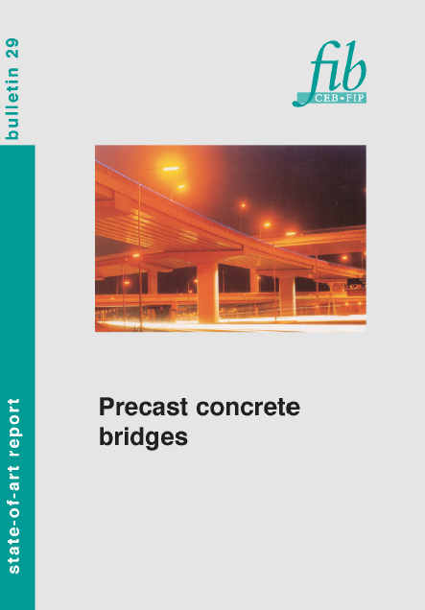
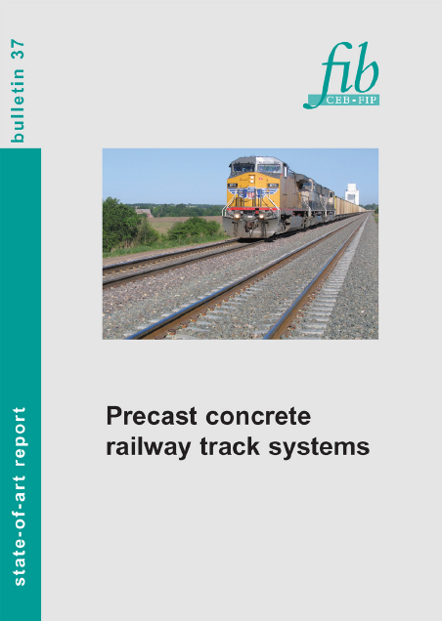
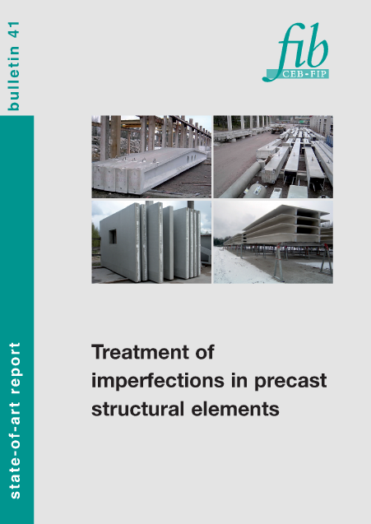




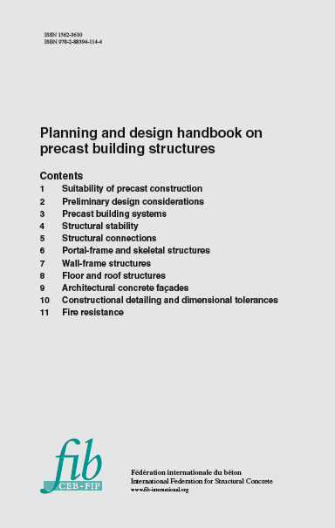
fib Commission of Prefabrication. Publications
5

Slide 6





fib Commission of Prefabrication. Publications
6

Slide 7
fib Commission of Prefabrication.
Publications of TG6.5 Precast concrete bridges.
7

Slide 8
Lateral Stability of Precast Concrete Beams
TG 6.5 Precast concrete bridges
Convener: Waimberg (Brazil)
Document ”Lateral Stability of Precast Concrete Beams”
Main Authors: Albert de la Fuente, David Fernández-Ordóñez
In collaboration with PCI. Will be a joint document fib/PCI
8

Slide 9
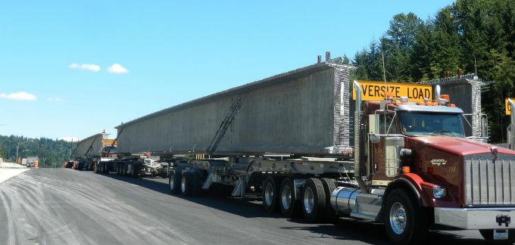
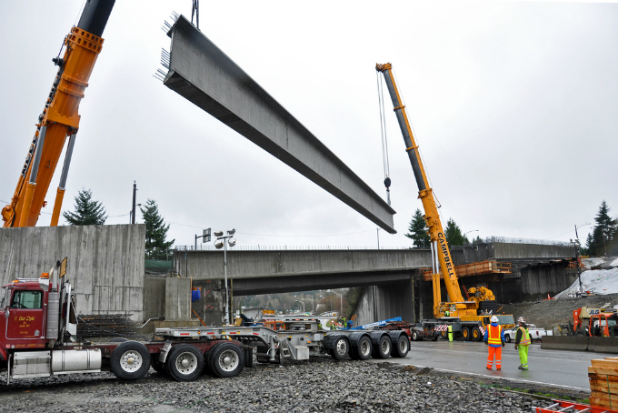
Lateral Stability of Precast Concrete Beams
Increase of the mechanical capacity of the materials
Increase of the transport and lifting capacity
Increase height and weight
Increase in slenderness of the girder
Stability problems
PCI 2016
9

Slide 10
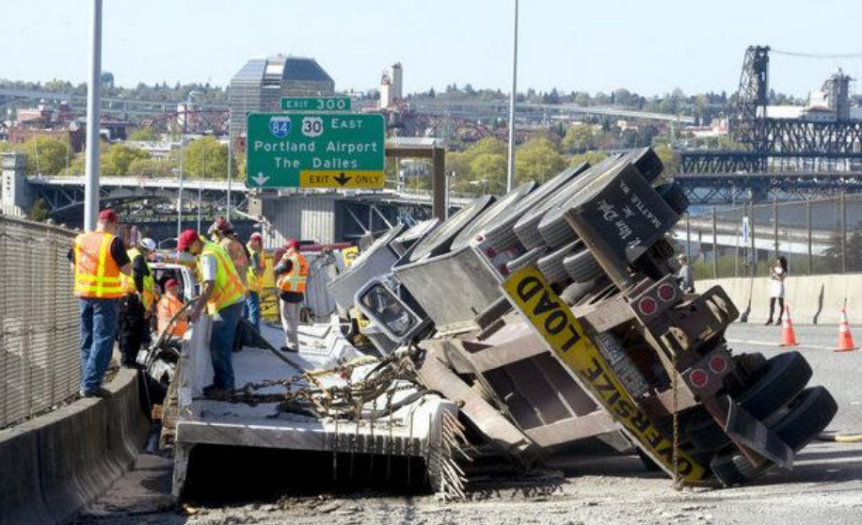
Examples of stability failure
Accident during transpotation of a precast girder in Portland’s Marquam Bridge, USA
PCI 2016
LATERAL SLOPE + CURVE + BRAKE

Slide 11
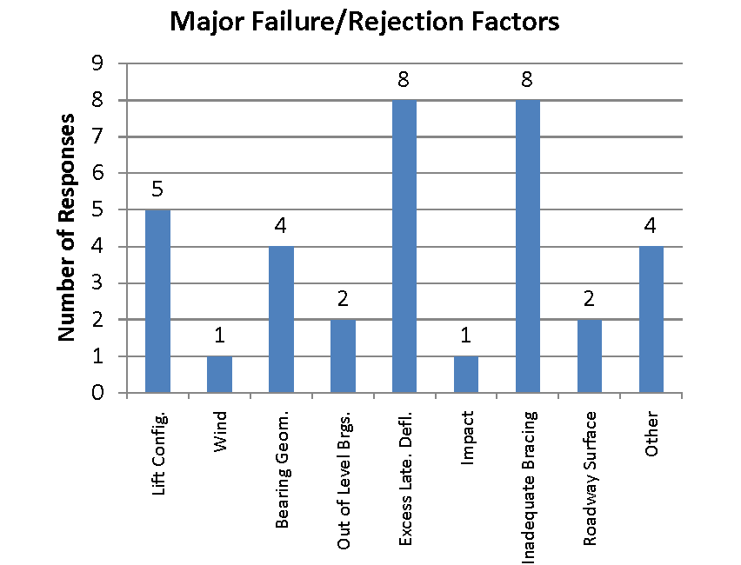
Examples of stability failure
PCI 2016
Notes:
Ditto

Slide 12
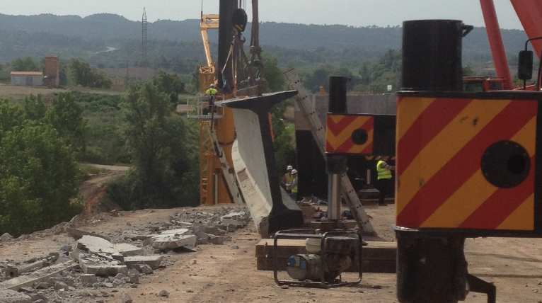
Examples of stability failure
Stability problem occurred during lifting in Barcelona

Slide 13
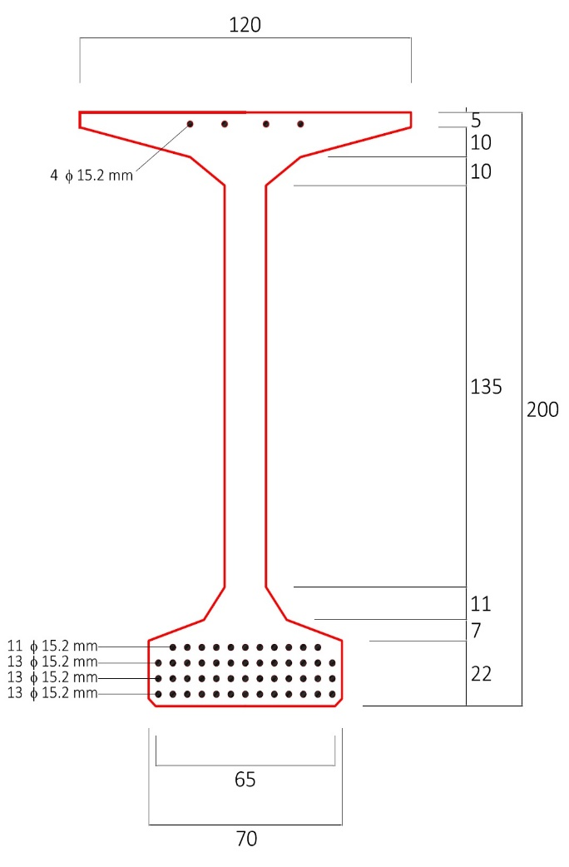
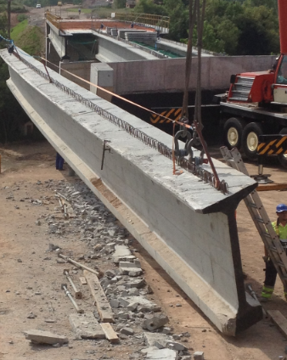
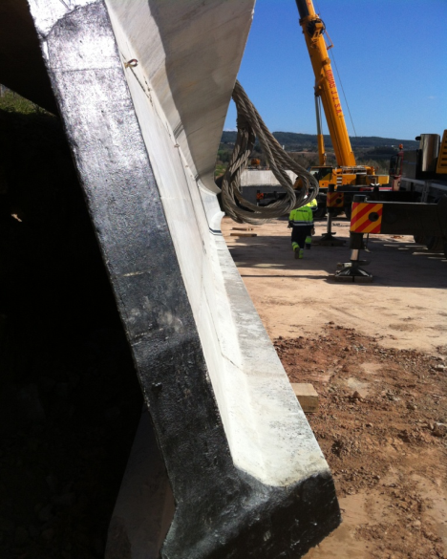
Examples of stability failure
L=46m f = 90 mm (L/510 < L/500) OK
EN 15050:2008

Slide 14
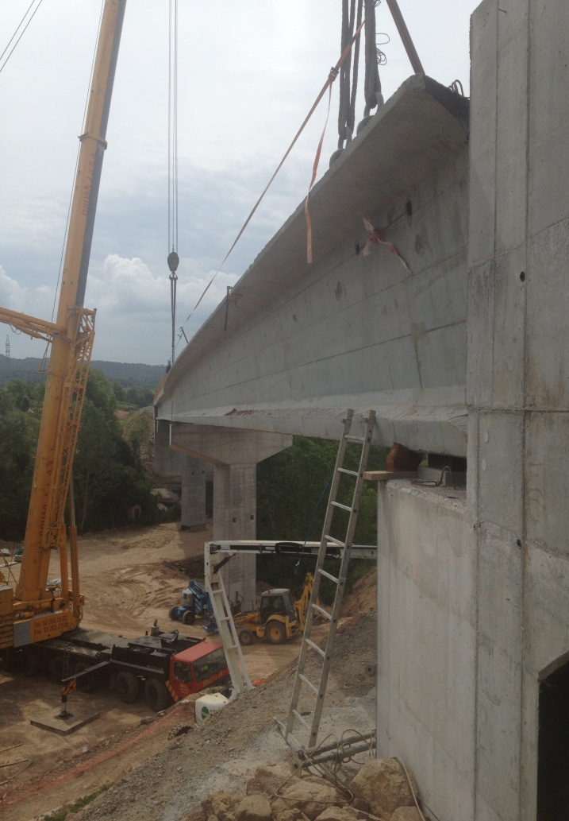
Real failure case study of a 45.6m PPCG

Slide 15
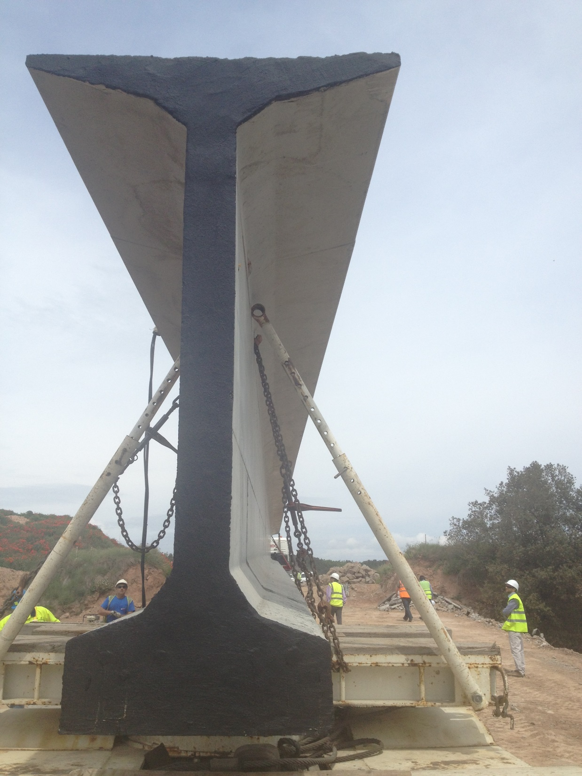
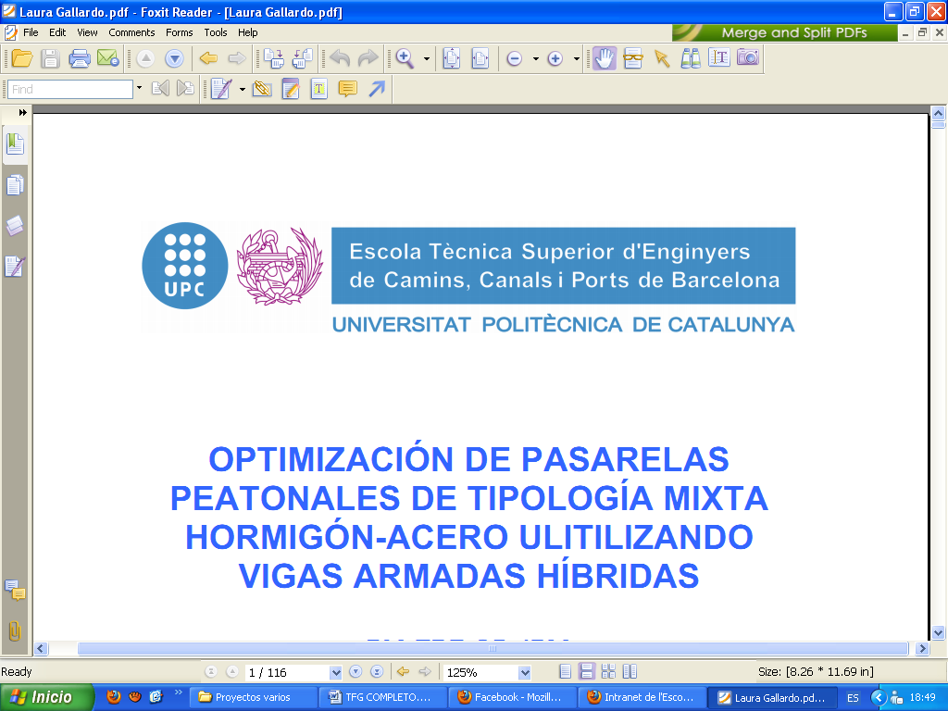
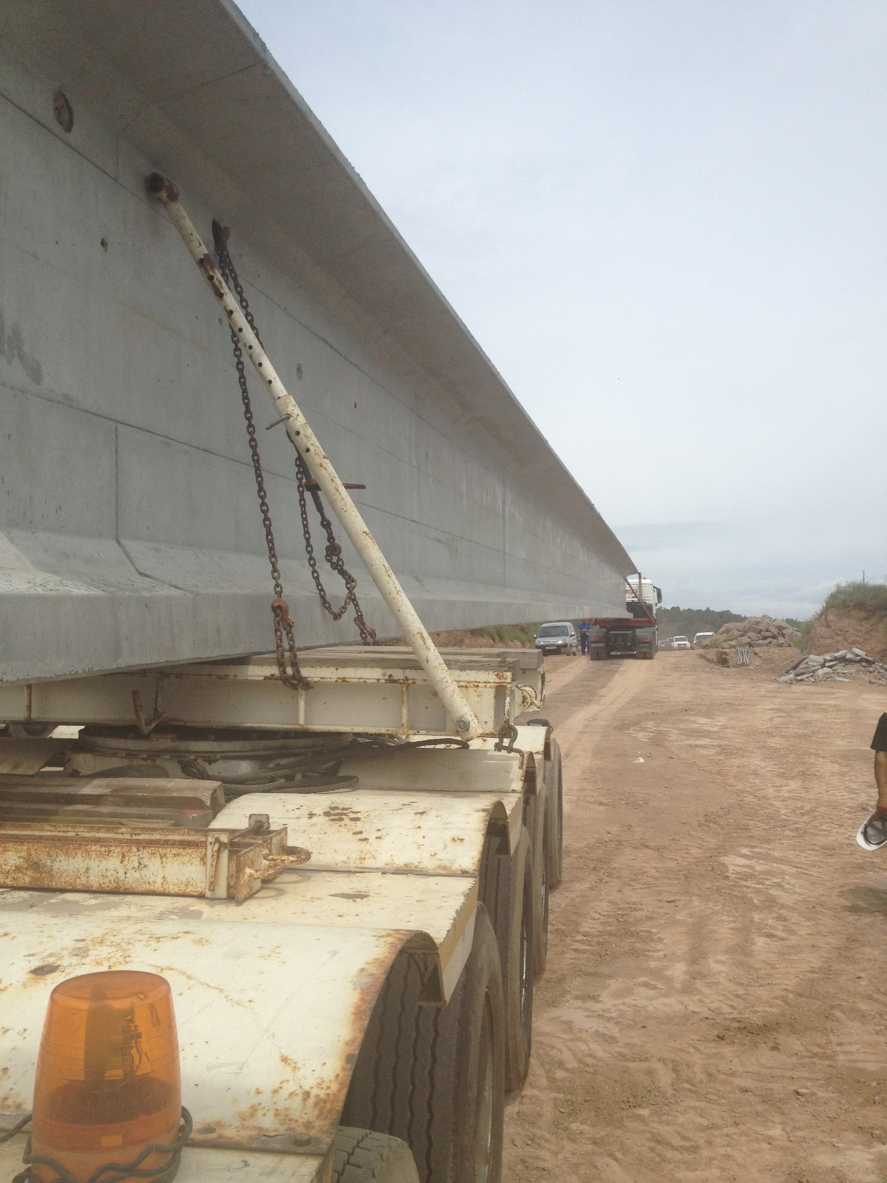

Case study of a 45.6m PPCG

Slide 16
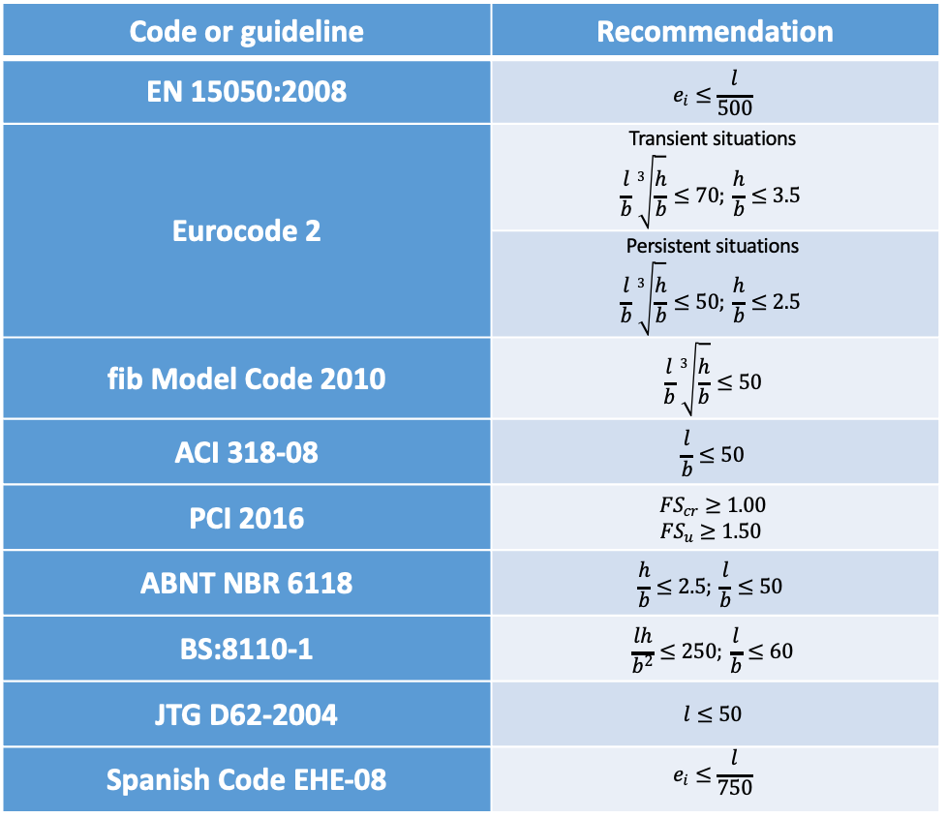
Code Provisions
Code or guideline | Recommendation
EN 15050:2008 | $$e_{i}≤\frac{l}{500}$$
Eurocode 2 | Transient situations $$\frac{l}{b}\sqrt[3]{\frac{h}{b}}≤70; \frac{h}{b}≤3.5$$
 | Persistent situations $$\frac{l}{b}\sqrt[3]{\frac{h}{b}}≤50; \frac{h}{b}≤2.5$$
fib Model Code 2010 | $$\frac{l}{b}\sqrt[3]{\frac{h}{b}}≤50$$
ACI 318-08 | $$\frac{l}{b}≤50$$
PCI 2016 | $$FS_{cr}≥1.00$$ $$FS_{u}≥1.50$$
ABNT NBR 6118 | $$\frac{h}{b}≤2.5; \frac{l}{b}≤50$$
BS:8110-1 | $$\frac{lh}{b^{2}}≤250; \frac{l}{b}≤60$$
JTG D62-2004 | $$l≤50$$
Spanish Code EHE-08 | $$e_{i}≤\frac{l}{750}$$
CODE PROVISIONS FOR LATERAL STABILITY CHECKING OF LONG PRESTRESSED CONCRETE GIRDERS SHOULD BE REVISED

Slide 17
Mechanical phenomenon
Limitations of the initial lateral sweep according to standards
± L/500 fib Bulletin 29, Precast Concrete Bridges
± 3 mm / 3m PCI 2016, Recommended Practice for Lateral Stability of Precast, Prestressed Concrete Bridge Girders
± L/750 EHE-08 Instrucción del Hormigón Estructural. Spain
± L/1000 NBR 9062 (2017) Diseño y Construcción de Structuras de Hormigón Prefabricado

Slide 18

Mechanical phenomenon
Key Design References
Robert Mast’s Publications on “Lateral Stability of Long Prestressed Beams, Parts 1 and 2”.
Mast, R. F., “Lateral Stability of Long Prestressed Beams – Part 1,” PCI JOURNAL, V. 34, No. 1, Jan-Feb 1989.
Mast, R. F., “Lateral Stability of Long Prestressed Beams – Part 2,” PCI JOURNAL, V. 38, No. 1, Jan-Feb 1993.
PCI Recommended practice for Lateral Stability of Precast, Prestressed Concrete Bridge Girders (PCI, 2016)

Slide 19
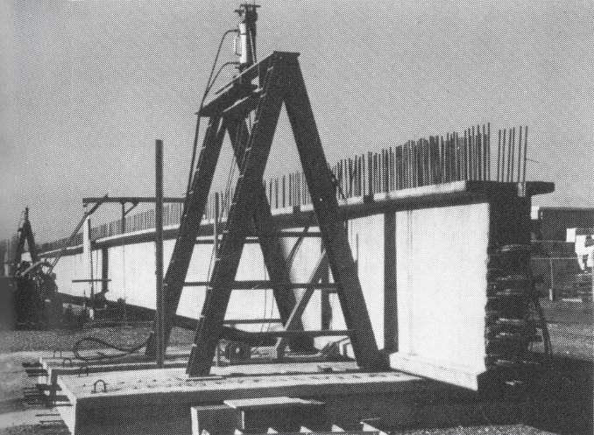
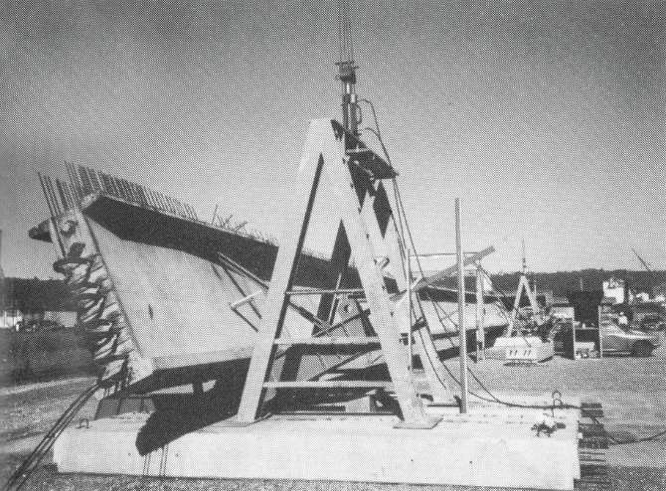
Mechanical phenomenon
Full-scale test on a 45.4 m precast prestressed concrete girder subjected to controlled roll: (a) overall view of the setup and (b) deformed shape near maximum tilt of 32º Mast (1994)

Slide 20
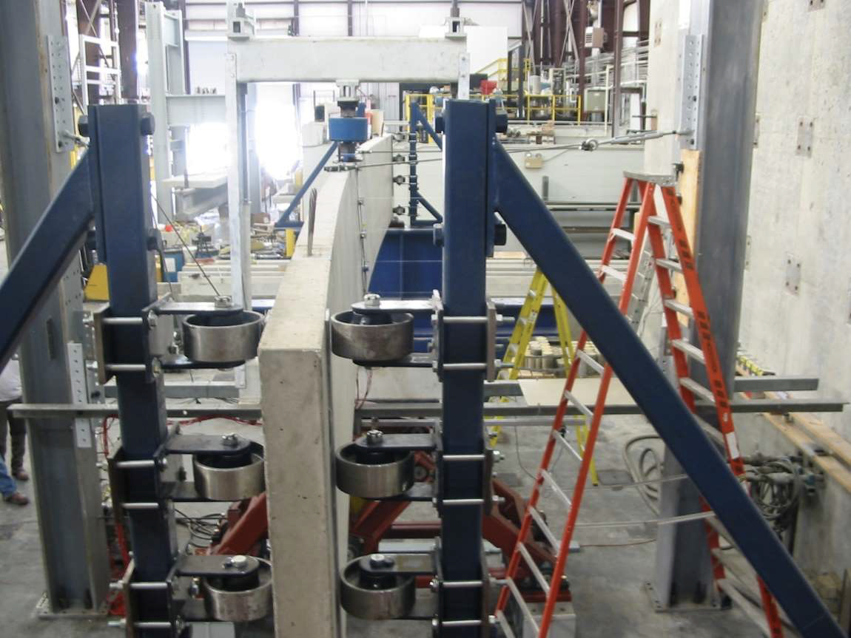
Mechanical phenomenon
Prestressed concrete beam subjected to a midspan point load during a lateral-torsional buckling test. The beam is end supported and lateral deflection is restrained at the supports. (Hurff, 2010)

Slide 21
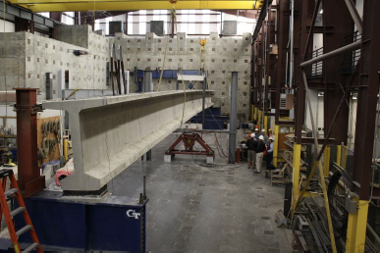
Mechanical phenomenon
Rollover stability test on a PCI BT-54 prestressed concrete beam supported on elastomeric bearing pads (Hurff and Kahn, 2010)

Slide 22
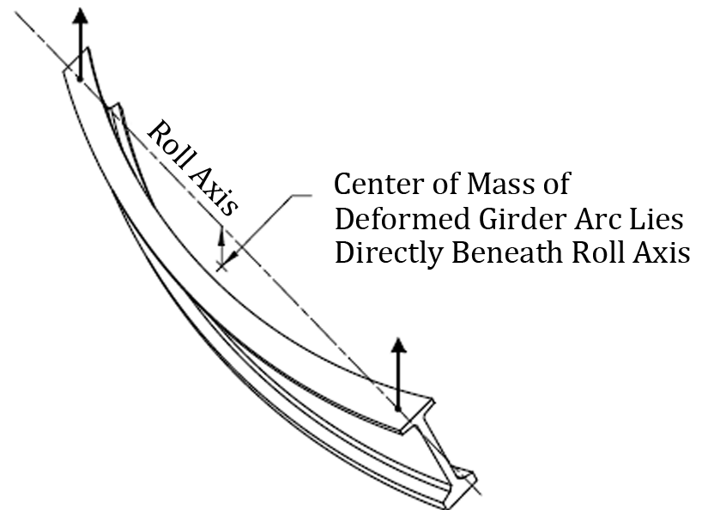
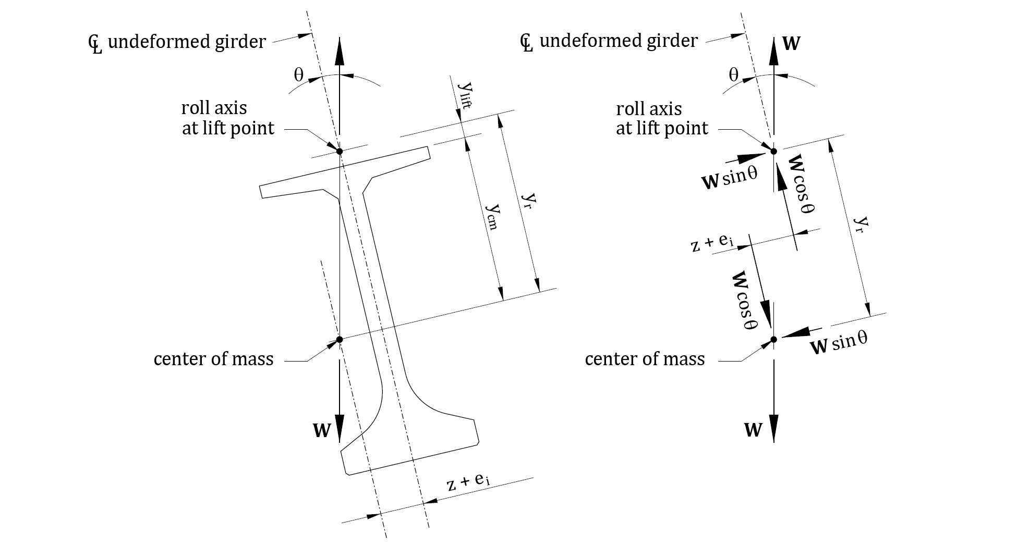
Mechanical phenomenon. Hanging girders
Notes:
When a girder is lifted, the girder will roll about an axis (the roll axis) that connects the centre of rotation at each support (the roll centre) until a state of equilibrium is reached. Lateral imperfections caused by sweep and eccentricity of the lifting devices from the centreline of the girder form an initial eccentricity (ei) that tends to cause the centre of gravity of the beam (G) to be slightly shifted to one side of the roll axis.
The lifting cables do not provide torsional resistance at the roll centres to balance the rolling moment generated. Consequently, the girder rolls as a rigid solid about the axis defined by the two lifting points, so the centroid seeks an equilibrium position beneath the roll axis by tilting an angle θi. The lateral eccentricity of the deflected shape of the girder, z, is caused by part of the beam weight (W) applied at the minor-axis (Wsinθ).
This lateral component of W activates a lateral deflection, which further shifts G and increases the tilt angle due to second order effects (see in figure 3.2 the geometric condition and free body diagram of the rotated girder).

Slide 23
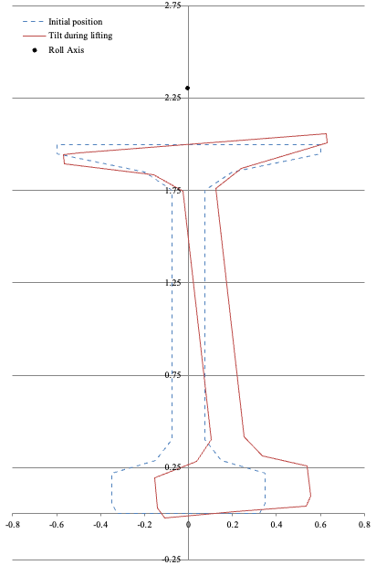
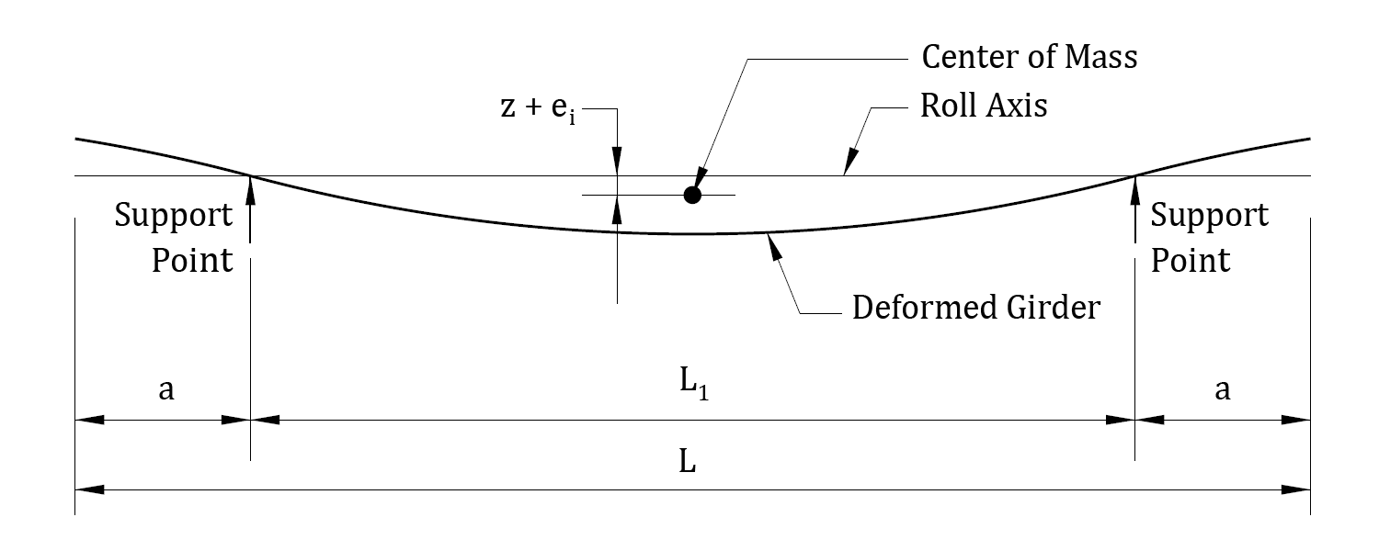
Mechanical phenomenon
Notes:
¿Why this lateral sweep can occur?
¿Which factors govern the magnitude of this sweep?

Slide 24

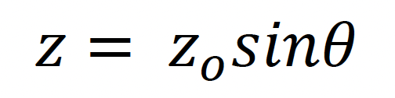
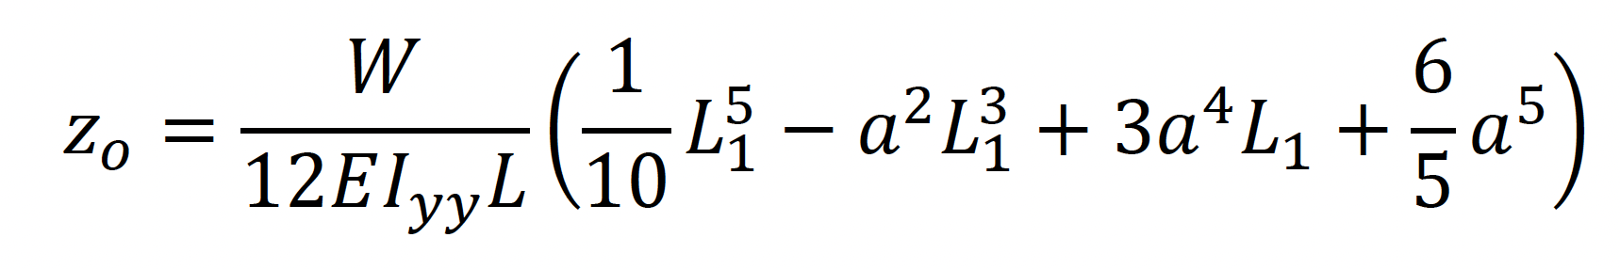
Mechanical phenomenon
- The lateral eccentricity of the deflected shape of the girder (z) is caused by the deflection from force Wsinθ.
- As the girder rotates to seek equilibrium, the lateral deflection of the girder under self-weight will vary as a function of the girder rotation.
Notes:
The lateral deflection of the centre of mass of the deflected shape of the girder, z, can be redefined according to
zo is the theoretical lateral deflection of G caused by the full weight of the beam (W) applied to the weak axis. It can be computed by means of equation 3.2, which allows considering the positive effect of overhanging by moving the lifting points inwards a distance (a).

Slide 25


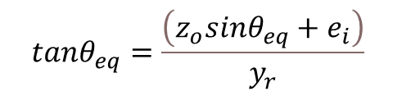
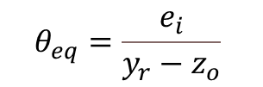
Mechanical phenomenon
Imposing equilibrium conditions
Equilibrium angle computed (non-linear equation)
Small angles and deformations
Notes:
The equilibrium is satisfied if the resisting moment (Mr, equation 3.3) and the acting moment (Ma, equation 3.4) taken about the roll axis (figure 3.2) are balanced (equation 3.5).
𝑀r = 𝑊𝑠𝑖𝑛𝜃 ∙ 𝑦r (3.3)
𝑀a = 𝑊𝑐𝑜𝑠𝜃(𝑧 + 𝑒i) = 𝑊𝑐𝑜𝑠𝜃(𝑧o𝑠𝑖𝑛𝜃 + 𝑒i) (3.4)
𝑊𝑠𝑖𝑛𝜃 ∙ 𝑦r = 𝑊𝑐𝑜𝑠𝜃(𝑧o𝑠𝑖𝑛𝜃 + 𝑒i) (3.5)
The equilibrium tilt angle θeq can be assessed by means of successive approximations of equation 3.6.
𝑡𝑎𝑛𝜃eq = (𝑧_{o}𝑠𝑖𝑛𝜃_{eq} + 𝑒_{i}) / 𝑦r (3.6)
For small values of θeq, equation 3.7 also provides suitable results.
𝜃eq = 𝑒i / (𝑦r − 𝑧o) (3.7)
If the lateral bending stiffness is compatible with the magnitude of ei, material strength and lifting conditions, the girder reaches the equilibrium at a tilt angle θeq slightly larger than angle θi (figure 3.1b). On the contrary, if the lateral bending stiffness is not enough, lateral deflection and lateral bending moment increase and this may produce cracking, or even a collapse.

Slide 26
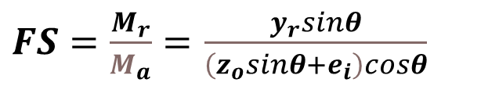
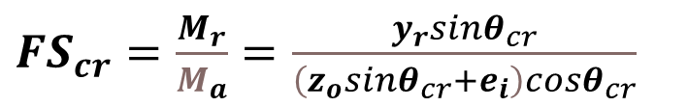
Mechanical phenomenon
Safety factor
Two conditions:
For the angle (θ_{cr}) that produces tensile cracking at the most critical flange
upward
top flange under tensile stresses
θ_{eq}
¿How to compute this angle θ_{cr} ?
Downward bottom flange under compression stresses

Slide 27
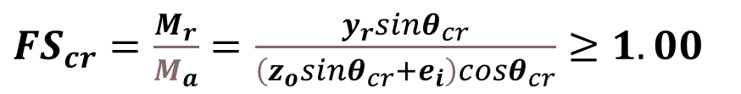
Mechanical phenomenon
Safety factor
Two conditions:
For the angle (θ_{cr}) that produces tensile cracking at the most critical flange

Slide 28
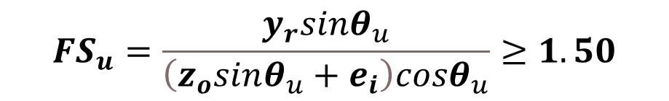
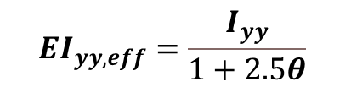
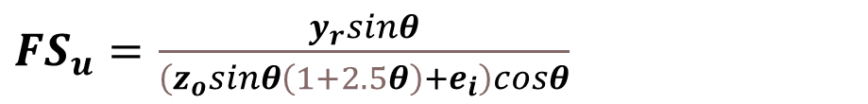
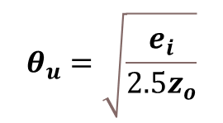
Mechanical phenomenon
Safety factor
Two conditions:
For the angle (θ_{u}) that produces the failure of the beam due to lateral bending
Maximizing

Slide 29
Mechanical phenomenon

Slide 30
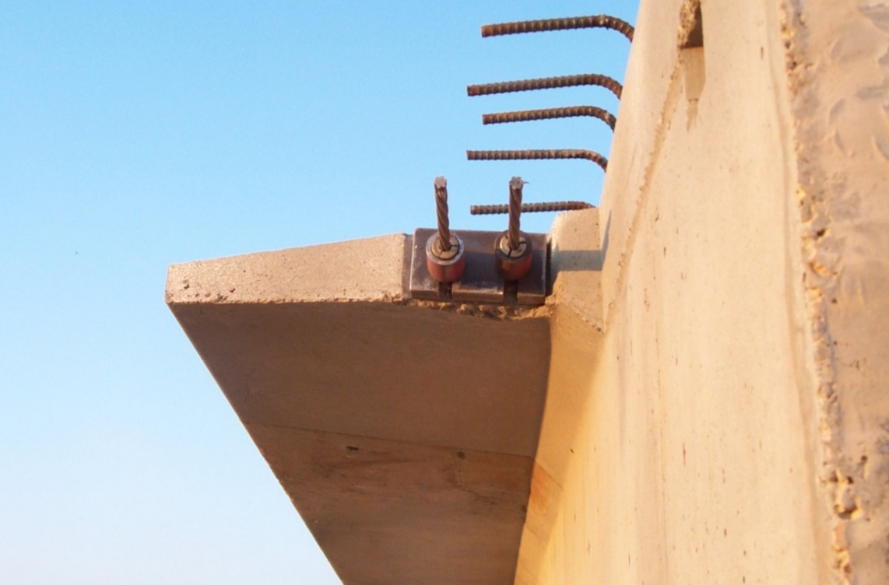
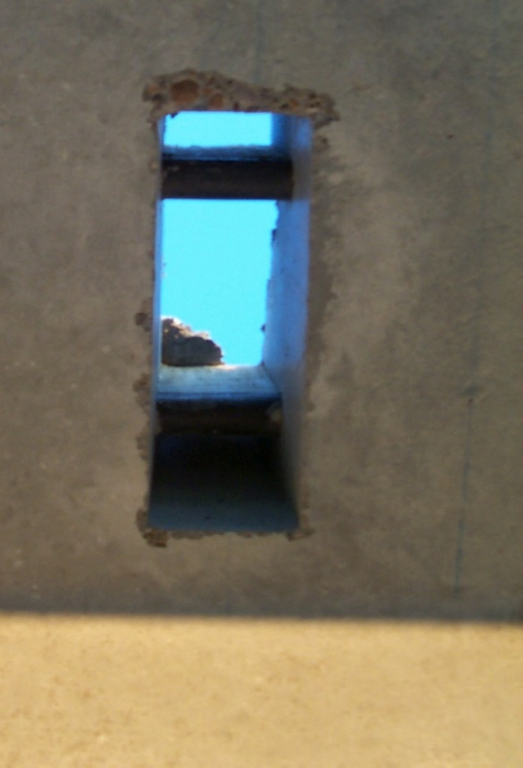
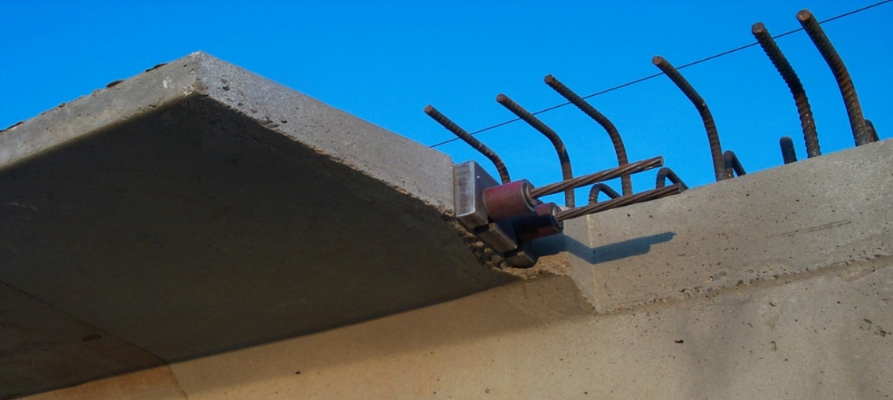
Measures to increase FS
Temporary posttensioning the top flange

Slide 31
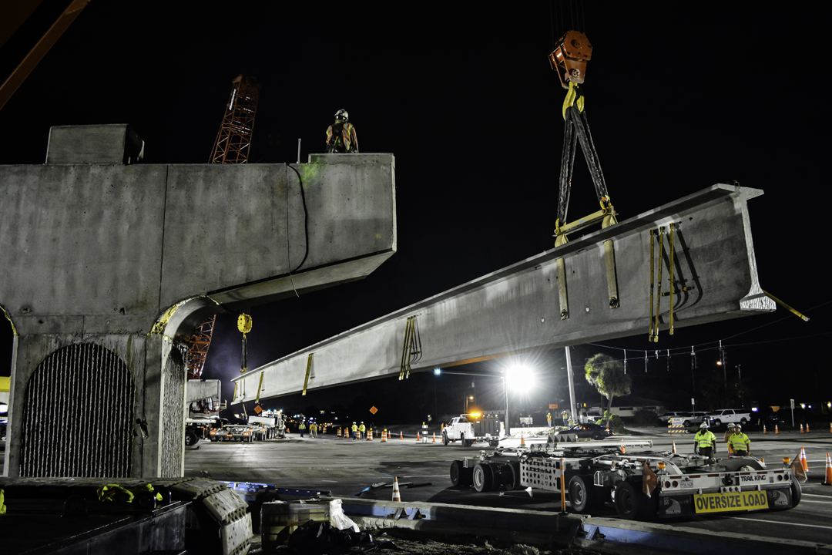
Measures to increase FS
Shift the lifting points inwards
The Lane Construction Corporation

Slide 32
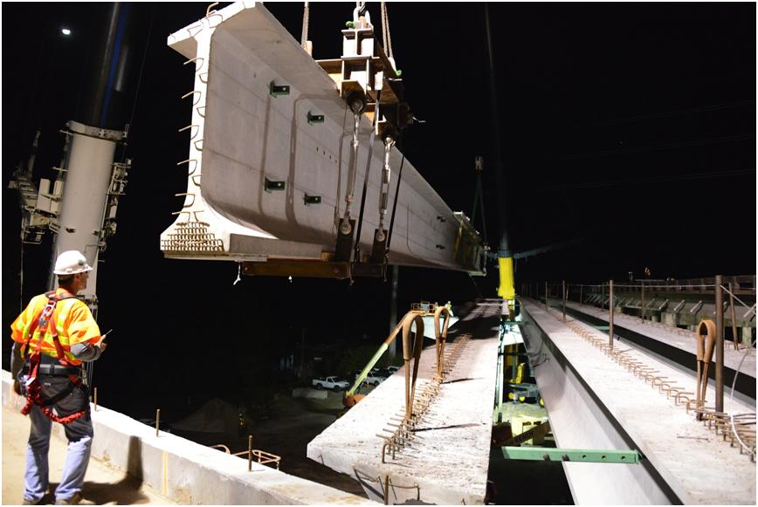
Measures to increase FS
Lateral bracing
The Lane Construction Corporation

Slide 33
Measures to increase FS
Increase the rigid height of the lifting device
The Lane Construction Corporation

Slide 34
Measures to increase FS
Increase width of the upper flange

Slide 35
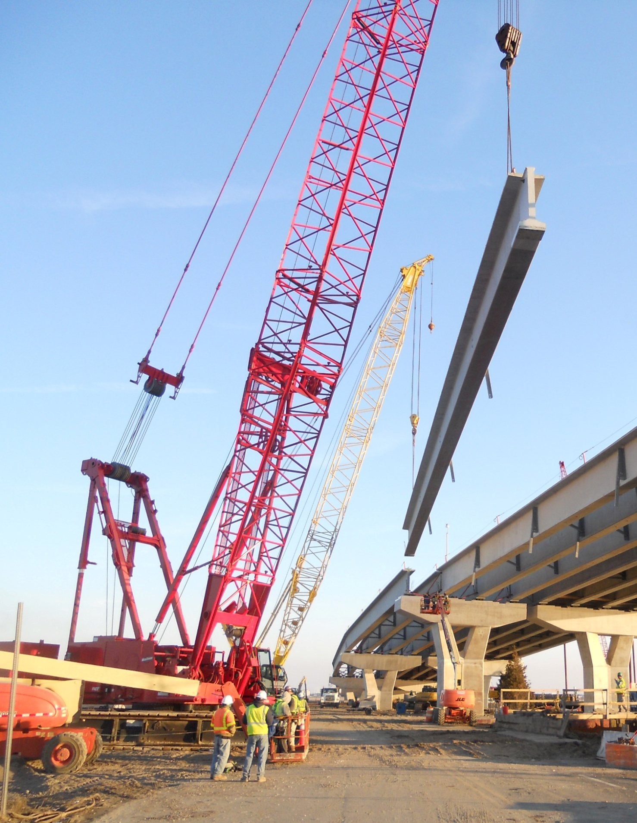
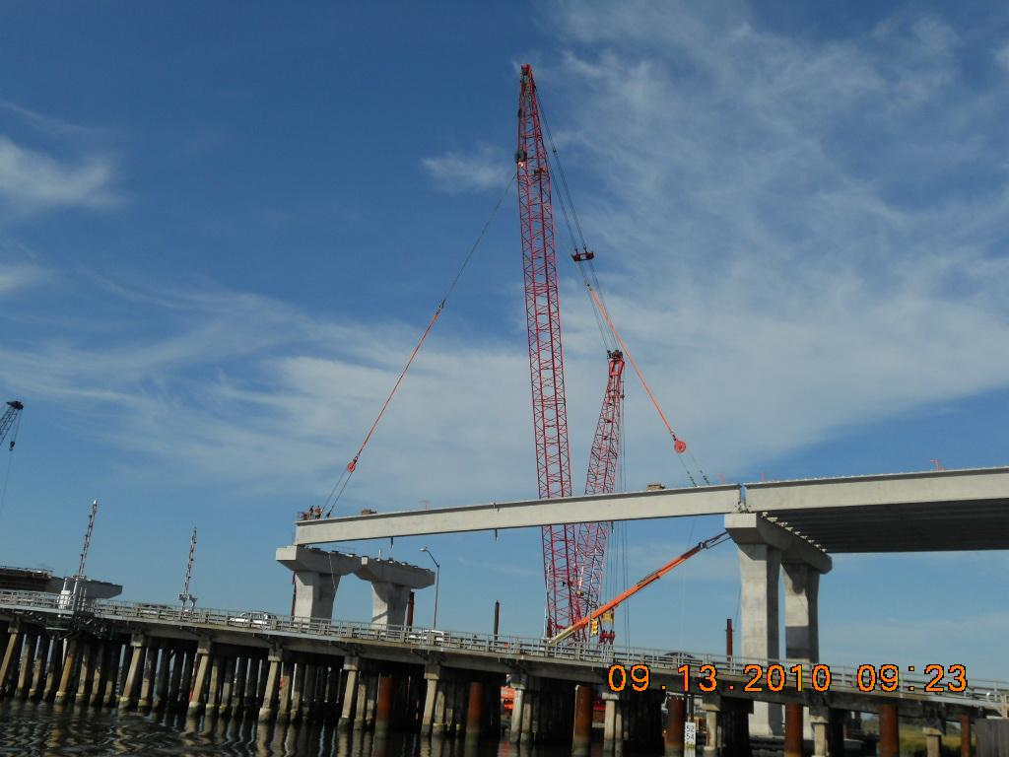
Other aspects to be considered
Angle of the cables
¿Are there differences between both lifting approaches in terms of lateral stability?

Slide 36
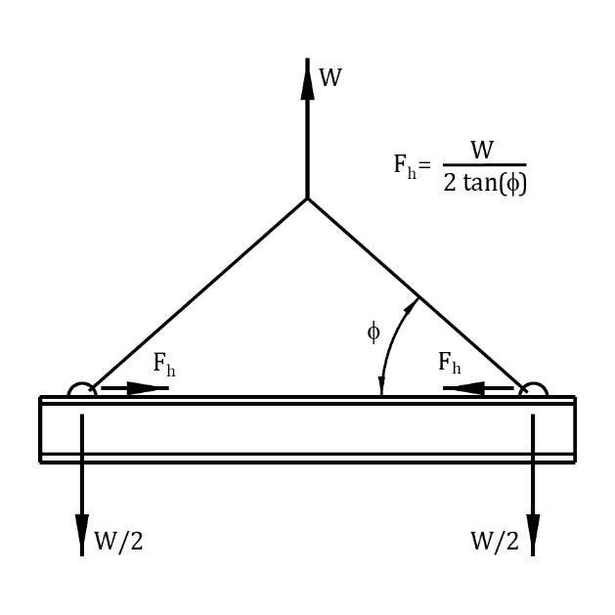
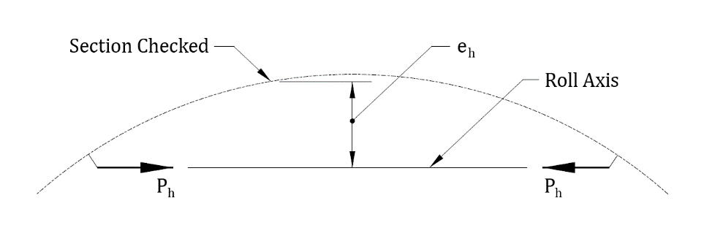
Other aspects to be considered
Angle of the cables

Slide 37
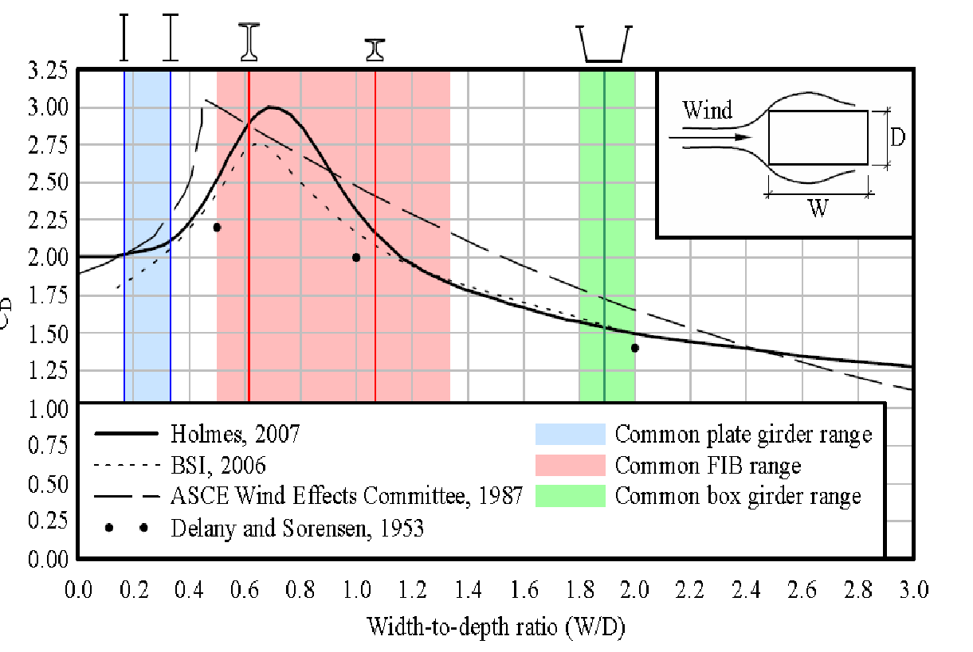
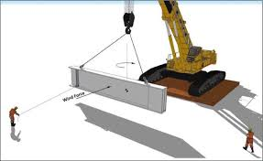
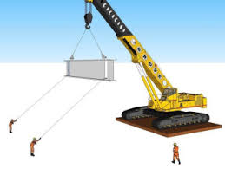
Other aspects to be considered
Wind load

Slide 38
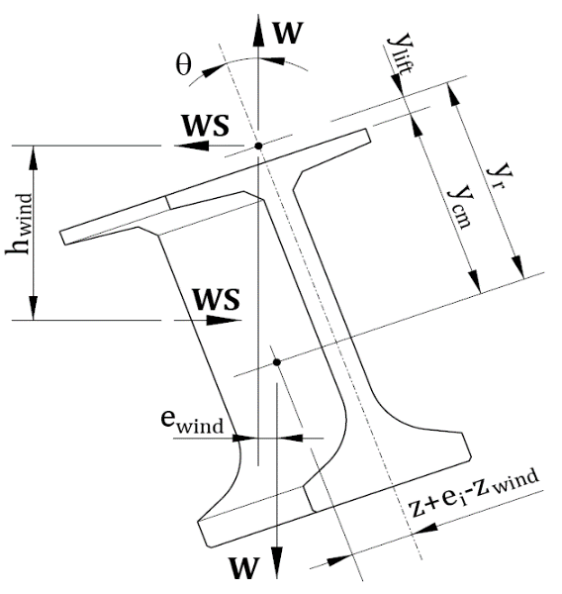



Other aspects to be considered
Wind load
Wind increasing rotation, decreasing lateral deflection
Wind reduces rotation, increasing lateral deflection

Slide 39




Stability during transport

Slide 40


Stability during transport

Slide 41

Stability during transport

Slide 42



Stability during transport

Slide 43

Stability during transport

Slide 44



Stability during transport
Factor of Safety against roll over

Slide 45


Measures to increase the FS

Slide 46



Measures to increase the FS

Slide 47


Stability during temporary support

Slide 48


Stability during temporary support

Slide 49

Stability during temporary support
Rotational constant (experimental)
from Consolazio & Hamilton, Experimental Validation of Bracing Requirements for Long-Span Concrete Girders, December 2012

Slide 50


Stability during temporary support

Slide 51


Measures to increase the FS

Slide 52
The current world record
68m-long (223 ft) precast prestressed lightweight concrete girder
Bridge over the Puyalllup River (Tacoma)
Weight 122 Ton
20% of reduction concrete density
68 Mpa of compressive strength at 28d
81 strands + 10 temporary (Po = 1700 Ton)
The Concrete Bridge Magazine, Fall 2019

Slide 53

The current world record
The Concrete Bridge Magazine, Fall 2019

Slide 54

The current world record
The Concrete Bridge Magazine, Fall 2019

Slide 55

The current world record
The Concrete Bridge Magazine, Fall 2019

Slide 56
The current world record
Notes:
This girder was lifted from vertical cables with pick points at 7.92 m (26 ft.) from the ends. The sweep considered for the stability analysis was 71 mm (2.79 in, 1/8” per 10’ of girder length) and the offset to lift loops 6.4 mm (0.25 in.).
The stability analysis for lifting operation resulted in Figure 2, in which the relationship between factor of safety (FS) and θ is included.
From Figure 2, it can be noticed that the equilibrium tilt angle (θ_{eq}) is 2.08º, while the crack tilt angle (θ_{cr}) for the lifting configuration considered reaches up to 5.95º, leading to a cracking safety factor (FS_{cr}) of 1.57 > 1.00 and a factor of safety against failure (FS_{u}) of 1.36 < 1.50; thus, this configuration is sufficiently reliable to avoid cracking during lifting.
Within the framework of the PCI (2016) recommendations, FS_{u} = FS_{cr} = 1.57 when FS_{u} < FS_{cr} .

Slide 57

The current world record

Slide 58
The current world record

Slide 59
Thank you!
David Fernández-Ordóñez
fib Secretary General

