Slide 1
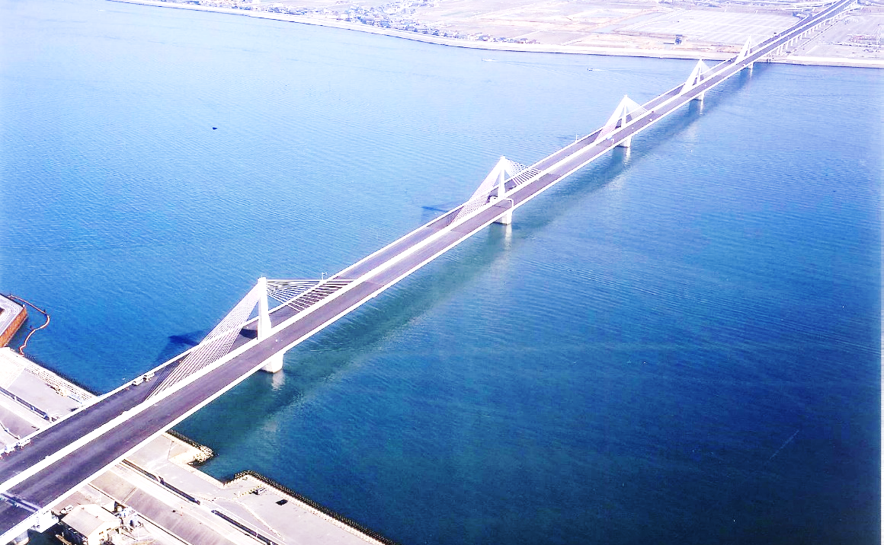
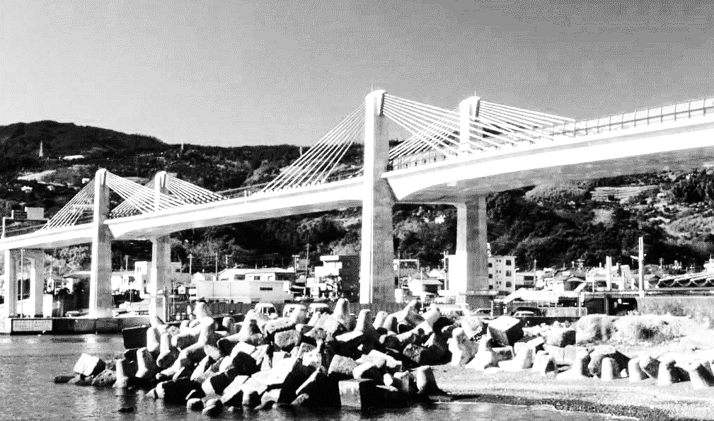

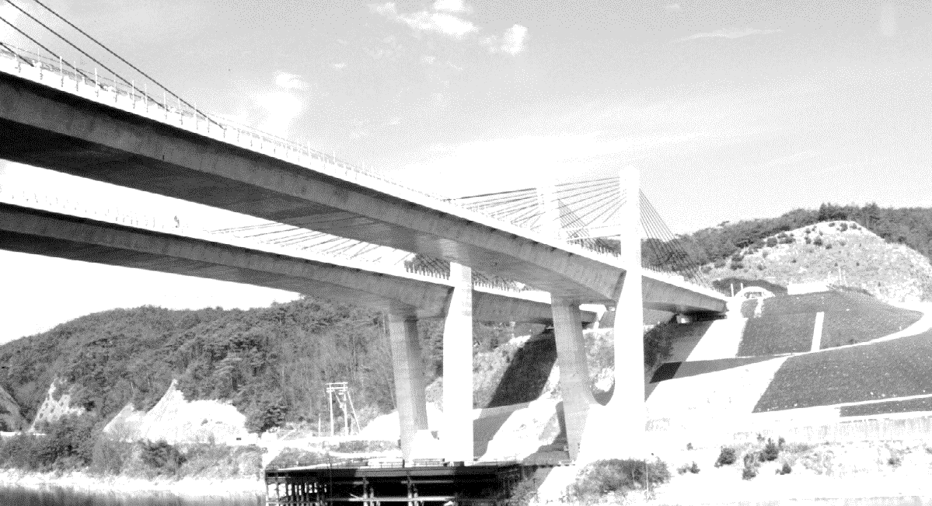
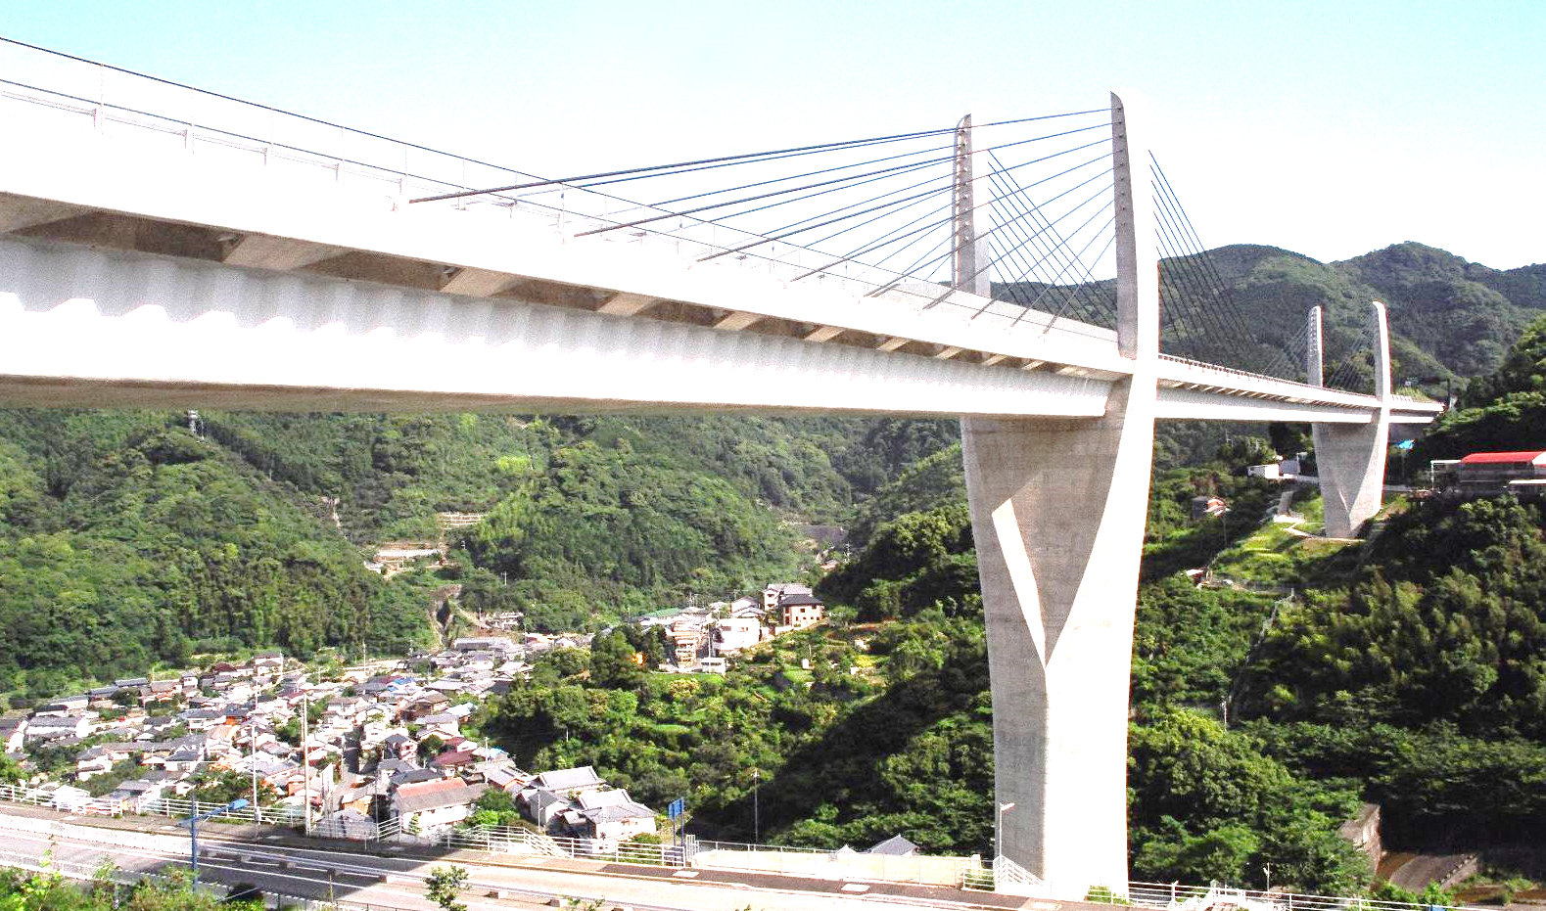

Birth, development and Future of Extradosed bridges
Akio KASUGA
Sumitomo Mitsui Construction

Slide 2
Birth

Slide 3

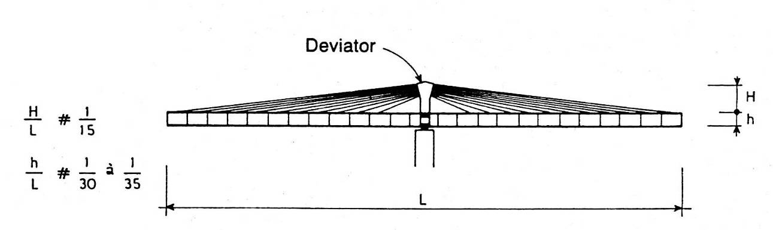
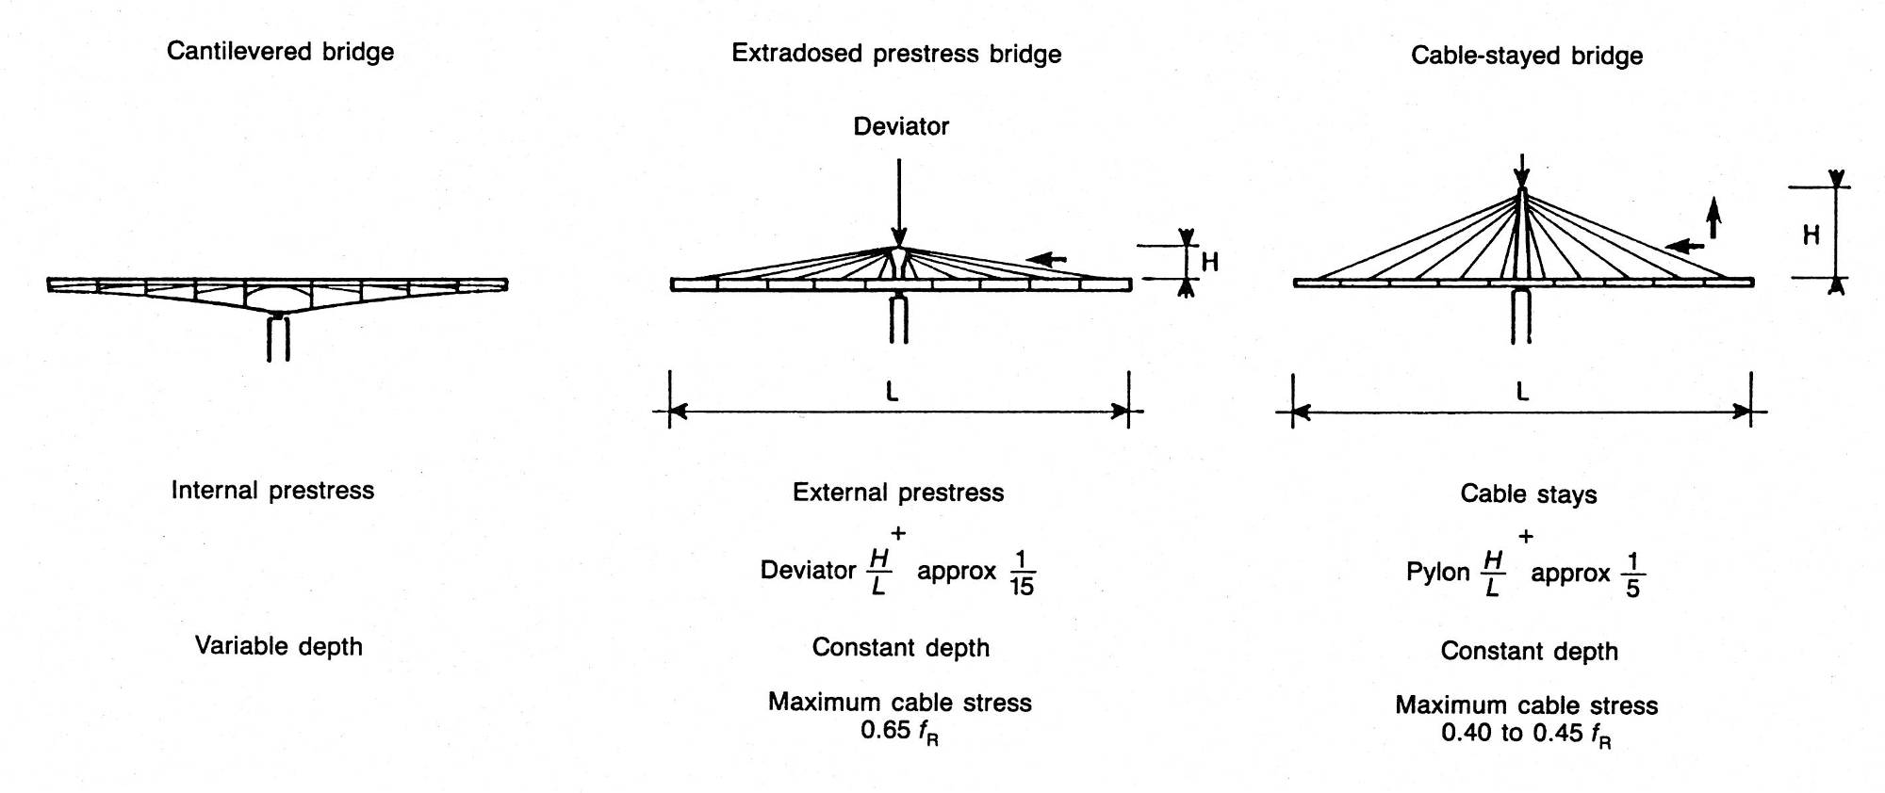
Congresso Brasileiro de Pontes e Estruturas / Rio de Janeiro / 12 e13 de maio de 2025
Mathivat’s Paper (FIP Note, 1988)
3

Slide 4
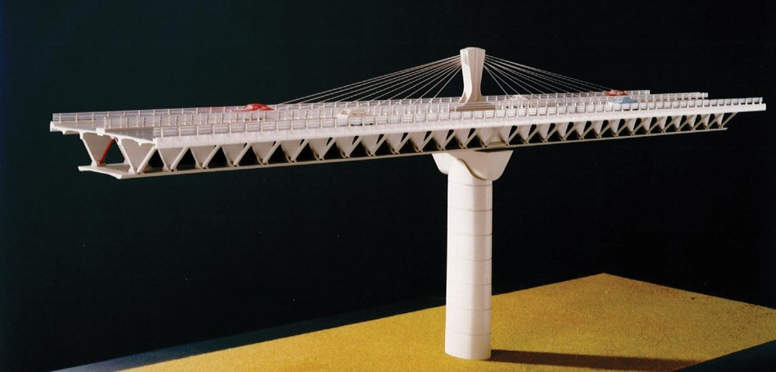
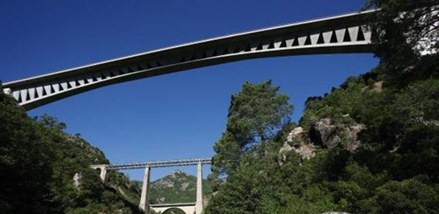
Congresso Brasileiro de Pontes e Estruturas / Rio de Janeiro / 12 e13 de maio de 2025
Arrêt-Darré Viaduct
Source：SECOA
4

Slide 5
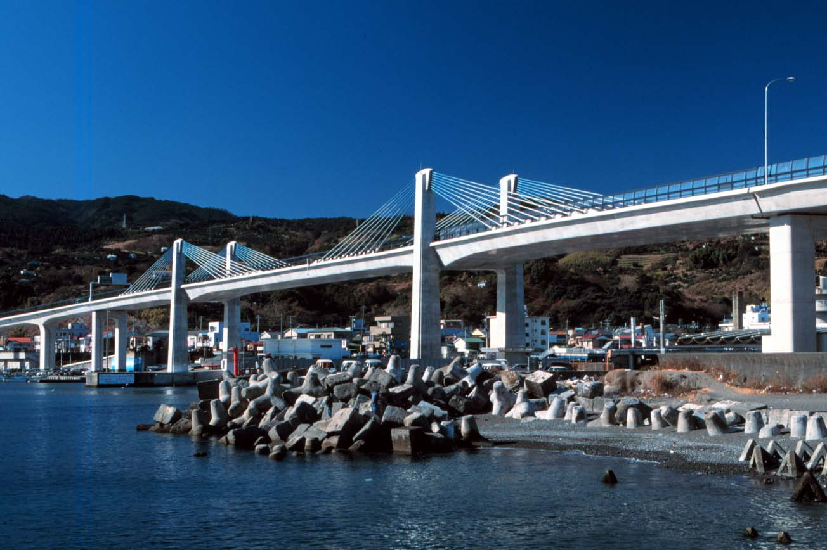
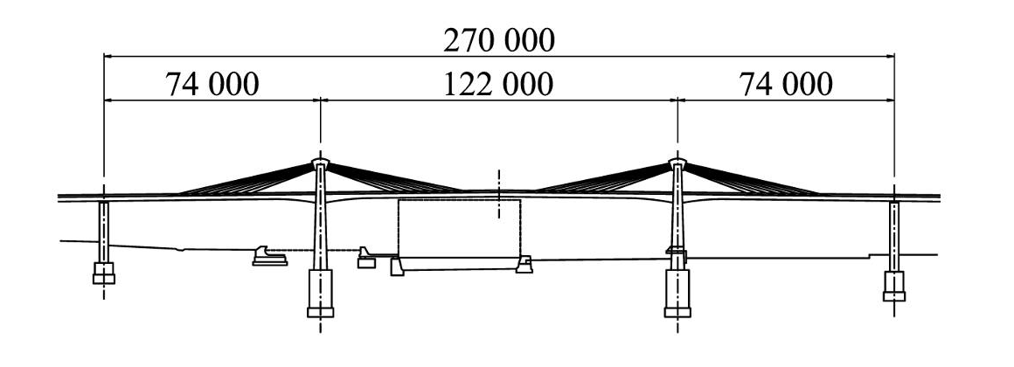
Congresso Brasileiro de Pontes e Estruturas / Rio de Janeiro / 12 e13 de maio de 2025
Odawara Blueway Bridge (1994)
5

Slide 6
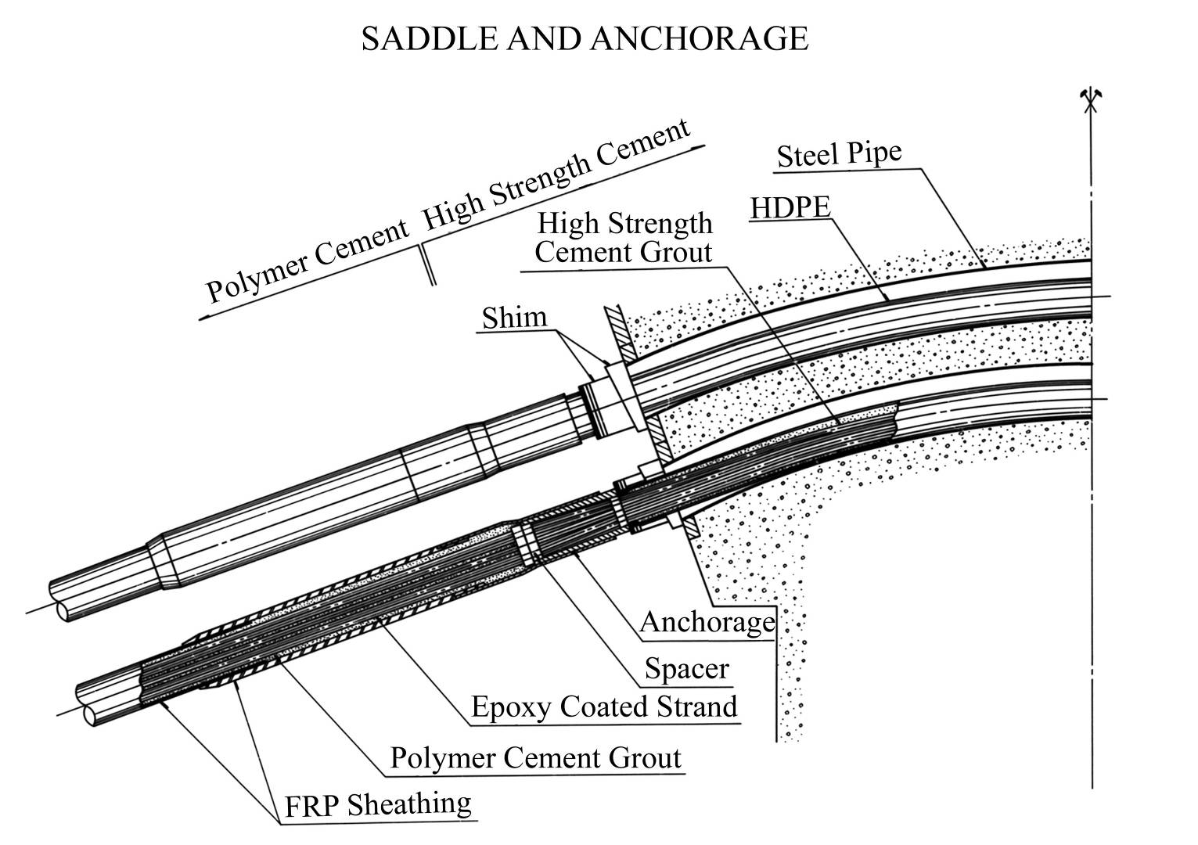
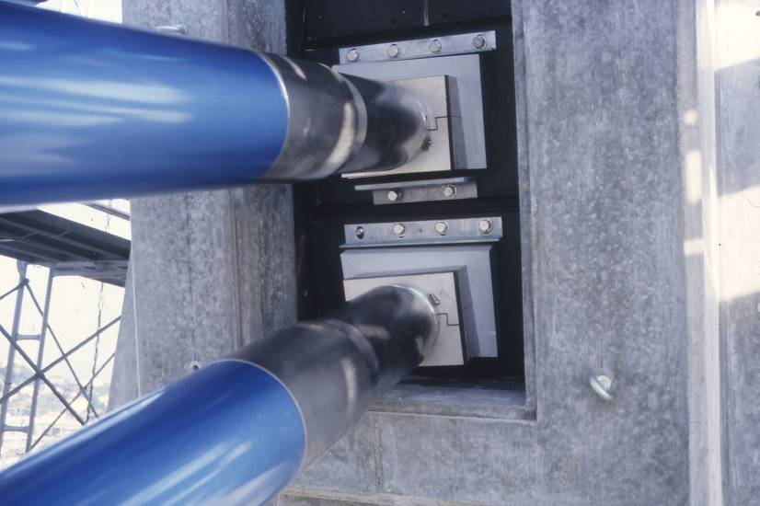
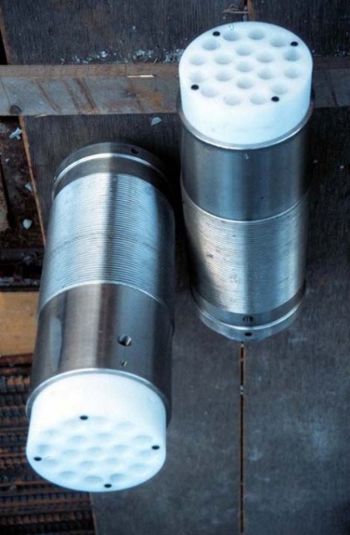
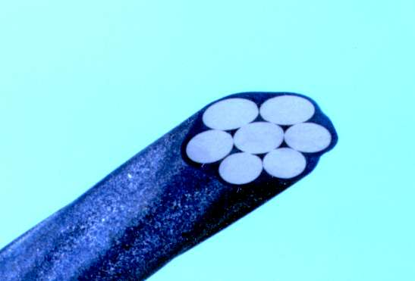
Congresso Brasileiro de Pontes e Estruturas / Rio de Janeiro / 12 e13 de maio de 2025
Development of saddle & extradosed cable system
No saddle system was available.
New saddle system fixed at both ends was developed.
Epoxy coated strand was used as extradosed cables.
6

Slide 7
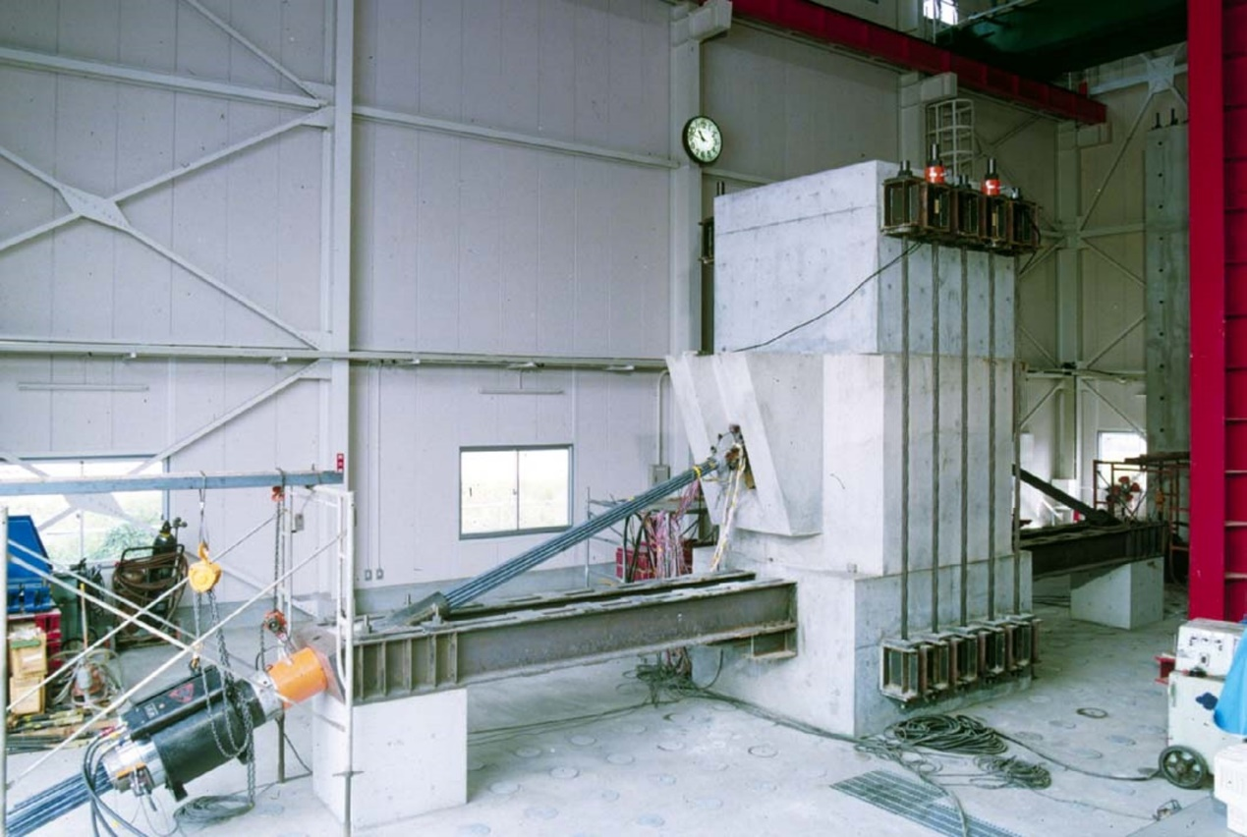
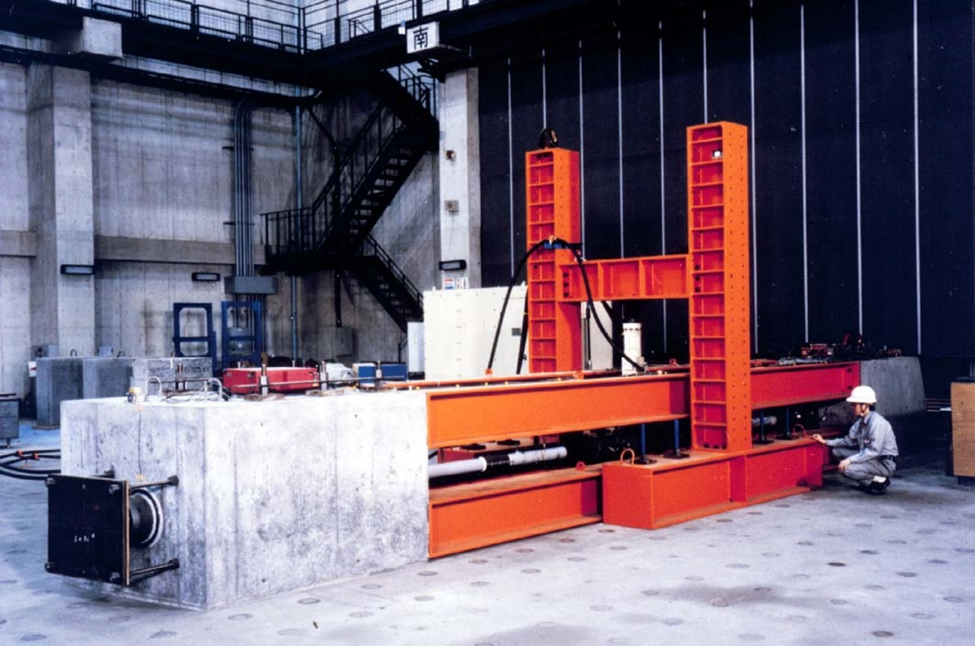
Congresso Brasileiro de Pontes e Estruturas / Rio de Janeiro / 12 e13 de maio de 2025
Experiments for extradosed cable system
Strength test of saddle
Flexural fatigue test of extradosed cable
7

Slide 8
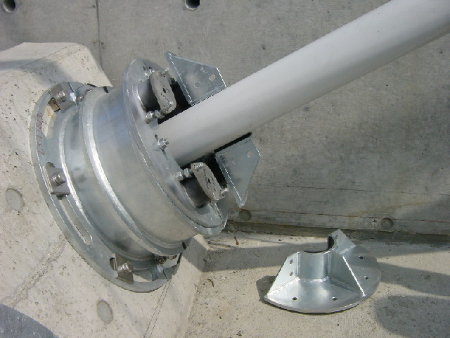
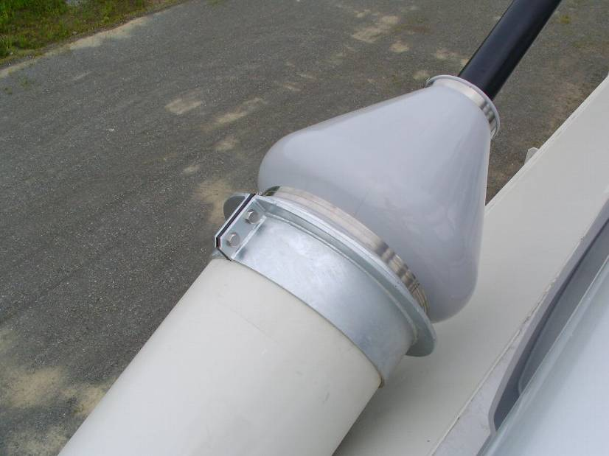
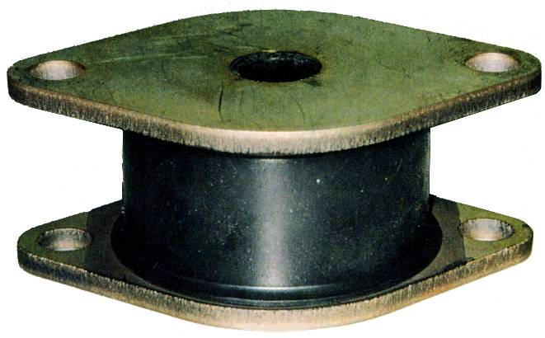
Congresso Brasileiro de Pontes e Estruturas / Rio de Janeiro / 12 e13 de maio de 2025
Development of high damping rubber damper
After Odawara, HDR damper was widely used all over the world.
HDR
8
Notes:
An allowable stress of 0.6fpu is used for extradosed bridges.
In order to suppress the vibration due to wind, especially rain induced vibration, against fatigue problem, high damping rubber dampers were developed for the stay cables.
These dampers are very small, so they can be hidden in the cover.
This technology played a role in the development of the extradosed bridges.

Slide 9
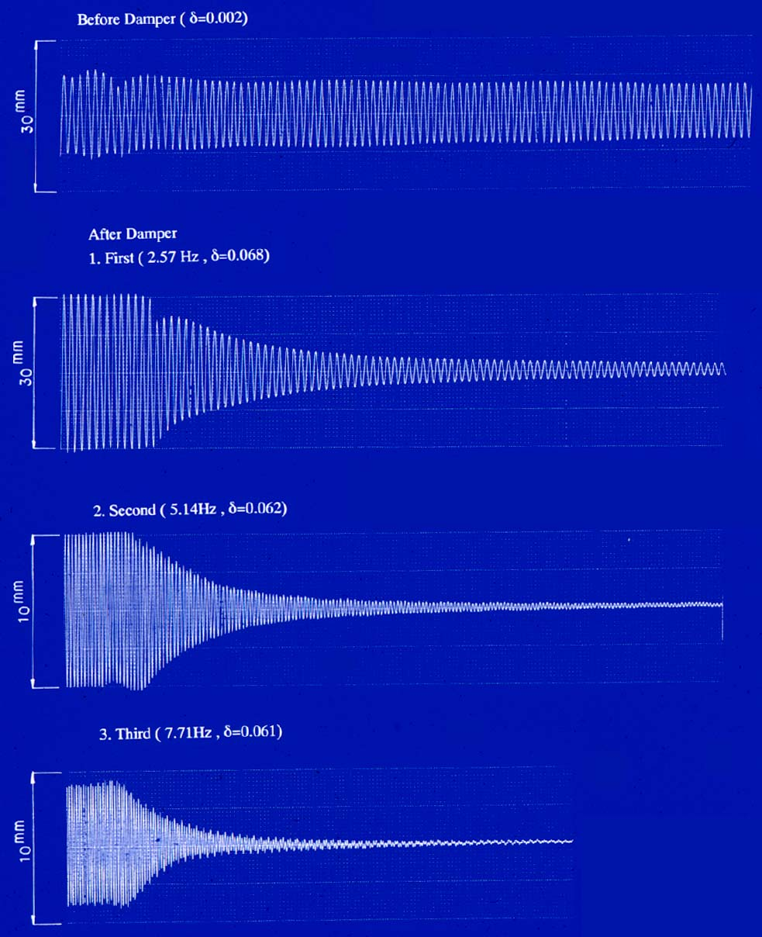
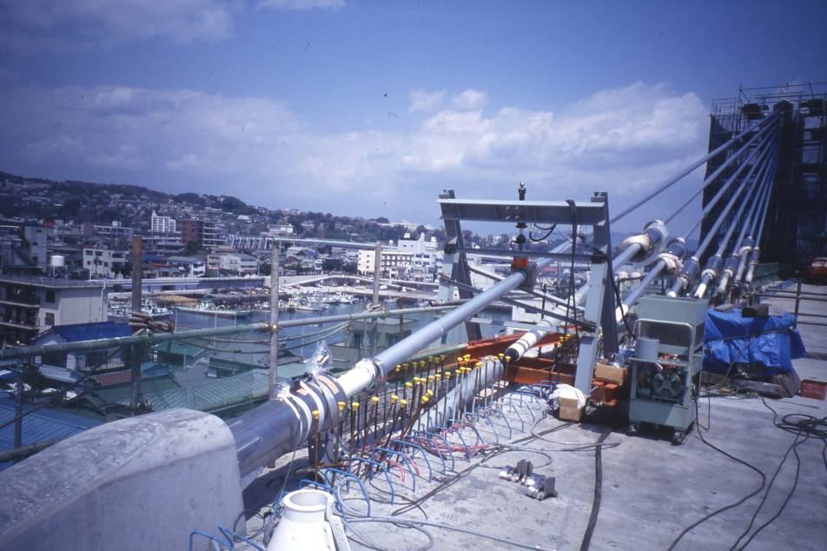
Congresso Brasileiro de Pontes e Estruturas / Rio de Janeiro / 12 e13 de maio de 2025
Field test of high damping rubber damper
w/o Damper (LD = 0.002)
LD
LD : Logarithmic Decrement
LD_{max}
w/ Dampers 1st Mode (2.57Hz, LD = 0.068)
k_{opt}
k
2nd Mode (5.14Hz, LD = 0.062)
3rd Mode (7.71Hz, LD = 0.061)
9

Slide 10
Development

Slide 11
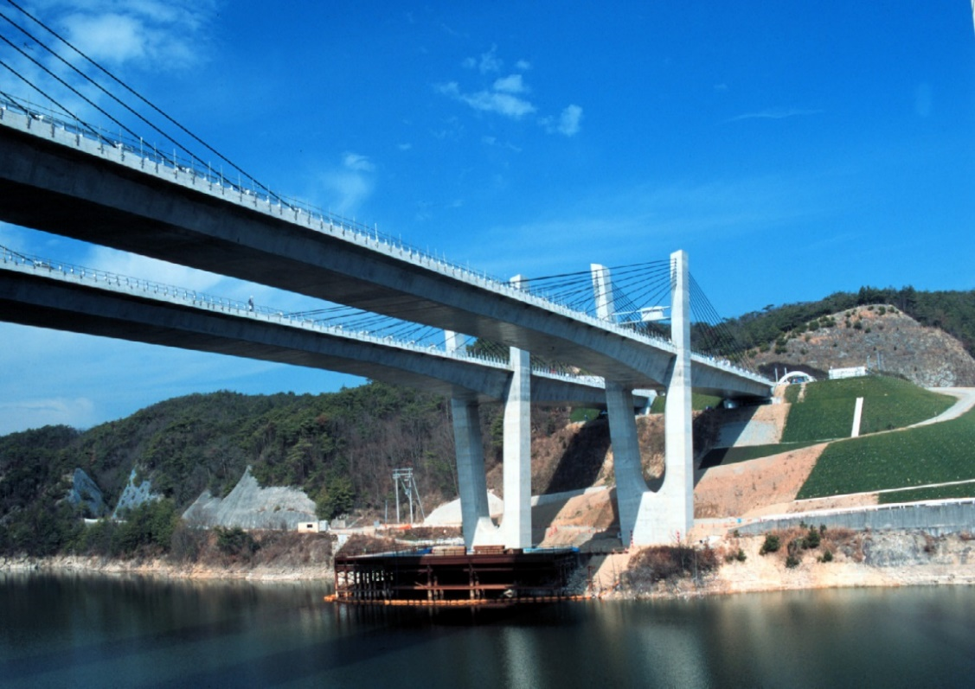
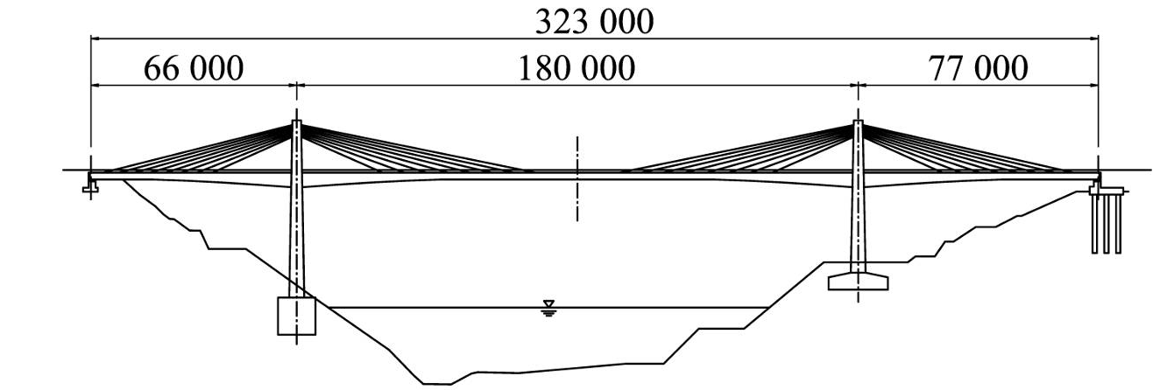
Congresso Brasileiro de Pontes e Estruturas / Rio de Janeiro / 12 e13 de maio de 2025
Tsukuhara Bridge (1997)
11

Slide 12
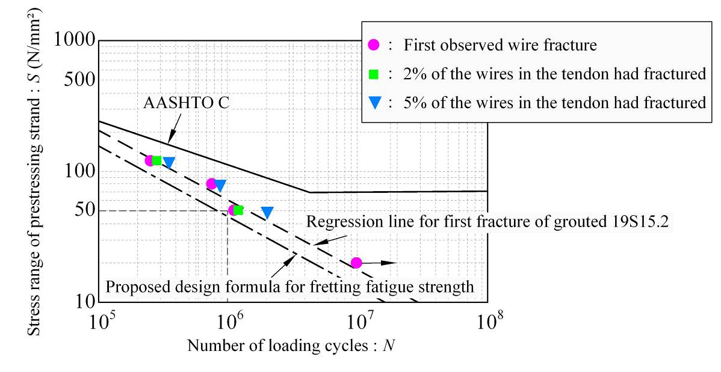
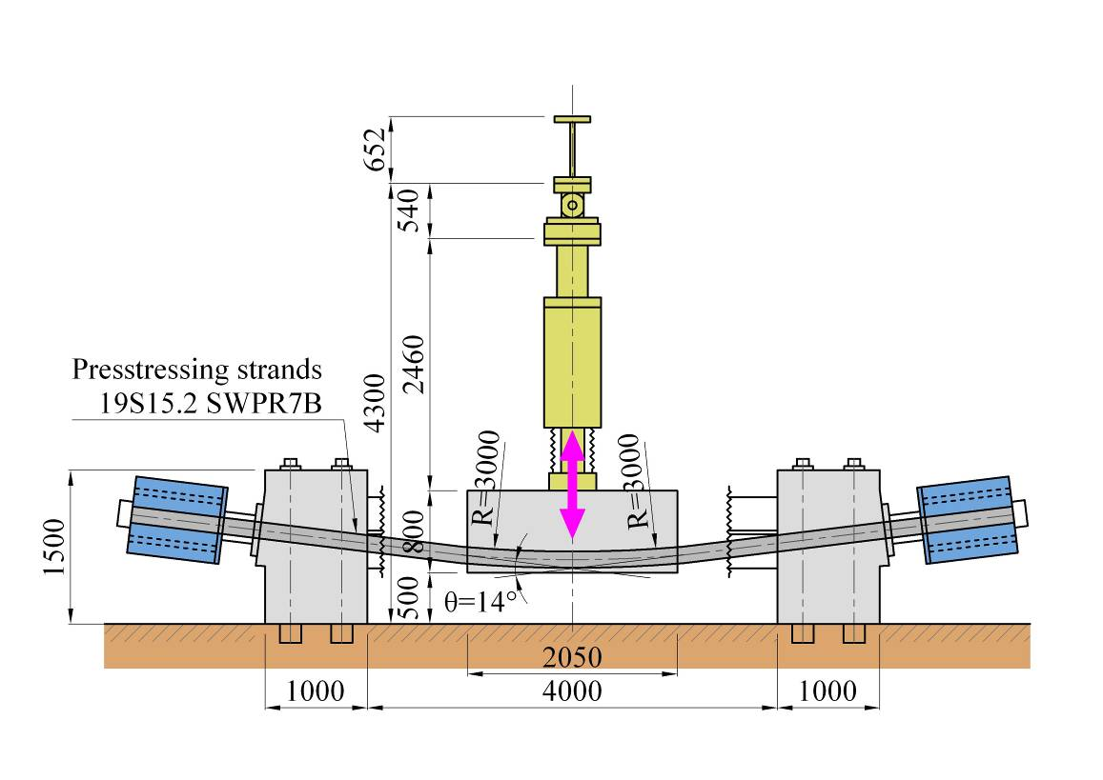
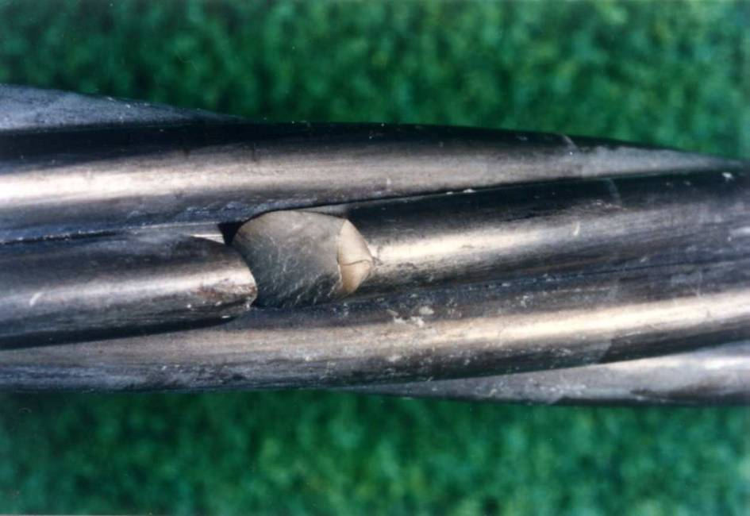
Congresso Brasileiro de Pontes e Estruturas / Rio de Janeiro / 12 e13 de maio de 2025
Fretting fatigue test of saddle
Δϭ ≤ 50N/mm²
12

Slide 13
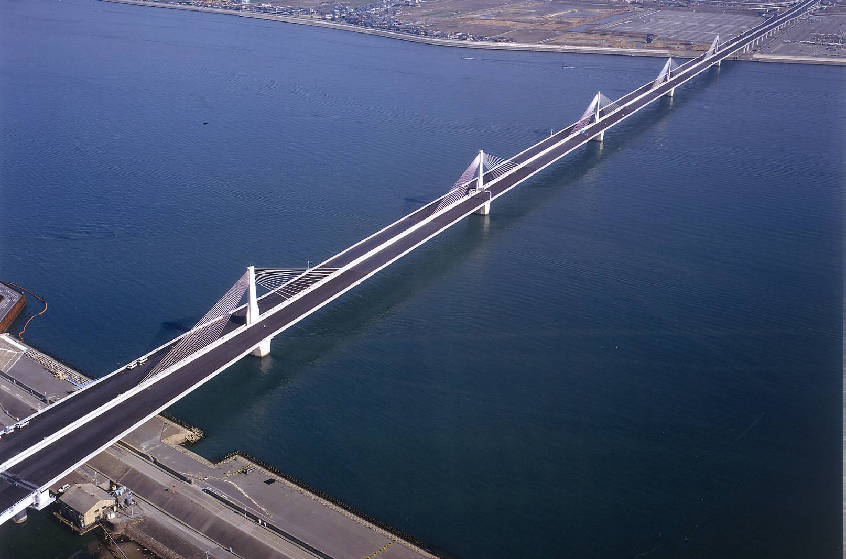
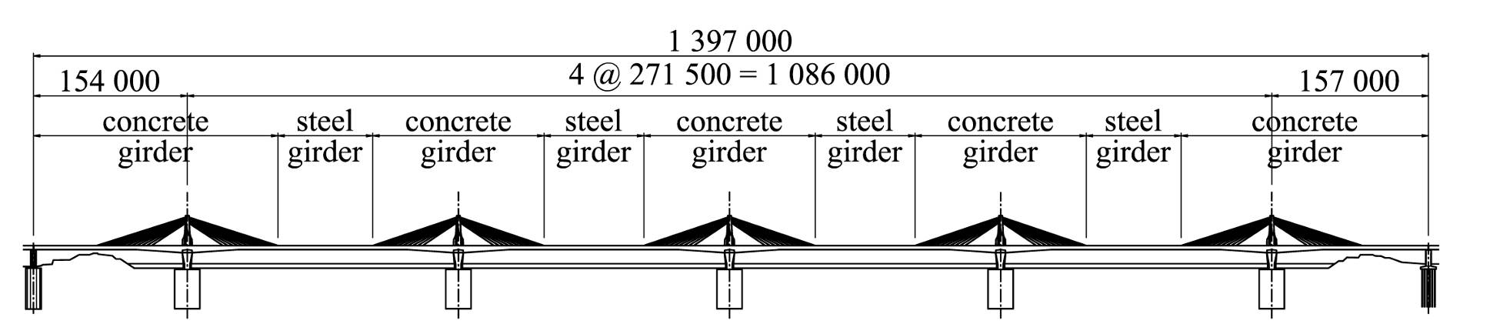
Congresso Brasileiro de Pontes e Estruturas / Rio de Janeiro / 12 e13 de maio de 2025
Ibigawa Bridge (2001)
The longest Hybrid girder
Saddle to steel anchorage box (80t)
13

Slide 14
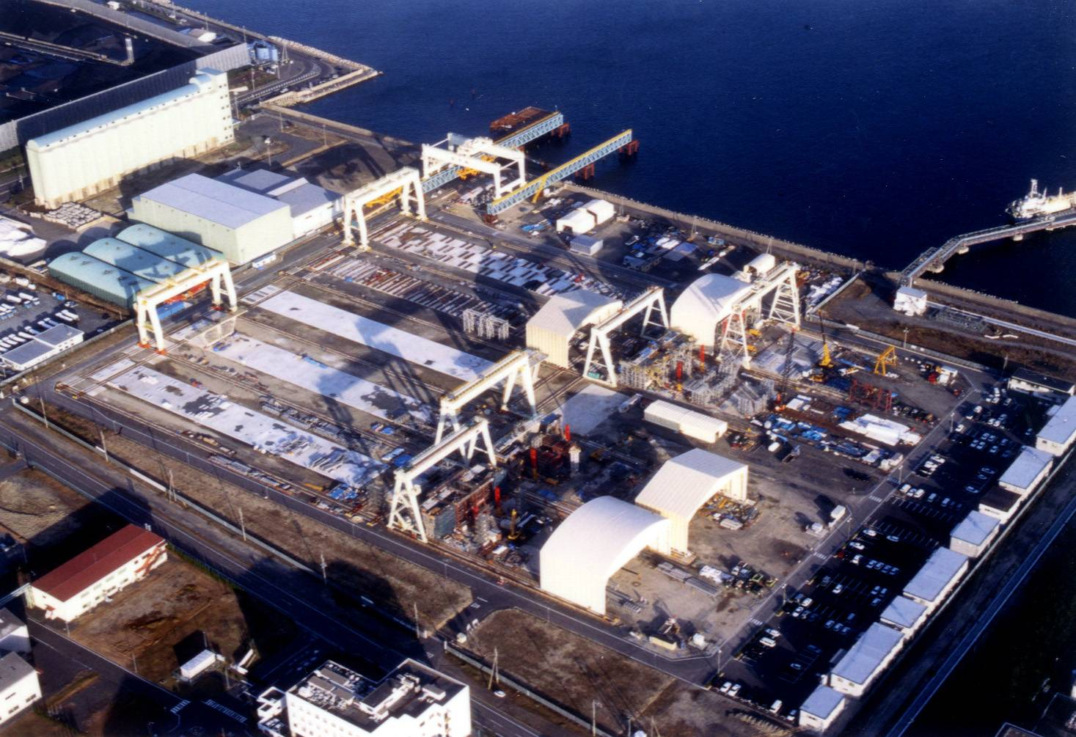
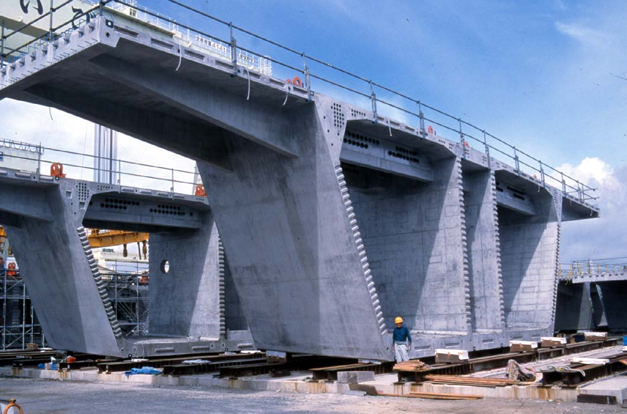
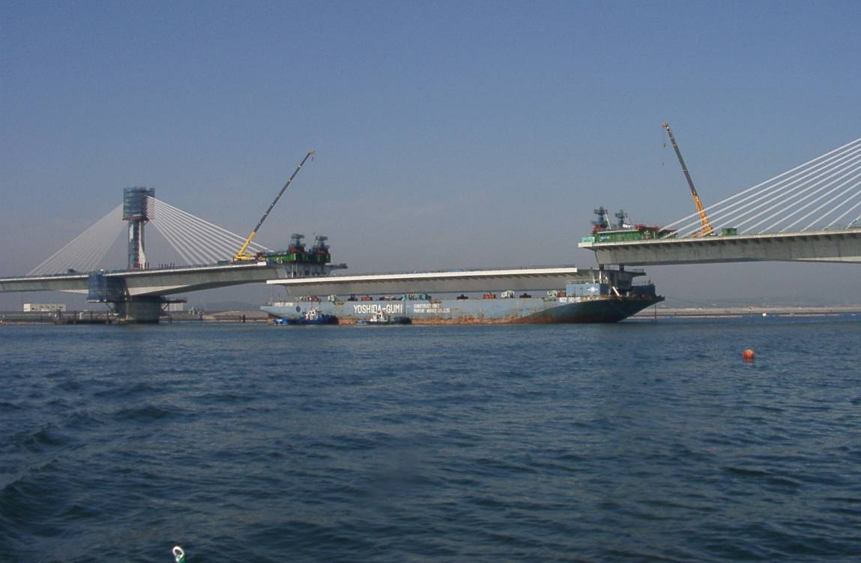
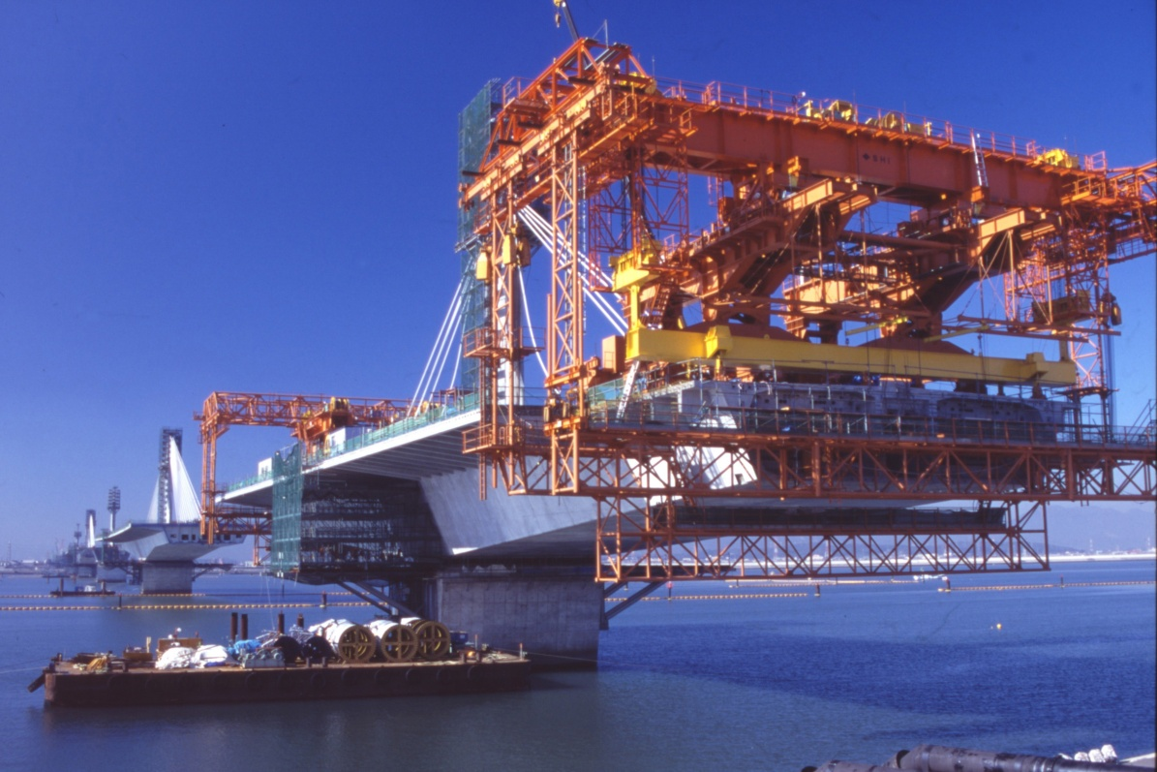
Congresso Brasileiro de Pontes e Estruturas / Rio de Janeiro / 12 e13 de maio de 2025
Construction of Ibigawa Bridge
Fabrication Yard（100,000m²）
Segment（400ｔ）
Lifting of Steel Girder（2000ｔ）
Lifting Traveler
14

Slide 15
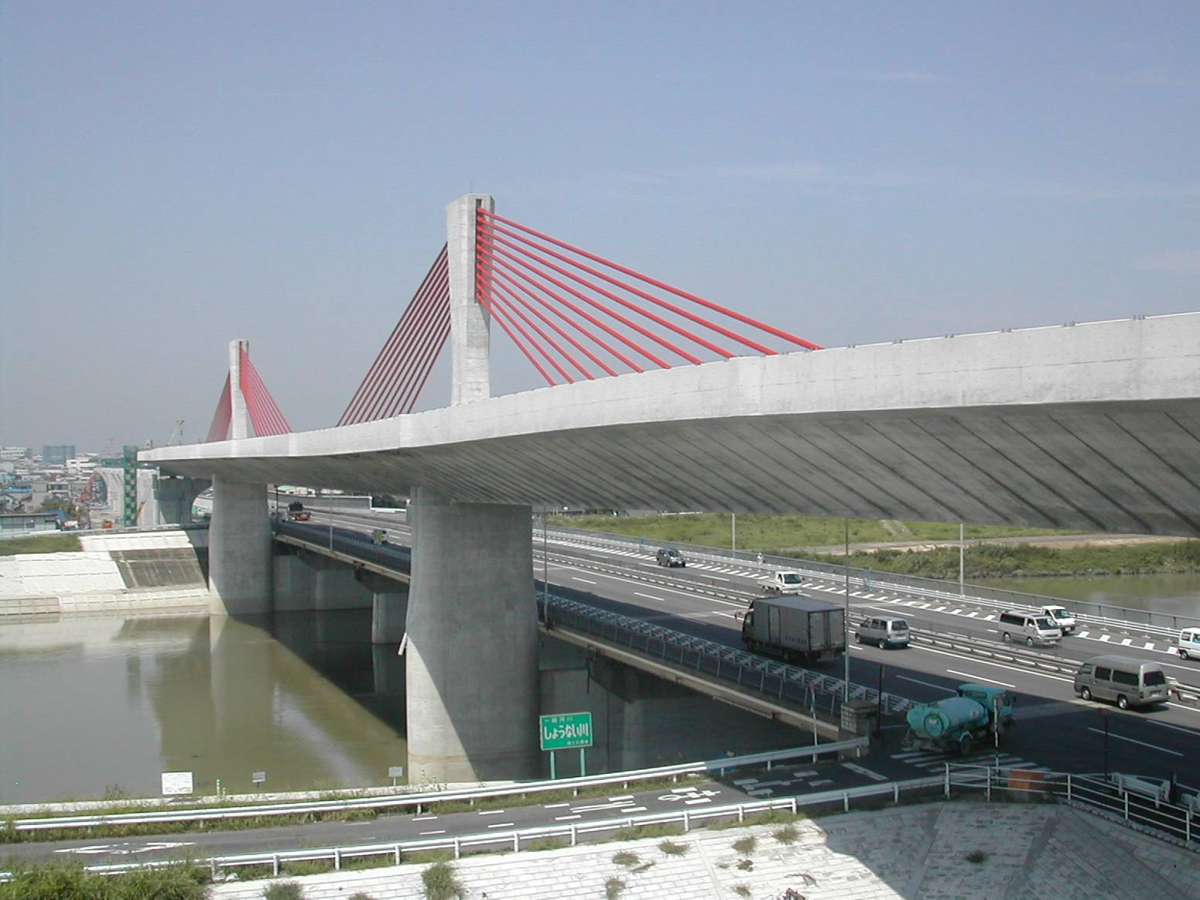
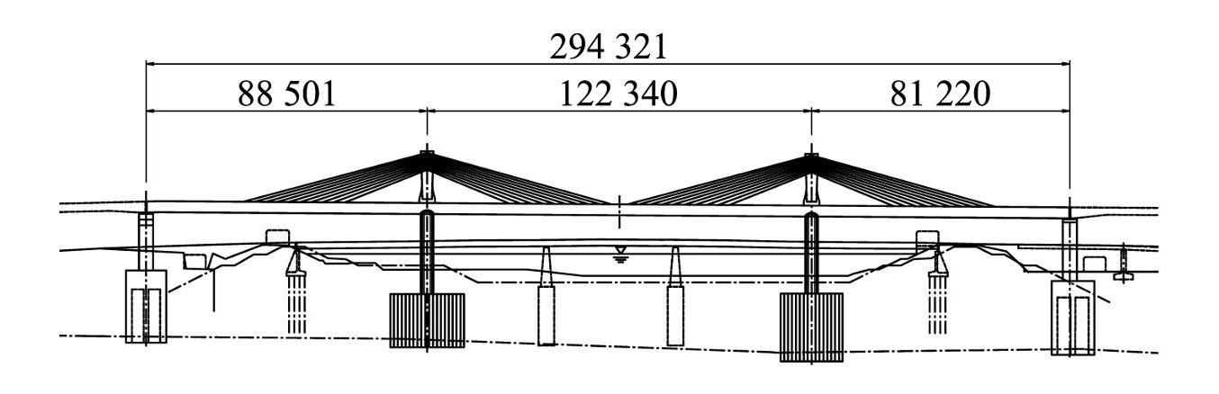
Congresso Brasileiro de Pontes e Estruturas / Rio de Janeiro / 12 e13 de maio de 2025
Shin-Meisei Bridge (2004)
15

Slide 16
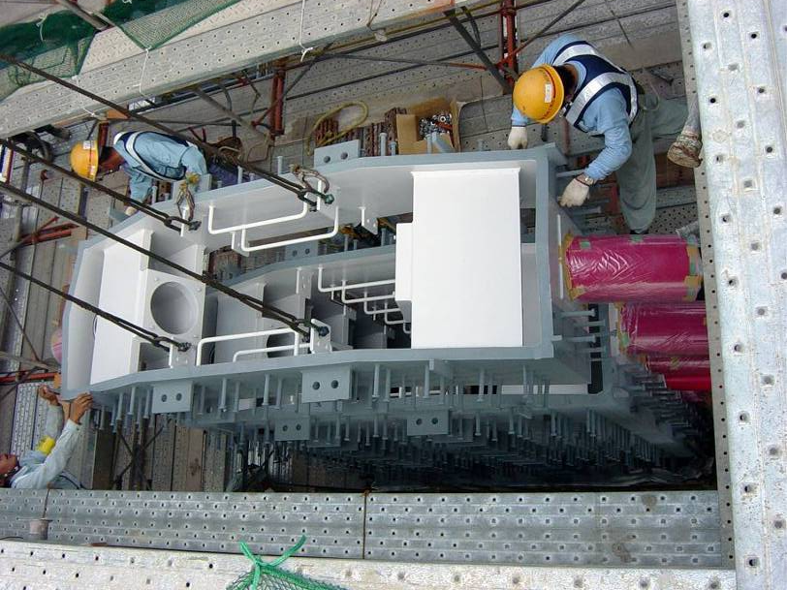
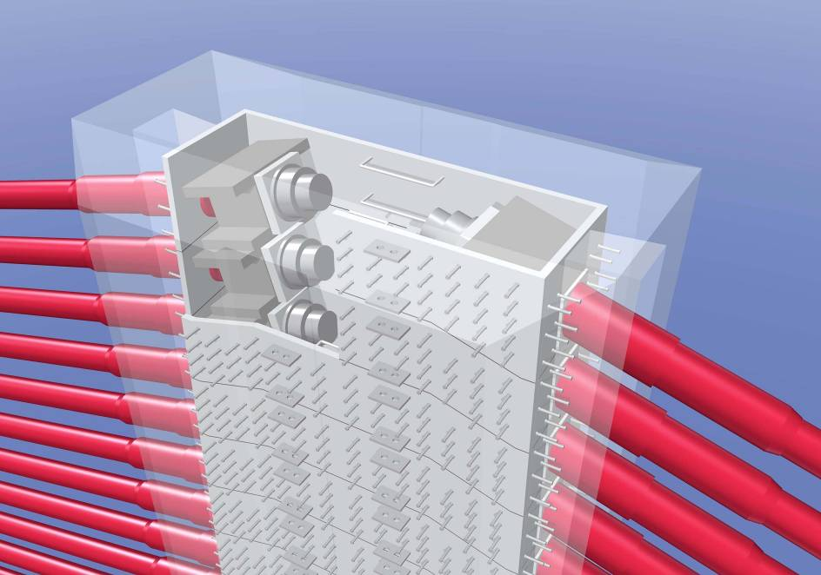
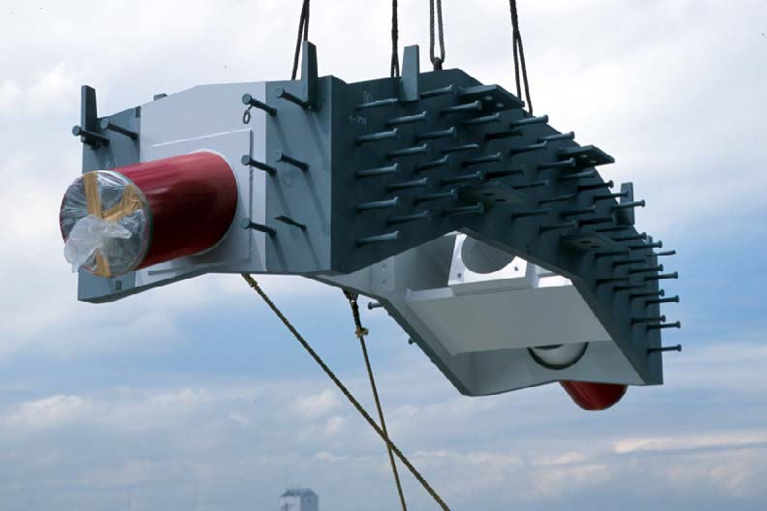
Congresso Brasileiro de Pontes e Estruturas / Rio de Janeiro / 12 e13 de maio de 2025
Development of steel box anchorage for the pylon
Concrete after Completion
Each plate is just metal touch.
Horizontal Tension ：Steel
Vertical Compression：Steel & Concrete
16

Slide 17
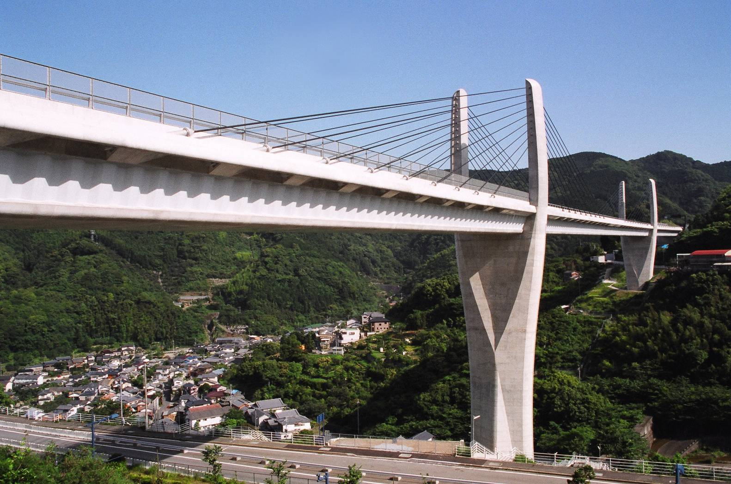
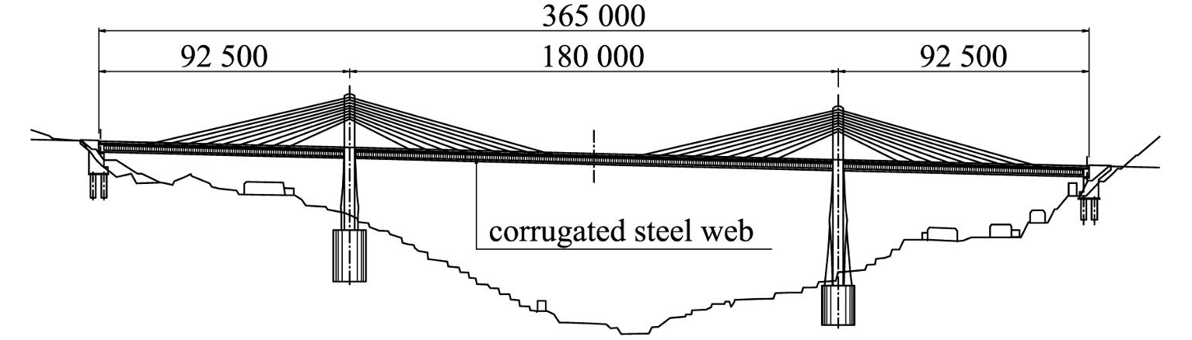
Congresso Brasileiro de Pontes e Estruturas / Rio de Janeiro / 12 e13 de maio de 2025
Himi Bridge (2004)
Extradosed bridge with Corrugated Steel Web
17

Slide 18
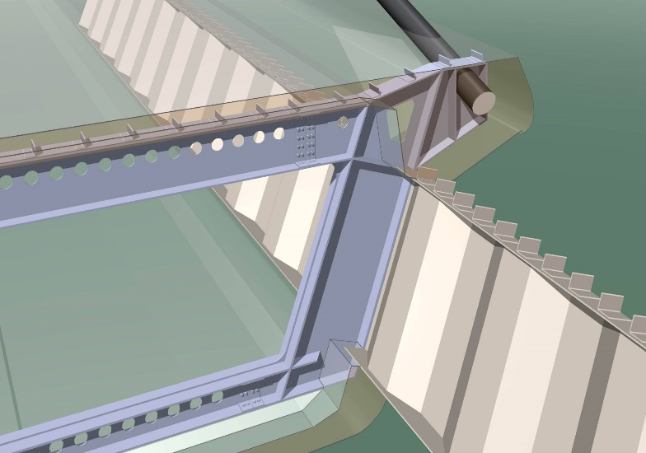
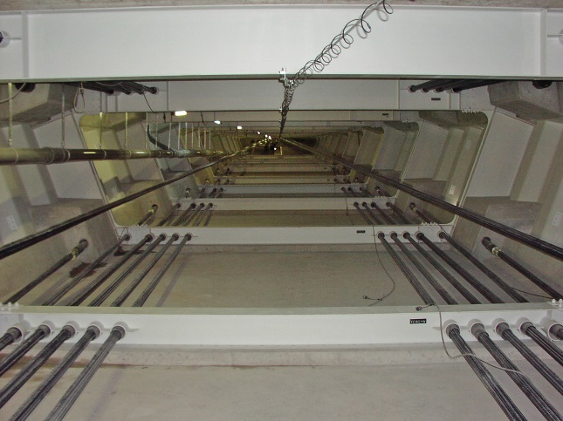
Congresso Brasileiro de Pontes e Estruturas / Rio de Janeiro / 12 e13 de maio de 2025
Stay sable anchorage in the girder
Steel Diaphragm of Himi Bridge for Corrugated Steel Web
18
Notes:
On the Himi Bridge, a diaphragm anchorage was adopted to transmit the vertical component of stay cable forces.
This is special problem in corrugated steel web.
At the same time, diaphragm works as a rib reinforcing the upper and lower decks.

Slide 19
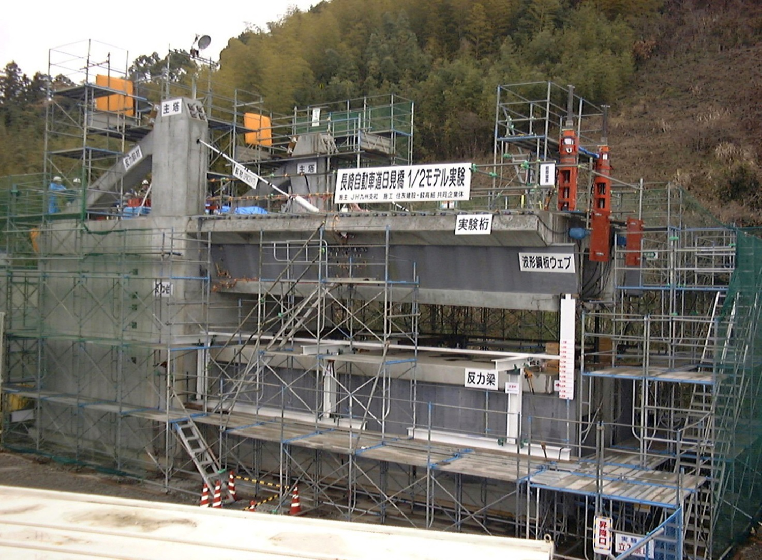
Congresso Brasileiro de Pontes e Estruturas / Rio de Janeiro / 12 e13 de maio de 2025
Half size model test
Extradosed Cable
Loading
Girder
Bearing Bram
19

Slide 20
Congresso Brasileiro de Pontes e Estruturas / Rio de Janeiro / 12 e13 de maio de 2025
Test results
20

Slide 21
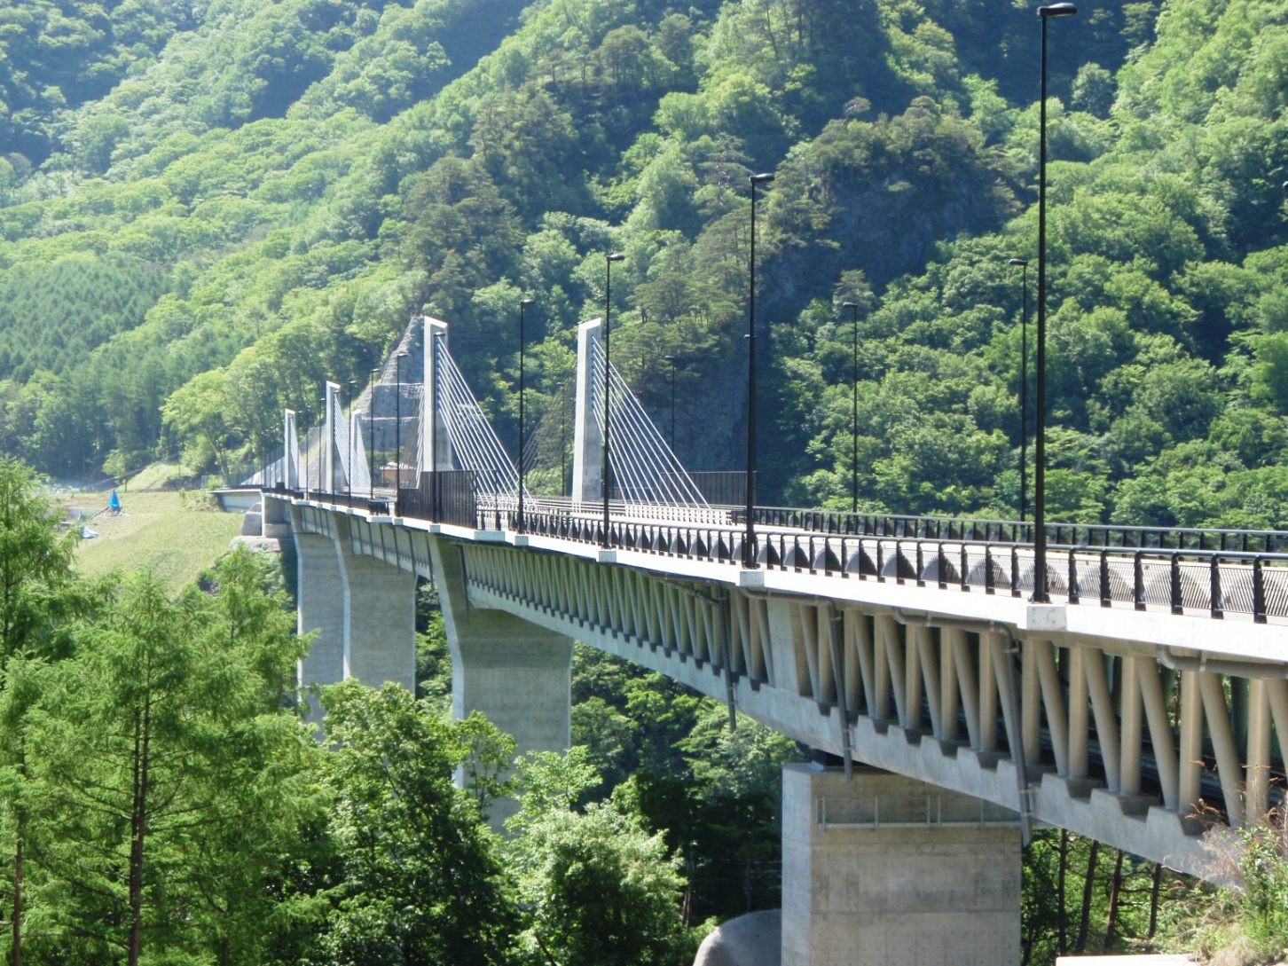
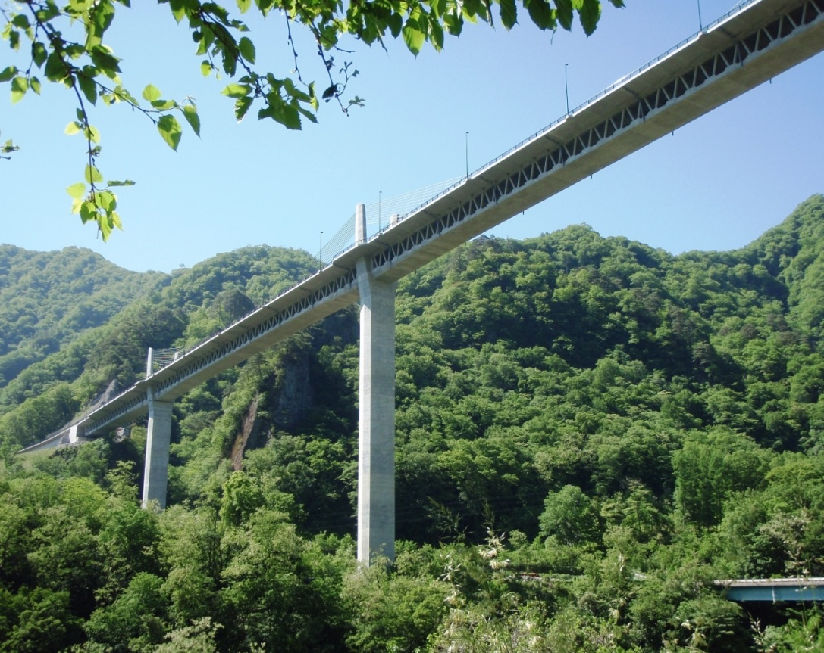
Congresso Brasileiro de Pontes e Estruturas / Rio de Janeiro / 12 e13 de maio de 2025
Fudo Bridge (2010)
Extradosed bridge with composite truss
21

Slide 22
Test of truss connection
Congresso Brasileiro de Pontes e Estruturas / Rio de Janeiro / 12 e13 de maio de 2025
Stay Cable Force
Compression
Tension
Horizontal Force
22

Slide 23
Congresso Brasileiro de Pontes e Estruturas / Rio de Janeiro / 12 e13 de maio de 2025
Perforated dowel connection
Compression Member
Tension Member
Rotational
Spring
(2500kNm/rad)
Rib plate
Concrete dowel
Rigid Connection
Spiral bar
Horizontal Load (kN)
Filled w/
concrete
Secondary Bending Moment (kNm)
23

Slide 24
Congresso Brasileiro de Pontes e Estruturas / Rio de Janeiro / 12 e13 de maio de 2025
Re-bar connection
Compression Member
Tension Member
Nut
Rotational
Spring
(1000kNm/rad)
Bearing plate
Re-bar
Nut
Horizontal Load (kN)
Rigid Connection
Filled w/
concrete
Secondary Bending Moment (kNm)
24

Slide 25
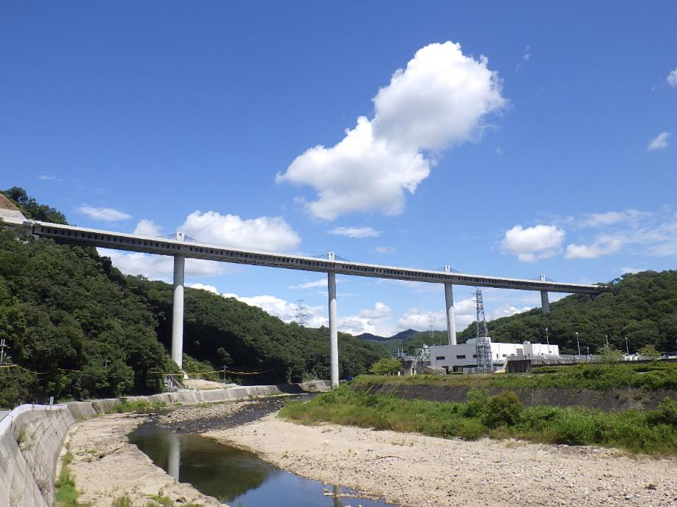
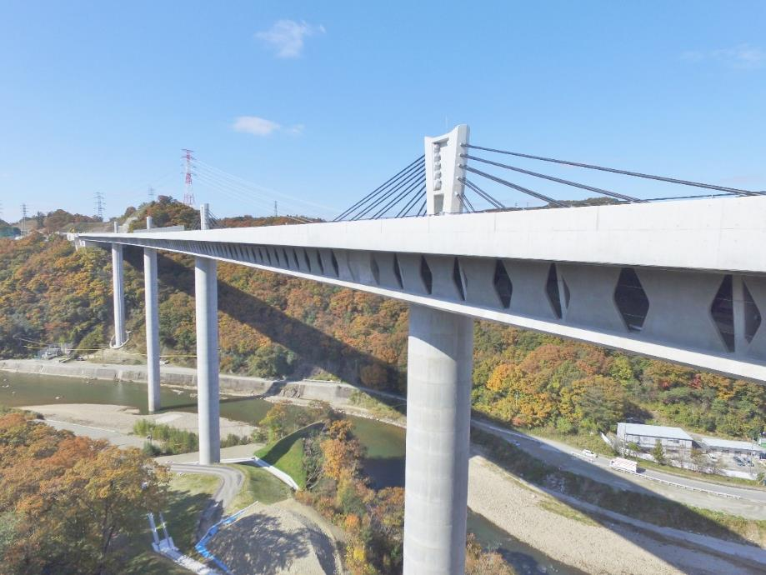
Congresso Brasileiro de Pontes e Estruturas / Rio de Janeiro / 12 e13 de maio de 2025
Mukogawa Bridge (2016)
25

Slide 26
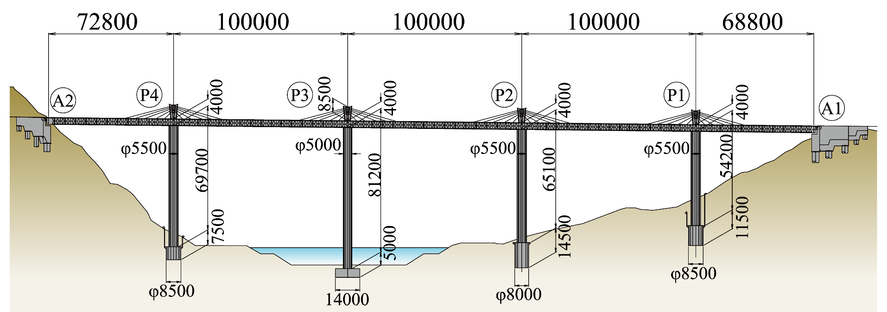
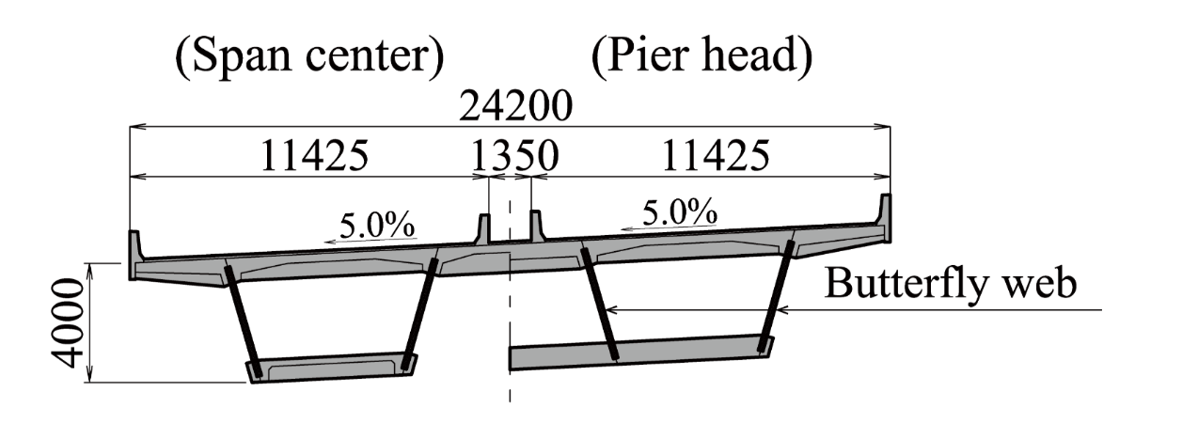
Congresso Brasileiro de Pontes e Estruturas / Rio de Janeiro / 12 e13 de maio de 2025
Mukogawa Bridge (2016)
26

Slide 27
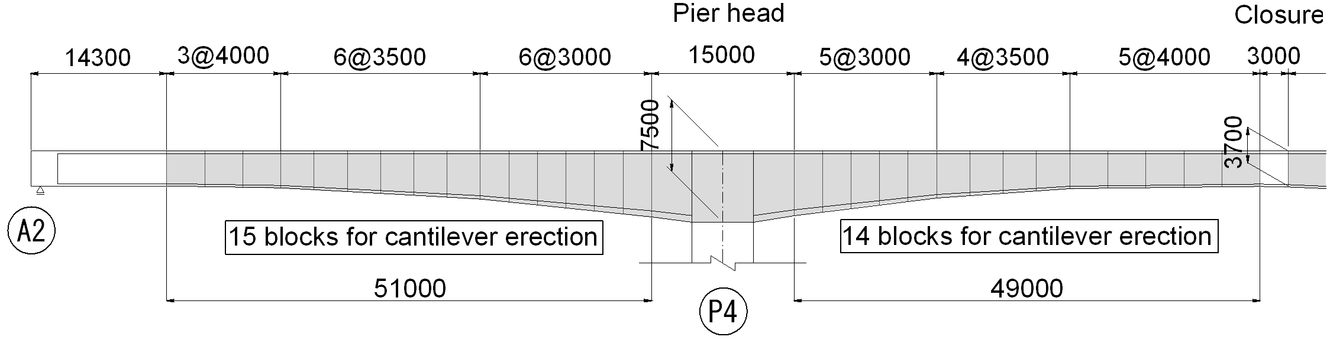
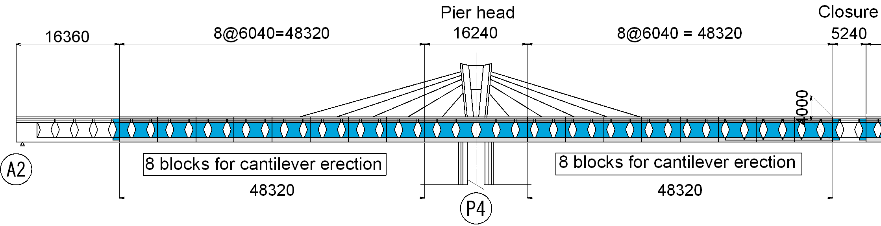
Congresso Brasileiro de Pontes e Estruturas / Rio de Janeiro / 12 e13 de maio de 2025
Effects of the extradosed bridge with butterfly webs
Basic design (101 segments)
15 segments for cantilever erection
14 segments for cantilever erection
Detail design (54 segments)
8 segments for cantilever erection
8 segments for cantilever erection
Number of days required for cantilever construction reduced.
The weight of superstructure was reduced up to 20% from the basic design.
27

Slide 28




Congresso Brasileiro de Pontes e Estruturas / Rio de Janeiro / 12 e13 de maio de 2025
Improvement of structural seismic performance
Basic design
D≦5.0m
Detail design
Bending moment at the bottom of the piers
Total weight of substructures can be reduced up to about 50%.
28

Slide 29




Congresso Brasileiro de Pontes e Estruturas / Rio de Janeiro / 12 e13 de maio de 2025
Construction of superstructure
29
Notes:
29

Slide 30


Congresso Brasileiro de Pontes e Estruturas / Rio de Janeiro / 12 e13 de maio de 2025
Development of cost-effective anchorage system
30

Slide 31



Congresso Brasileiro de Pontes e Estruturas / Rio de Janeiro / 12 e13 de maio de 2025
Improvement of buildability and cost
Each plate has a gap.
Re-bar dowels
Steel plate(t=100mm)
31

Slide 32


Congresso Brasileiro de Pontes e Estruturas / Rio de Janeiro / 12 e13 de maio de 2025
Nakatsugawa Bridge
32

Slide 33

Congresso Brasileiro de Pontes e Estruturas / Rio de Janeiro / 12 e13 de maio de 2025
Constraints on the conceptual design
Bridge pier positions constrained by a fault zone and high-voltage power lines
Limited pier position because of fault
Lighter span to help unbalanced structure
A challenge to long span butterfly web
33

Slide 34



Congresso Brasileiro de Pontes e Estruturas / Rio de Janeiro / 12 e13 de maio de 2025
Prestressing tendon layout of large butterfly panel
Tension
Compression
&
Tension during earthquake
Pretension strands
Non-tensioned strands for earthquakes
Post tension strands
20mm wet Joint by non-shrink mortar
Post tension strands to connect butterfly parts
34

Slide 35




Congresso Brasileiro de Pontes e Estruturas / Rio de Janeiro / 12 e13 de maio de 2025
Large butterfly panel
Triangular elements
Assembly of large panel
Square element
Completion of large panel
35

Slide 36



Congresso Brasileiro de Pontes e Estruturas / Rio de Janeiro / 12 e13 de maio de 2025
Evolution of stay cable anchorage in towers
Divided steel anchorage shell
(2004)
Concrete anchorage
(2004)
Single steel plate anchorage
(2012)
Double steel plates anchorage
(2017)
Oval shape steel anchorage
(2018)
36

Slide 37


Congresso Brasileiro de Pontes e Estruturas / Rio de Janeiro / 12 e13 de maio de 2025
Improvement of efficiency for extradosed cable anchorage
Extradosed cable 27S15.2
Extradosed cable force
Steel plate t=40mm (SM490)
Horizontal component
Horizontal component is carried by steel plates
Vertical component is carried by concrete
Cheep manufacture and no welding at the site
Stud D19@150
Extradosed cable force
Oval shaped hybrid anchorage box
Concrete
Steel plate
GAP
Concrete
37

Slide 38



Congresso Brasileiro de Pontes e Estruturas / Rio de Janeiro / 12 e13 de maio de 2025
Test of oval shaped extradosed cable anchorage
Half size model set-up
Stud D10@150
Jack
Steel plate t=22mm (SM490)
38

Slide 39


Congresso Brasileiro de Pontes e Estruturas / Rio de Janeiro / 12 e13 de maio de 2025
Accelerated construction of stay cable anchorage
The horizontal component of stay cable forces is carried by the steel plate, and the vertical component is carried by the concrete, forming a composite structure.
The work at the site consists only of assembling the vertical reinforcing bars and pouring concrete.
Oval shape steel anchorage
(2018)
Easy manufacturing
Precast formwork with hoop re-bars
39

Slide 40
Congresso Brasileiro de Pontes e Estruturas / Rio de Janeiro / 12 e13 de maio de 2025
Construction progress of the extradosed bridges
Overseas bridge numbers
Japanese bridge numbers
Odawara Blueway Bridge
Number of extradosed bridges
Year
40

Slide 41

Congresso Brasileiro de Pontes e Estruturas / Rio de Janeiro / 12 e13 de maio de 2025
Cost comparison
■ エクストラドーズド橋
▲ 斜張橋
◆ 箱桁橋
41

Slide 42


(2009)
Congresso Brasileiro de Pontes e Estruturas / Rio de Janeiro / 12 e13 de maio de 2025
Specifications for CSB & EDB by JPCI
(2012)
Allowable Stress of Stay Cables
42

Slide 43


Congresso Brasileiro de Pontes e Estruturas / Rio de Janeiro / 12 e13 de maio de 2025
Extradosed bridge construction achievements
North America (2%)
Others (1%)
South America (2%)
South-East Asia (3%)
Textbook (IABSE, 2019)
India (5%)
South Korea (7%)
China (36%)
EU (10%)
Japan (34%)
43

Slide 44


fib 2022 AOS
Congresso Brasileiro de Pontes e Estruturas / Rio de Janeiro / 12 e13 de maio de 2025
Rose Fitzgerald Kennedy Bridge, Ireland
L=230m
44

Slide 45
Future

Slide 46



Congresso Brasileiro de Pontes e Estruturas / Rio de Janeiro / 12 e13 de maio de 2025
Long and multi-span extradosed bridges
500m multi-span cable-stayed type
500m multi-span extradosed type
Wind Tunnel Test Setup (1/100)
Photo : Kyoto University
30% opening leads to good performance in the wind tunnel test.
46

Slide 47



Congresso Brasileiro de Pontes e Estruturas / Rio de Janeiro / 12 e13 de maio de 2025
Stay cable stress change due to live load
Comparison of Material Quantities
47

Slide 48



Congresso Brasileiro de Pontes e Estruturas / Rio de Janeiro / 12 e13 de maio de 2025
Future application to the hybrid bridge with butterfly web
800m-span hybrid cable supported bridge (Extradosed + Suspension)
Wind Tunnel Test Setup
48

Slide 49
Concluding Remarks
Congresso Brasileiro de Pontes e Estruturas / Rio de Janeiro / 12 e13 de maio de 2025
The extradosed bridge enables engineers to apply consistent design principles to cable-stayed bridges and ordinary girder bridges.
Proposed stay cable design method is effective in consistent design approach.
The extradosed bridge greatly increases the degree of freedom for the design of cable-supported structures.
49

Slide 50



Congresso Brasileiro de Pontes e Estruturas / Rio de Janeiro / 12 e13 de maio de 2025
Gratitude to the father of the extradosed bridge
Jacques Mathivat (1932-2012)
50

Slide 51
I would like to take this opportunity to express my heartfelt gratitude to Mathivat who has changed my life in a significant way.

Slide 52

Thank you for your attention

