Slide 1
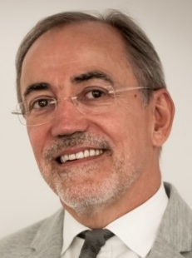
Structural engineers and structural engineering Challenges and opportunities
Hugo Corres
Past fib President
Prof. Technical University of Madrid
FHECOR Ingenieros Consultores

Slide 2
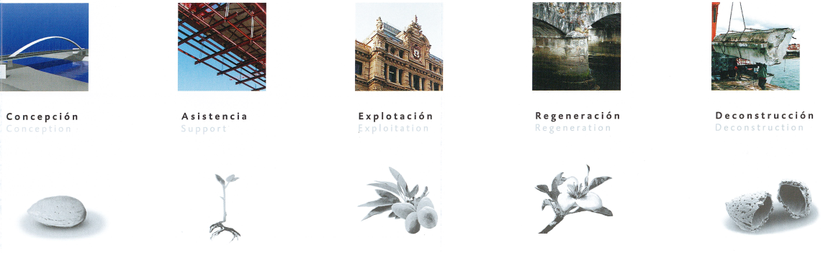
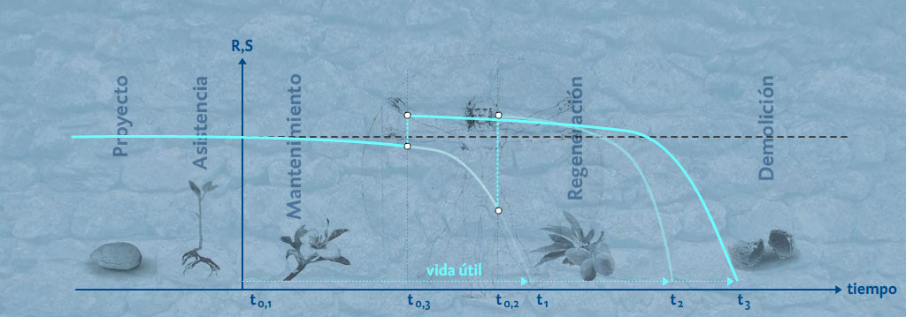
Service Life

Slide 3
How concrete structures are affected by the environment / DURABILITY
How Concrete Structures affect the environment / SOSTENIABILITY
1982
1991
1996
1999
2019
2024
2003
2004
2008
2013
2017
2021
1990
1995
1997
2006
2020
2022
2023
2002
2003
2012
2013
2018
2023
fib bulletin 109. Existing concrete structures life management, testing and structural health monitoring, state-of-the-art report
fib Bulletin 67. Guidelines for green concrete structures
fib Bulletin 18. Recycling of offshore concrete structures
fib Bulletin 71. Integrated life cycle assessment of concrete structures
fib bulletin 102. Guide for Protection and Repair of Concrete Structures
fib Bulletin 47. Environmental design of concrete structures – general principles
fib Bulletin of TG1.8 Industrial floor. Chapter on sustainability. To be published
fib bulletin 111. Modelling structural performance of existing concrete structures
fib bulletin 93. Birth certificate and through life management documentation
CEB Bulletin 221. Advanced studies on Structural concrete
fib bulletin 90. Externally applied FRP reinforcement for concrete structures
FIP Report. Durability of concrete structures in the North Sea
CEB Bulletin 224. Model Uncertainties. Concrete barriers for Environmental Protection
fib Bulletin 28 Environmental design
fib Bulletin 21. Environmental issues in prefabrication
Model Code 2010. Sustainability design chapter
Model Code 2020. Sustainability framework
fib Bulletin 23. Environmental effects of concrete
fib Bulletin 88. Sustainability of precast structures
CEB Bulletin 148. Durability of Concrete Structures
CEB Bulletin 238. New Approach to Durability Design
fib Bulletin 83. Chapter on sustainability
fib Bulletin 34 Model Code for service life design
FIP Report. Practical design of structural concrete
CEB-FIP Model Code. Durability Chapter

Slide 4

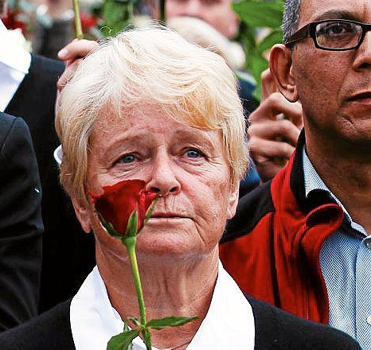

Development that meets the needs of the present without compromising the ability of future generations to meet their own needs
c
Gro Harlem Brundtland

Slide 5
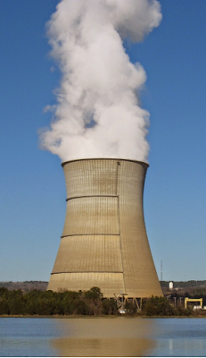
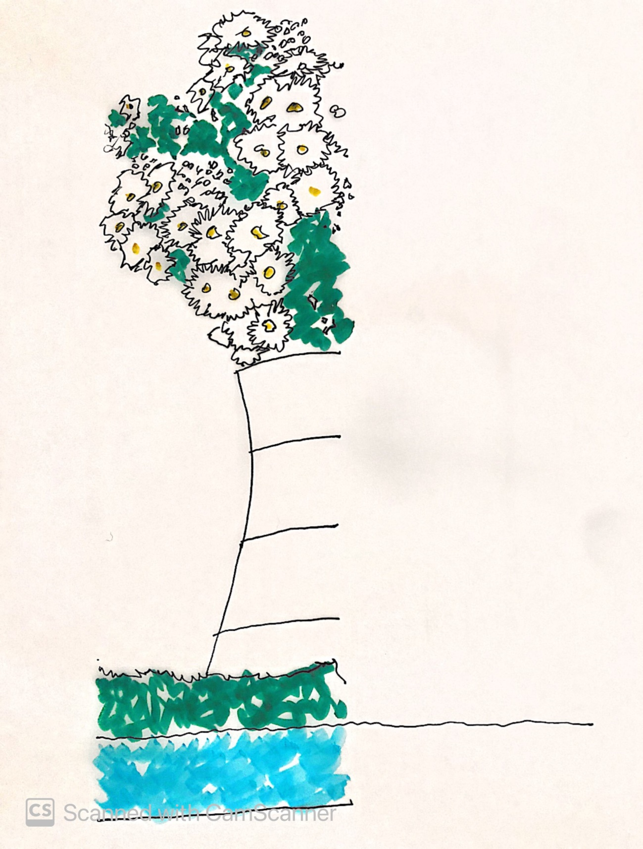
ENVIRONMENTAL

Slide 6
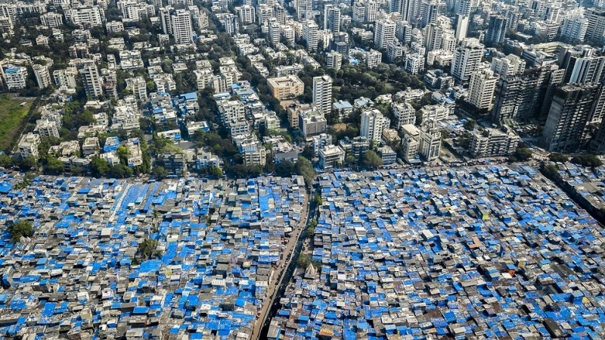
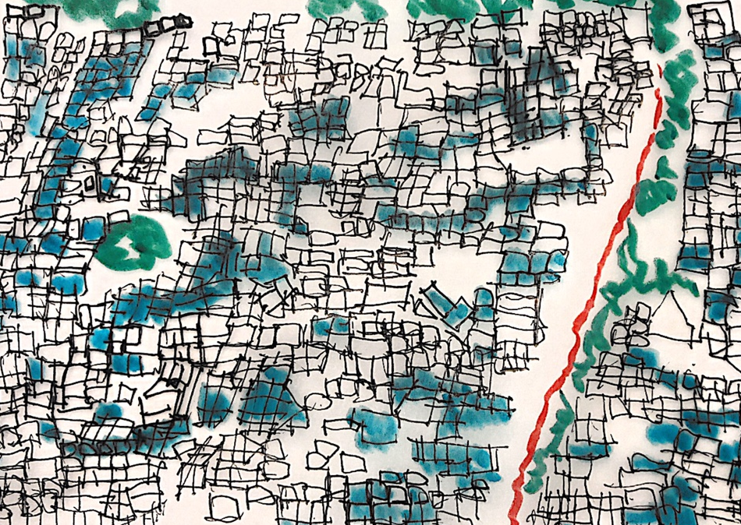
SOCIAL
SOCIAL

Slide 7
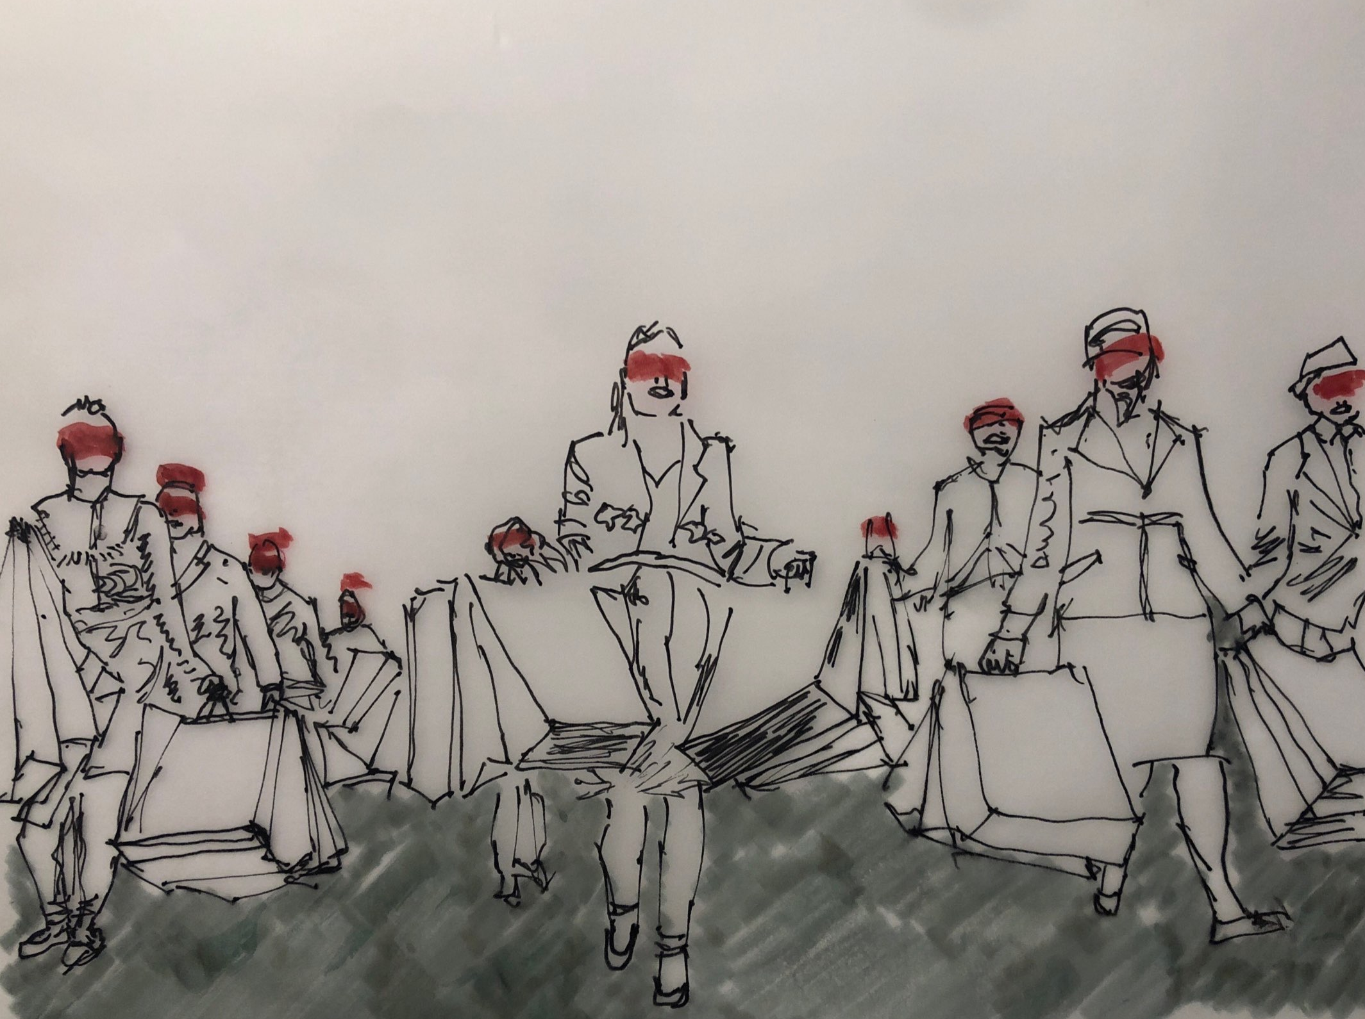
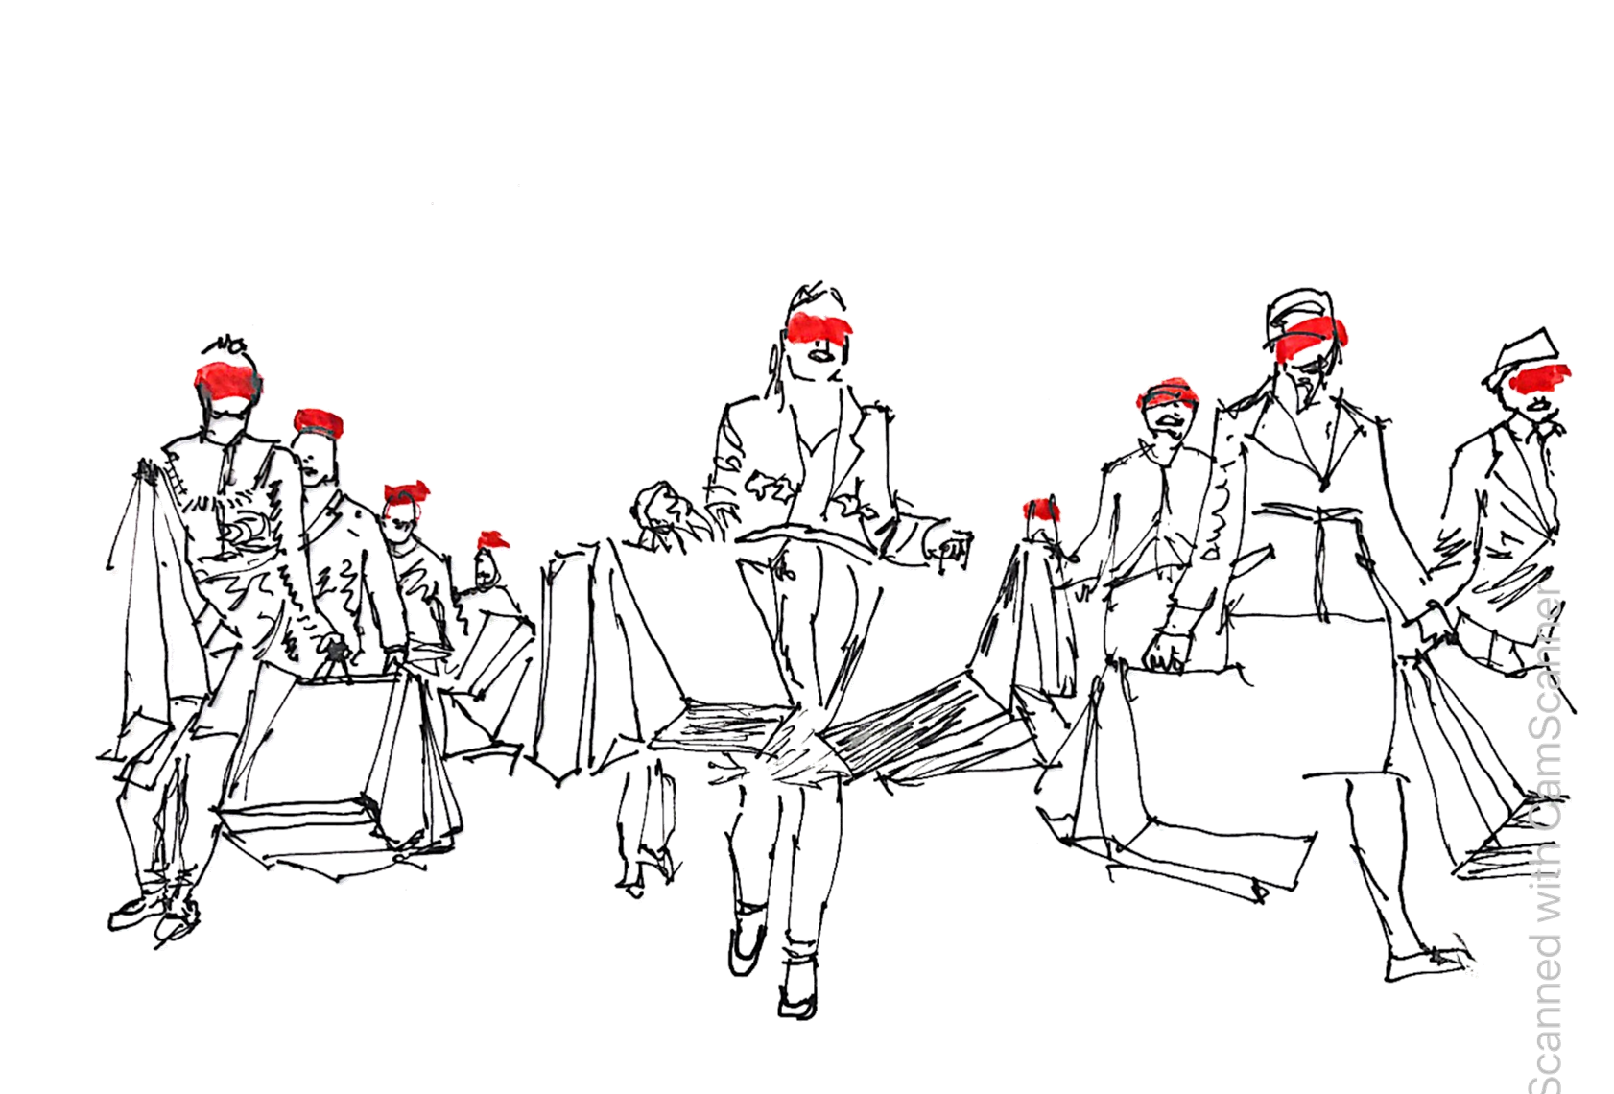
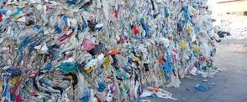
ENVIRONMENTAL
ECONOMICAL

Slide 8
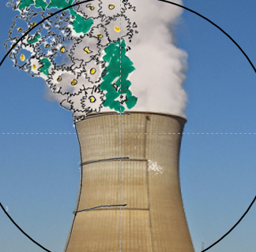
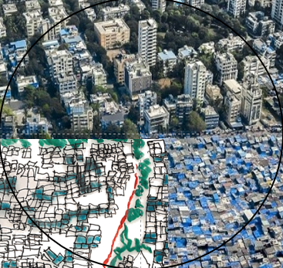
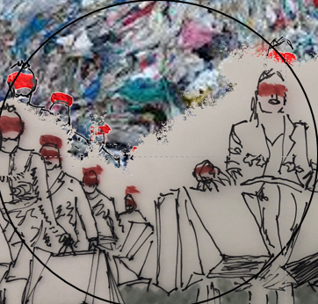
ENVIRONMENTAL
SOCIAL
SUSTAINABILITY
ECONOMICAL
Notes:
Poner con unos colores mas intensos

Slide 9
ENVIRONMENTAL
SOCIAL
SOCIO-ENVIRONMENTAL JUSTICE
USE OF RESOURCES
SAFETY
CONTAMINATION
COMFORT
WASTE
CREATIVITY
SUSTAINABILITY
ECO-EFFICIENCY
SOCIAL INCLUSION
ECONOMICAL
COST
MAINTENANCE
DURABILITY
Notes:
Poner con unos colores mas intensos

Slide 10
How concrete structures are affected by the environment / DURABILITY
How Concrete Structures affect the environment / SOSTENIABILITY
1982
1991
1996
1999
2019
2024
2003
2004
2008
2013
2017
2021
1990
1995
1997
2006
2020
2022
2023
2002
2003
2012
2013
2018
2023
fib bulletin 109. Existing concrete structures life management, testing and structural health monitoring, state-of-the-art report
fib Bulletin 67. Guidelines for green concrete structures
fib Bulletin 18. Recycling of offshore concrete structures
fib Bulletin 71. Integrated life cycle assessment of concrete structures
fib bulletin 102. Guide for Protection and Repair of Concrete Structures
fib Bulletin 47. Environmental design of concrete structures – general principles
fib Bulletin of TG1.8 Industrial floor. Chapter on sustainability. To be published
fib bulletin 111. Modelling structural performance of existing concrete structures
fib bulletin 93. Birth certificate and through life management documentation
CEB Bulletin 221. Advanced studies on Structural concrete
fib bulletin 90. Externally applied FRP reinforcement for concrete structures
FIP Report. Durability of concrete structures in the North Sea
CEB Bulletin 224. Model Uncertainties. Concrete barriers for Environmental Protection
fib Bulletin 28 Environmental design
fib Bulletin 21. Environmental issues in prefabrication
Model Code 2010. Sustainability design chapter
Model Code 2020. Sustainability framework
fib Bulletin 23. Environmental effects of concrete
fib Bulletin 88. Sustainability of precast structures
CEB Bulletin 148. Durability of Concrete Structures
CEB Bulletin 238. New Approach to Durability Design
fib Bulletin 83. Chapter on sustainability
fib Bulletin 34 Model Code for service life design
FIP Report. Practical design of structural concrete
CEB-FIP Model Code. Durability Chapter

Slide 11
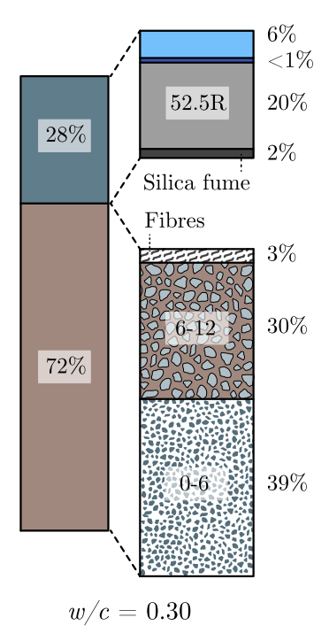
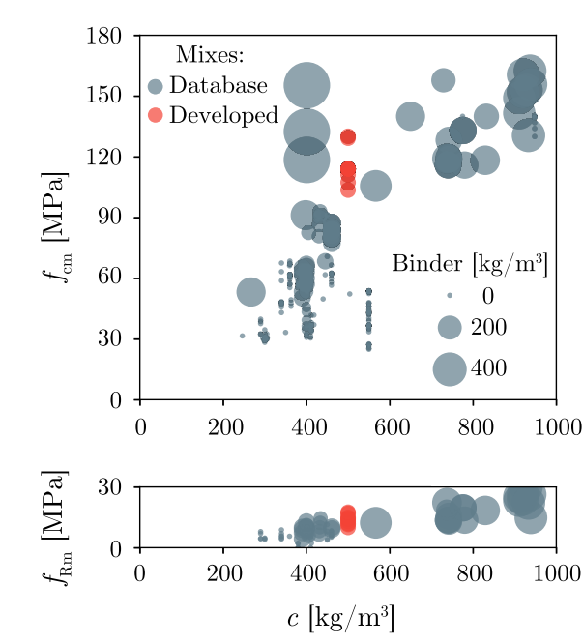
Mix design
Bekaert 4D Plus 80/60 (4D+60)
Tensile strength 2200 MPa
Components proportions of the HPFRC coarse aggregate mix designs
f_{cm} and f_{Rm} vs c
Notes:
These graphs show with grey circles a database of different mixes published in the scientific literature, the area of the circles is the binder content. The red circles represent the HPFRC mixes developed in this research project. It’s seeing in the cement content how with 500 kg/m3 this HPFRC developed surpassed 100 MPa thanks to a coarse fraction with a maximum aggregate size of 12 mm.
Bekaert 4D Plus 80/60 (4D+60)
Tensile strength 2200 MPa

Slide 12


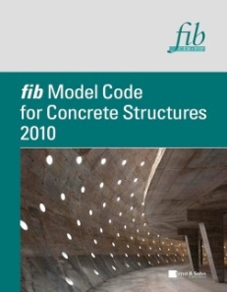
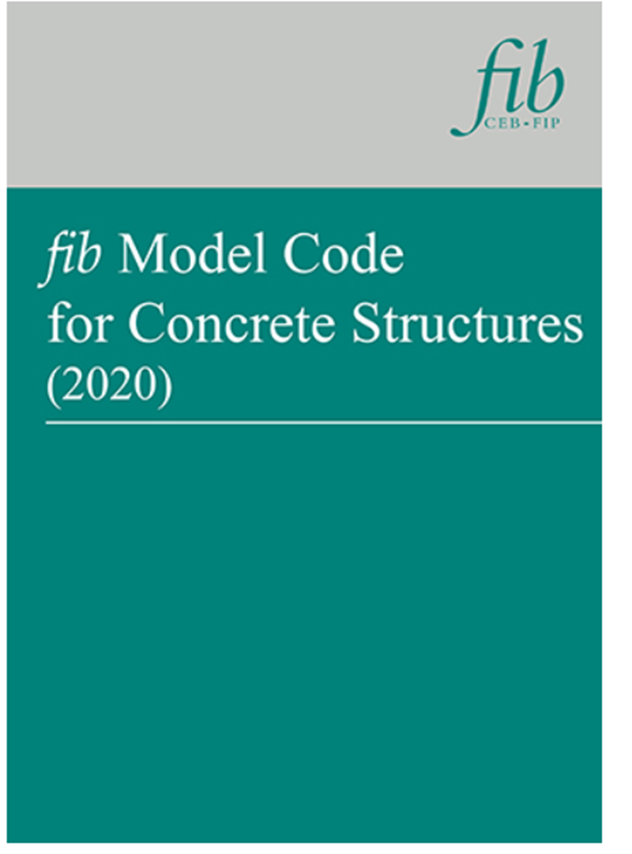
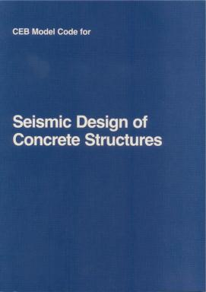

fib Evolution of Model Codes
1978
Model Code
Model Code
Model Code
1978
1985
2006
1970
1980
1990
2000
2010
2020
CEB Bull. 165 Seismic Design
fib Bull. 34 Service Life Design
Notes:
Agregar 2020

Slide 13
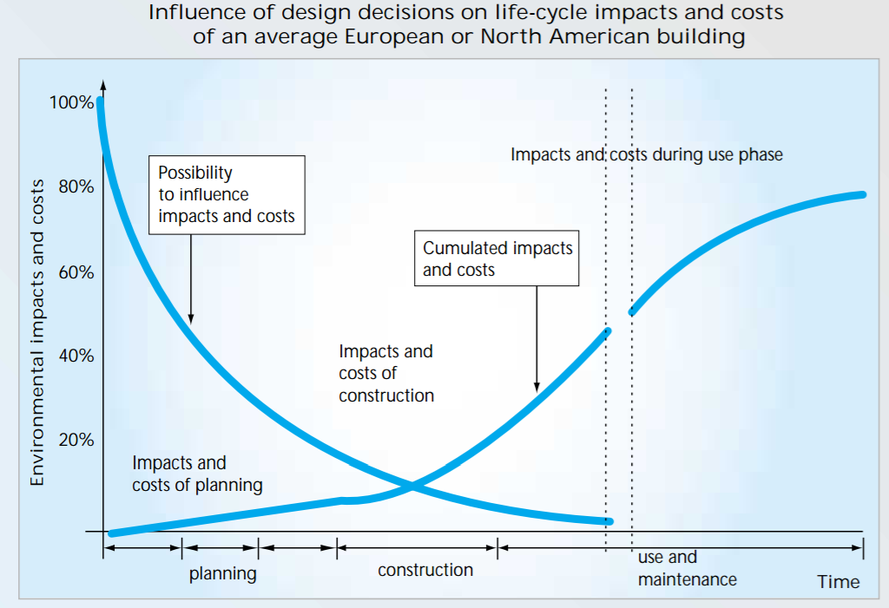
Source: Kohler, N. et al “Life-cycle analysis of the built environment”. Sustainable building construction

Slide 14
Conceptual Design Creativity + Knowledge + Experience within the global context of Sustainability

Slide 15
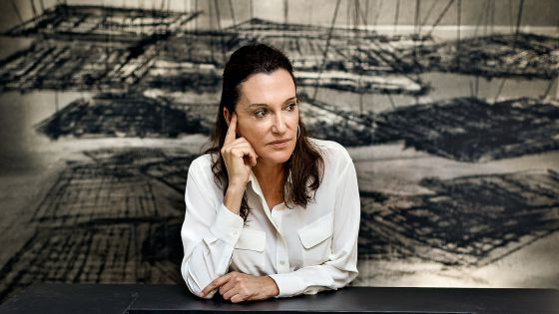
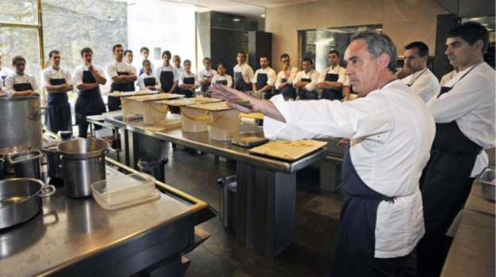
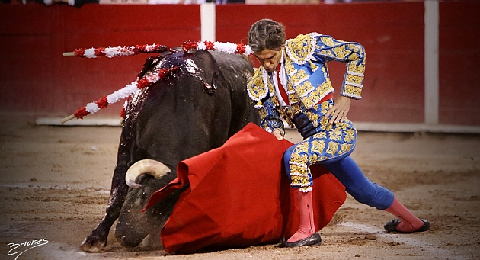
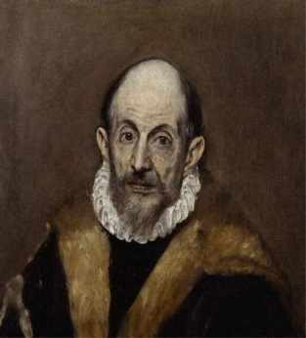
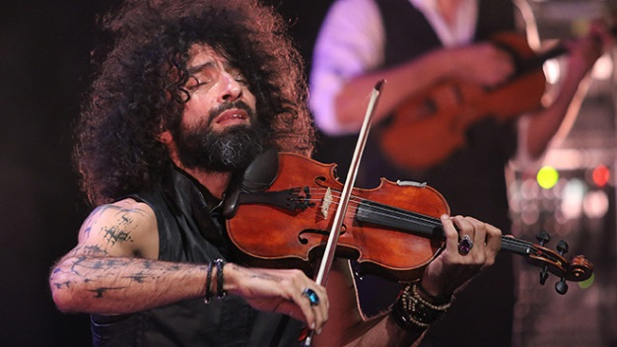
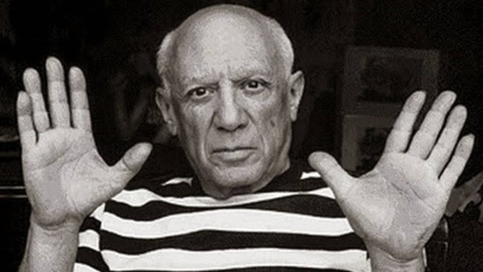

Slide 16
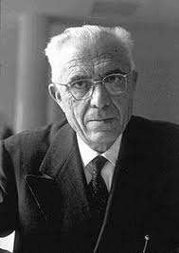
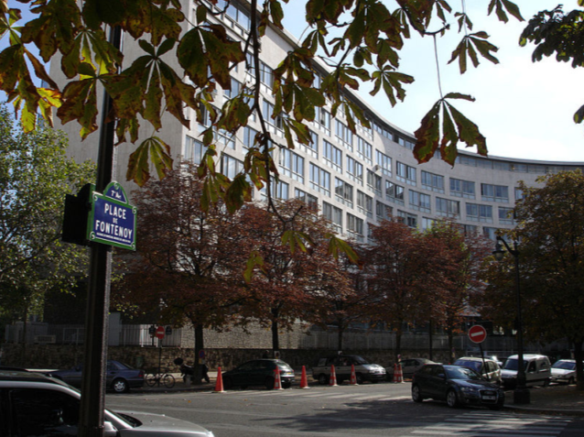
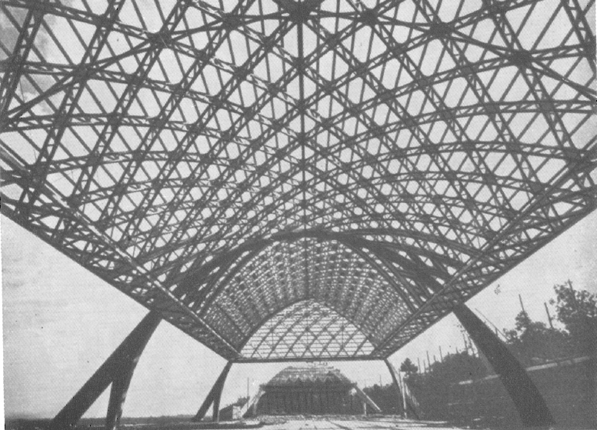
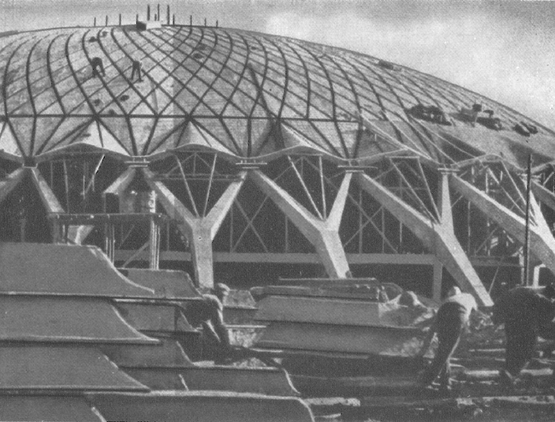
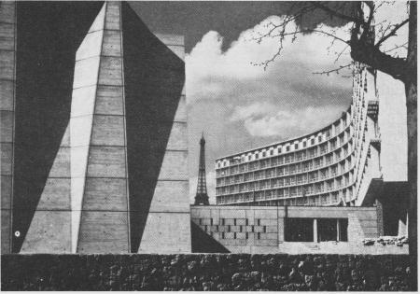
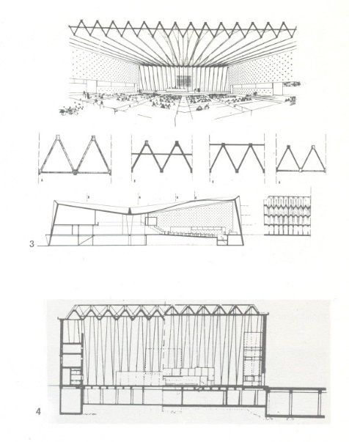
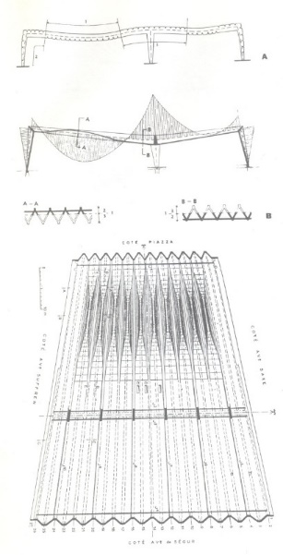
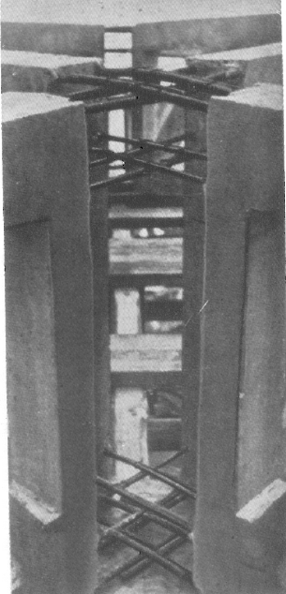
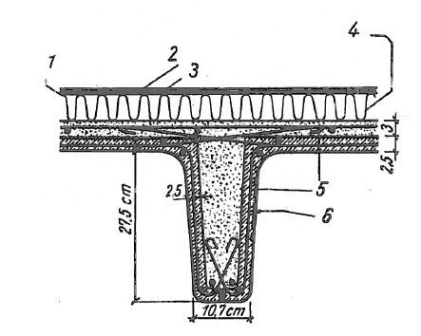
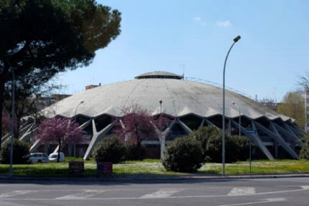
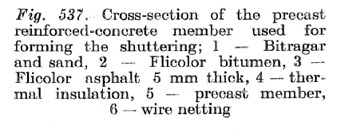
Pier Luigi Nervi (1891-1979)
PIER LUIGI NERVI (1891-1979)

Slide 17
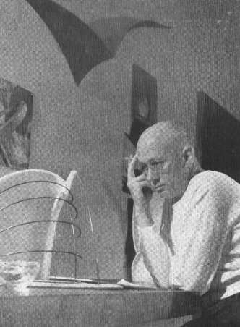
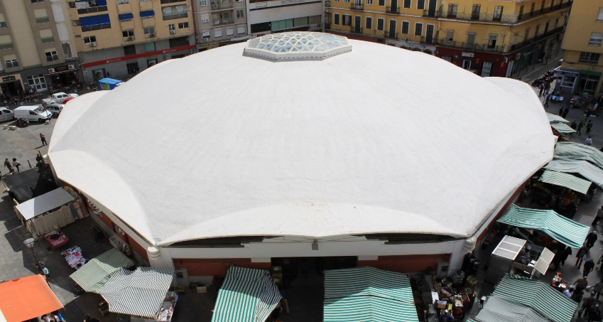
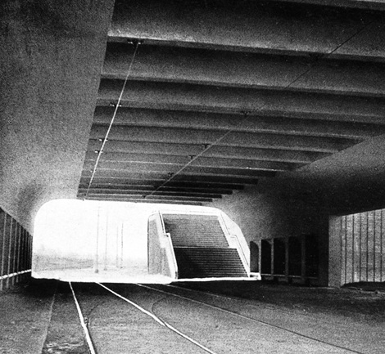
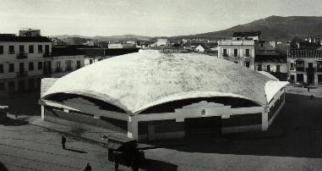
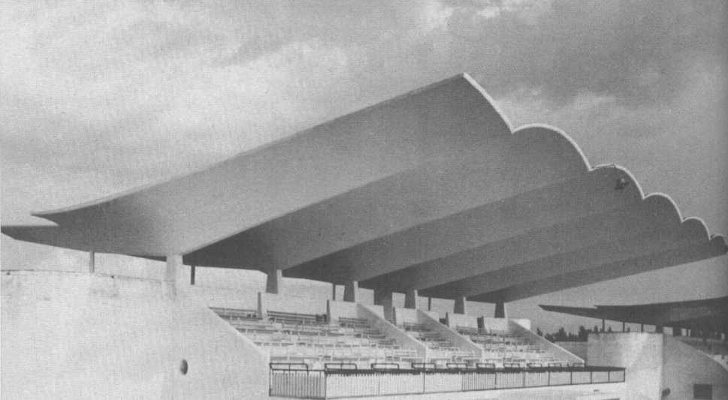
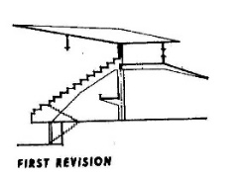
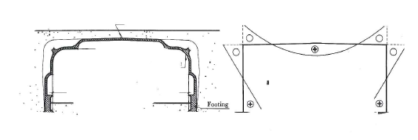
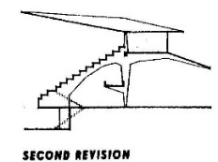
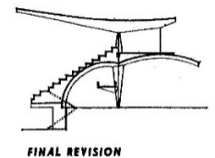
Eduardo Torroja (1899-1961)
EDUARDO TORROJA (1899-1961)

Slide 18
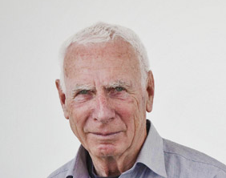
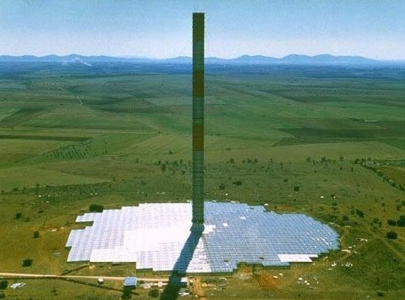
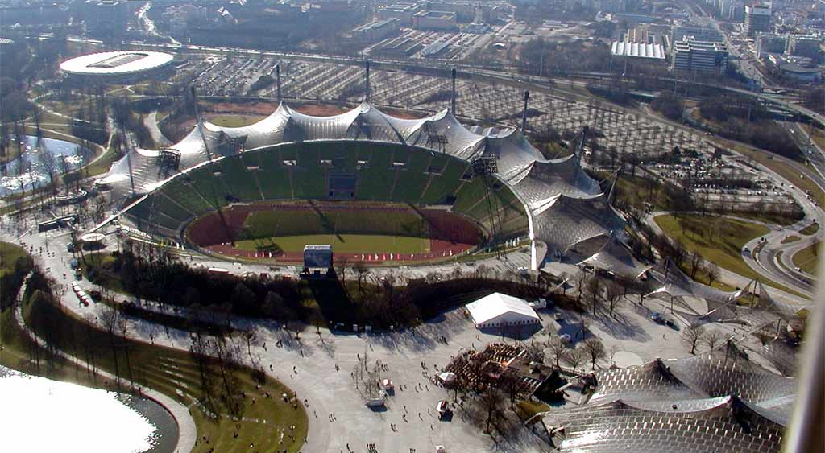
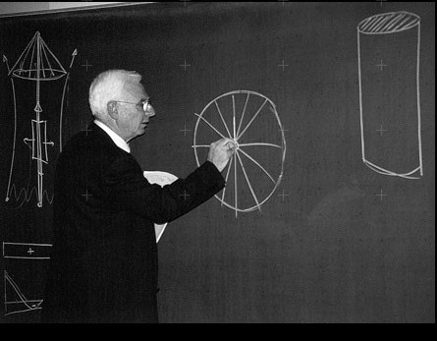




Jörg Schlaich (1934-1921)

Slide 19



Slide 20


Slide 21

Viaduct over the River Tajuña
Competition Cuarto Puente de Logroño
Decision for construction
Design
Demolition
Construction
Service
0 5 10 15 20 25 30 35 40 45 50 55 60 65 70 75 80 85 90 95 100 110 120
Time
Notes:
Conceptual Design. New Structures

Slide 22



Conceptual Design: General Process

Slide 23


Viaduct over the River Tajuña

Slide 24

Viaduct over the River Tajuña

Slide 25

Viaduct over the River Tajuña

Slide 26
Viaduct over the River Tajuña

Slide 27
Viaduct over the River Tajuña

Slide 28
Viaduct over the River Tajuña

Slide 29
Viaduct over the River Tajuña

Slide 30
Viaduct over the River Tajuña

Slide 31
Viaduct over the River Tajuña

Slide 32
Viaduct over the River Tajuña

Slide 33
Viaduct over the River Tajuña

Slide 34
Viaduct over the River Tajuña

Slide 35


Viaduct over the River Tajuña

Slide 36




Viaduct over the River Tajuña

Slide 37


Viaduct over the River Tajuña

Slide 38















How to make good structural engineering
Tipology
Materials
Life cycle

Slide 39


Viaduct over the River Tajuña

Slide 40



Viaduct over the River Tajuña

Slide 41

Viaduct over the River Tajuña

Slide 42
Viaduct over the River Tajuña

Slide 43

Viaduct over the River Tajuña

Slide 44

Viaduct over the River Tajuña

Slide 45

Bridge over the Alberche River

Slide 46



Bridge over the Alberche River

Slide 47

Viaduct over the River Tajuña

Slide 48


Viaduct over the River Tajuña

Slide 49

Zaragoza Expo 2008. Pavilion Bridge

Slide 50




Zaragoza Expo 2008. Pavilion Bridge (Richard Rogers – Fhecor)

Slide 51



Pasarela Madrid Río con material composite

Slide 52
Pasarela Madrid Río con material composite

Slide 53




Zaragoza Expo 2008. Pavilion Bridge

Slide 54

Zaragoza Expo 2008. Pavilion Bridge
1
2
3
4

Slide 55





Zaragoza Expo 2008. Pavilion Bridge

Slide 56



Zaragoza Expo 2008. Pavilion Bridge

Slide 57





Zaragoza Expo 2008. Pavilion Bridge

Slide 58







Zaragoza Expo 2008. Pavilion Bridge

Slide 59







Zaragoza Expo 2008. Pavilion Bridge

Slide 60







Zaragoza Expo 2008. Pavilion Bridge

Slide 61



Zaragoza Expo 2008. Pavilion Bridge. Details

Slide 62

Zaragoza Expo 2008. Pavilion Bridge. Construction Process: Launching

Slide 63




Zaragoza Expo 2008. Pavilion Bridge. Structural Project

Slide 64

Zaragoza Expo 2008. Pavilion Bridge. Construction Process: Launching

Slide 65

Zaragoza Expo 2008. Pavilion Bridge. Construction Process: Launching
Zaragoza Expo 2008. Pavilion Bridge

Slide 66

Zaragoza Expo 2008. Pavilion Bridge. Construction Process: Launching

Slide 67

Zaragoza Expo 2008. Pavilion Bridge. Construction Process: Launching

Slide 68

Zaragoza Expo 2008. Pavilion Bridge. Construction Process: Launching

Slide 69


Zaragoza Expo 2008. Pavilion Bridge

Slide 70

Widening of Los Santos Bridge
Decision for construction
Design
Construction
Life span
0 5 10 15 20 25 30 35 40 45 50 55 60 65 70 75 80 85 90 95 100 110 120
Time
Notes:
Agregar demolicion

Slide 71

Rande Cable-stayed Bridge

Slide 72

Rande Cable-stayed Bridge

Slide 73



Rande Cable-stayed Bridge
Possibilities to improve the capacity of existing structure

Slide 74
Rande Cable-stayed Bridge
Bending moments. Before widening
Works carried out in the superstructure
Bending moments. After widening

Slide 75


POSSIBILITIES TO IMPROVE THE CAPACITY OF EXISTING STRUCTURE
Rande Cable-stayed Bridge
Possibilities to improve the capacity of existing structure
Widening of the Existing Structures

Slide 76



SOLUTIONS THAT ARE PARALLEL TO EXISTING BRIDGE
Rande Cable-stayed Bridge
Possibilities to improve the capacity of existing structure

Slide 77

Rande Cable-stayed Bridge

Slide 78

Rande Cable-stayed Bridge

Slide 79


Rande Cable-stayed Bridge

Slide 80

Rande Cable-stayed Bridge

Slide 81




Rande Cable-stayed Bridge
Hinges

Slide 82

Rande Cable-stayed Bridge
Notes:
Poner unas diapos de alcoy, que le he pedido a cristina por email con copia a ti

Slide 83

Rande Cable-stayed Bridge
Notes:
Poner unas diapos de alcoy, que le he pedido a cristina por email con copia a ti

Slide 84

Rande Cable-stayed Bridge
Notes:
Poner unas diapos de alcoy, que le he pedido a cristina por email con copia a ti

Slide 85

Rande Cable-stayed Bridge

Slide 86



Rande Cable-stayed Bridge
Travelers

Slide 87


Rande Cable-stayed Bridge
Travelers

Slide 88



Rande Cable-stayed Bridge

Slide 89
Rande Cable-stayed Bridge

Slide 90

São Vicente Suspension Bridge. Cable Substitution and deck Rehabilitation, Brazil
Decision for construction
Design
Demolition Dismantlement Reconstruction
Construction
Service Life
0 5 10 15 20 25 30 35 40 45 50 55 60 65 70 75 80 85 90 95 100 110 120
Time

Slide 91

São Vicente Suspension Bridge. Cable Substitution and deck Rehabilitation, Brazil

Slide 92


São Vicente Suspension Bridge. Cable Substitution and deck Rehabilitation, Brazil
L = 180,00 m main span s = 5,92 m between hangers
b= 6,40 m width between trusse h = 3,70 m truss height
Main cables : 2 cables f 81 mm + 6 cables f 63 mm with f_{u} = 1500 MPa
Hangers : 42 mm diameter bars
TOTAL DEAD LOAD 5,17 kN/m² (INCLUDING WOOD AND SEWERAGE PIPES) ENGETI

Slide 93


São Vicente Suspension Bridge. Cable Substitution and deck Rehabilitation, Brazil
Each cable is formed by seven spiral cables formed with 3 mm wires.
The cables are arranged in a spiral ,the outer most six around a central cable.

Slide 94

São Vicente Suspension Bridge. Cable Substitution and deck Rehabilitation, Brazil
The cables are placed in two levels, six inferior 63 mm cables and two 81 mm cables in an the upper level

Slide 95

São Vicente Suspension Bridge. Cable Substitution and deck Rehabilitation, Brazil
Cables placed in two levels, with a common lower clamp and two independent clamps for the upper cables.

Slide 96

São Vicente Suspension Bridge. Cable Substitution and deck Rehabilitation, Brazil
Original saddle

Slide 97

São Vicente Suspension Bridge. Cable Substitution and deck Rehabilitation, Brazil
Original saddle

Slide 98


São Vicente Suspension Bridge. Cable Substitution and deck Rehabilitation, Brazil
Towers steel trusses sheathed with mass concrete.

Slide 99



São Vicente Suspension Bridge. Cable Substitution and deck Rehabilitation, Brazil
Towers steel trusses sheathed with mass concrete.

Slide 100

São Vicente Suspension Bridge. Cable Substitution and deck Rehabilitation, Brazil
Cable corrosion and loss of cross section

Slide 101

São Vicente Suspension Bridge. Cable Substitution and deck Rehabilitation, Brazil
Truss deck formed by 30 modules 5,92 m long. Truss height 3,70 m.

Slide 102

São Vicente Suspension Bridge. Cable Substitution and deck Rehabilitation, Brazil
Missing elements due to heavy corrosion

Slide 103

São Vicente Suspension Bridge. Cable Substitution and deck Rehabilitation, Brazil
Loss of paint and widespread corrosion

Slide 104

São Vicente Suspension Bridge. Cable Substitution and deck Rehabilitation, Brazil
Original cross section

Slide 105


São Vicente Suspension Bridge. Cable Substitution and deck Rehabilitation, Brazil
The project planned to use final upper cables as temporary cables
Contractor finally used a set of postensioning strands as temporary cable

Slide 106

São Vicente Suspension Bridge. Cable Substitution and deck Rehabilitation, Brazil
The project planned to use final upper cables as temporary cables
Contractor finally used a set of postensioning strands as temporary cable

Slide 107



São Vicente Suspension Bridge. Cable Substitution and deck Rehabilitation, Brazil
Sketch of the Construction sequence planned for hangers' substitution

Slide 108

São Vicente Suspension Bridge. Cable Substitution and deck Rehabilitation, Brazil
Temporary steel pier placed outside the bridge to maintain deck accesible for pedestrian traffic and rehabilitation works

Slide 109

São Vicente Suspension Bridge. Cable Substitution and deck Rehabilitation, Brazil
Temporary transverse beam placed before the beginning of load transfer to the temporary cables

Slide 110

São Vicente Suspension Bridge. Cable Substitution and deck Rehabilitation, Brazil
Cross section during load transfer, with temporary hangers and cables

Slide 111

São Vicente Suspension Bridge. Cable Substitution and deck Rehabilitation, Brazil
Sequential and simultaneous tensioning of temporary hangers and detensioning of original hangers

Slide 112

São Vicente Suspension Bridge. Cable Substitution and deck Rehabilitation, Brazil
Removal of original cables. Bridge supported on temporary cables

Slide 113

São Vicente Suspension Bridge. Cable Substitution and deck Rehabilitation, Brazil
Sequential and simultaneous tensioning of final hangers and detensioning of temporary hangers

Slide 114

São Vicente Suspension Bridge. Cable Substitution and deck Rehabilitation, Brazil
Installation of final upper cables, brought close to lower cables by a temporary hanger.

Slide 115

São Vicente Suspension Bridge. Cable Substitution and deck Rehabilitation, Brazil
Full Locked Coil cables ready to be dereeled

Slide 116

São Vicente Suspension Bridge. Cable Substitution and deck Rehabilitation, Brazil

Slide 117

São Vicente Suspension Bridge. Cable Substitution and deck Rehabilitation, Brazil

Slide 118

São Vicente Suspension Bridge. Cable Substitution and deck Rehabilitation, Brazil
Temporary clamps used to transfer the load to temporary bars and cut original cables

Slide 119

São Vicente Suspension Bridge. Cable Substitution and deck Rehabilitation, Brazil
Temporary clamps used to transfer the load to temporary bars and cut original cables

Slide 120


São Vicente Suspension Bridge. Cable Substitution and deck Rehabilitation, Brazil
Replacement of thousands of rivets

Slide 121

São Vicente Suspension Bridge. Cable Substitution and deck Rehabilitation, Brazil
Replacement of thousands of rivets

Slide 122

São Vicente Suspension Bridge. Cable Substitution and deck Rehabilitation, Brazil
Replacement of thousands of rivets

Slide 123

São Vicente Suspension Bridge. Cable Substitution and deck Rehabilitation, Brazil
Rivet control

Slide 124

São Vicente Suspension Bridge. Cable Substitution and deck Rehabilitation, Brazil

Slide 125






Slide 126

Final considerations
“Engineering is the art of modeling materials we do not wholly understand, into shapes we cannot precisely analyse, so as to withstand forces we cannot properly assess, in such a way that the public at large has not reason to suspect the extent of our ignorance.”
President of the Institution of Civil Engineers 1946
What we know
What we realise that we do not know
What we do not even realise that we do not know

Slide 127






Final considerations
The value of history in other professions

Slide 128

Final considerations
Students at the School of Civil Engineering of the Technical University of Madrid during the presentation of the class assignment of the subject Structural Typology, created by Torroja

Slide 129

Final considerations

Slide 130

fib

