Slide 1

Assessment and Retrofitting of Existing Bridges: The Swiss Experience of the Last Decades
Aurelio Muttoni
Muttoni Partners Consulting Engineers, Ecublens, Switzerland
Emeritus Professor at Swiss Federal Institute of Technology, Lausanne, Switzerland
XVI Congresso Brasileiro de Pontes e Estruturas,
Rio de Janeiro, 2025

Slide 2

Population of Switzerland:
∽ 9 million inhabitants
(∽ 4.2% of Brazil)
Area of Switzerland:
∽ 40 000 km2
(∽ 0.5% of Brazil)
Suiça

Slide 3
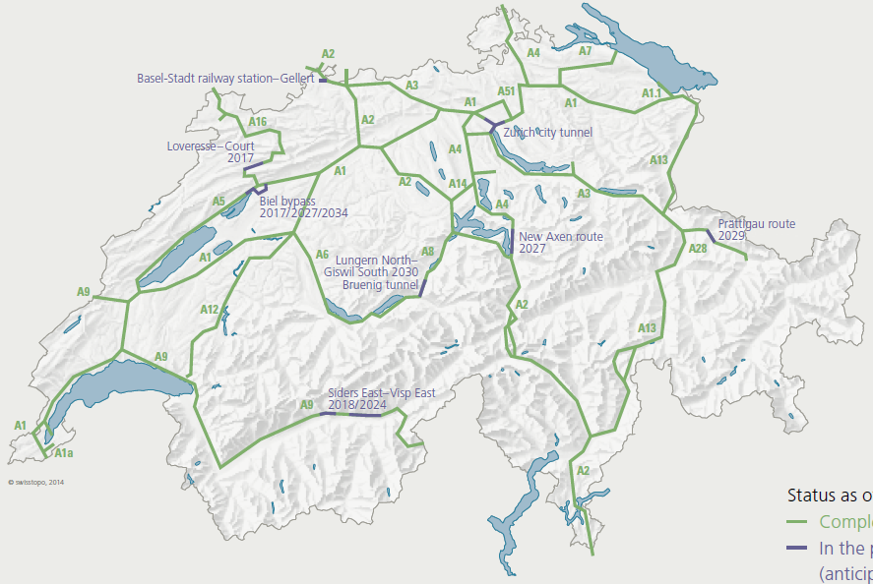
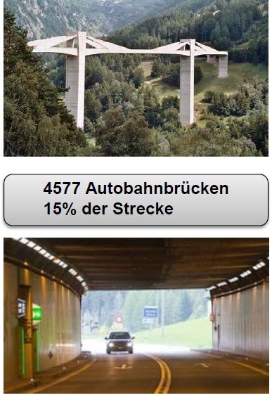

Situation in Switzerland with respect to assessment and retrofitting of existing bridges
The example of federal highway bridges
4577 federal highway bridges,
15% of the total length,
Average length = 60 m
Total length of federal highways (2022): 2 254 km + 17 200 km cantonal (national) roads (1.73 km of roads / km² of area)
239 federal highway tunnels
13% of the total length
Average length = 1’002 m

Slide 4
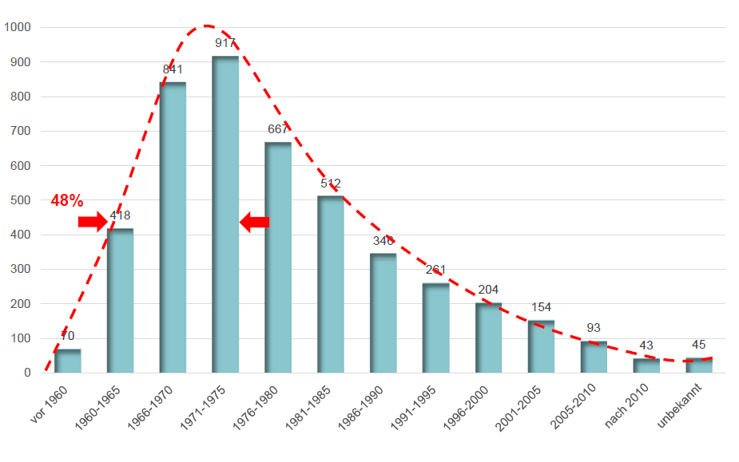
Situation in Switzerland with respect to assessment and retrofitting of existing bridges
The example of highway bridges
~ 50% older than 50 years
Number of bridges
SIA 162:1956
SIA 162:1968
SIA 162:1989
SIA 262:2003
SIA 262:2013
Source: Federal Roads Office FEDRO (2017)

Slide 5
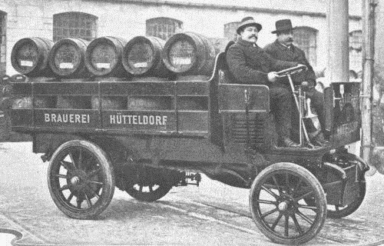
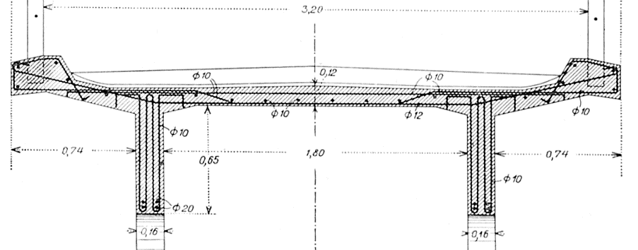

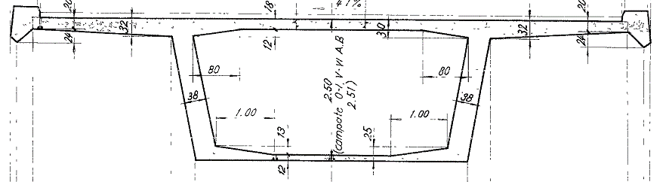
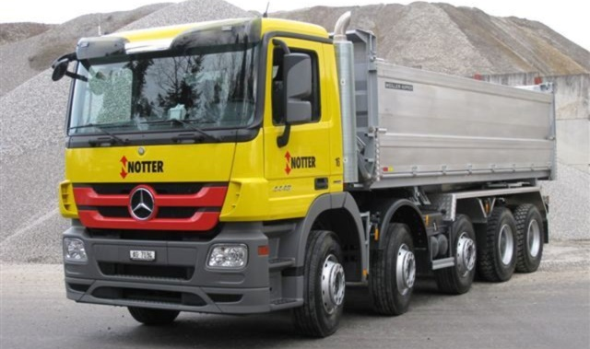
Very different types of bridges with increasing actions
120 mm
1905
1967
2025
Bridge designed by Robert Maillart, 1905
180 mm
Viadotto sopra le Fornaci, 1967
Nowadays: thickness of deck slab ≥ 250 mm

Slide 6
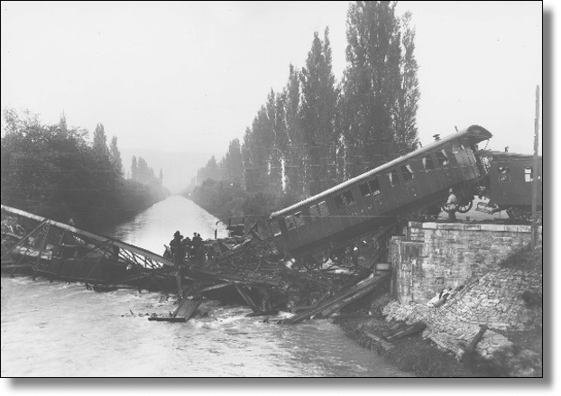
Standards for assessment of existing structures
1891: Collapse of a railway bridge designed by Eiffel at Münchenstein near Basel, Switzerland, the disaster claimed the lives of 73 and seriously injured 171 people
1892: Federal code on design and assessment of steel bridges and roofs of the Swiss railways

Slide 7
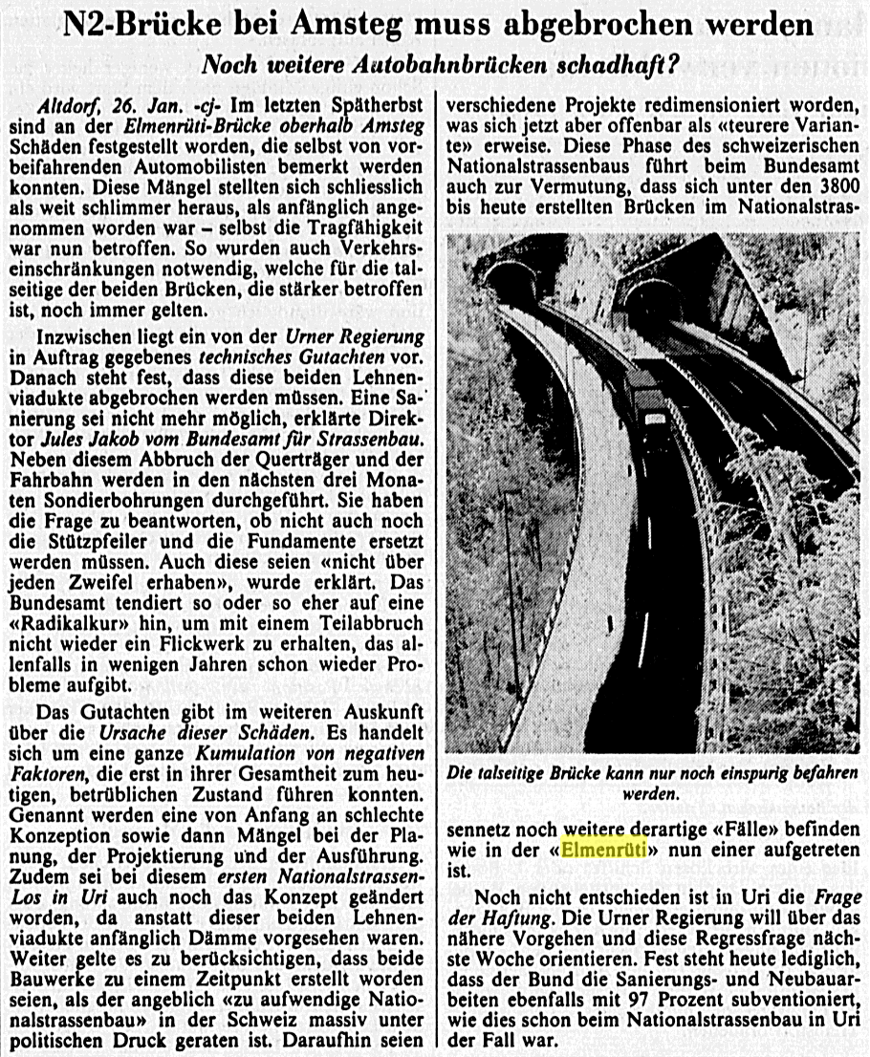
Assessment of existing structures in Switzerland
1st highway bridge with significant structural deficiencies and deteriorations detected in 1982,
Replaced after 17 years of service
% of tax on fuels devoted to research related to durability, maintenance, retrofitting and improved behaviour of infrastructure

Slide 8


Standards for assessment of existing structures in Switzerland
SIA 462:1994 “Assessment of the structural safety of existing constructions”
SIA 269:2011 “Bases for the maintenance of existing structures”
SIA 269/1:2011 “Actions”
SIA 269/2:2011 “Concrete structures”
SIA 269/3:2011 “Steel structures”
SIA 269/4:2011 “Composite structures”
SIA 269/5:2011 “Timber structures”
SIA 269/6:2011 “Masonry”
SIA 269/7:2011 “Geotechnical engineering”
SIA 269/8:2017 “Earthquake”

Slide 9
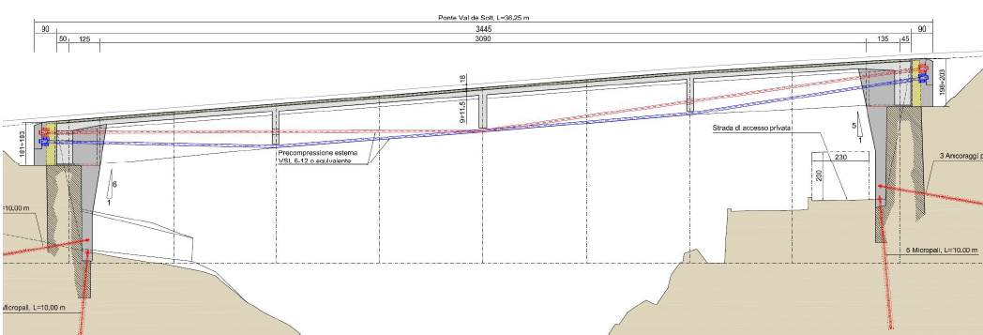
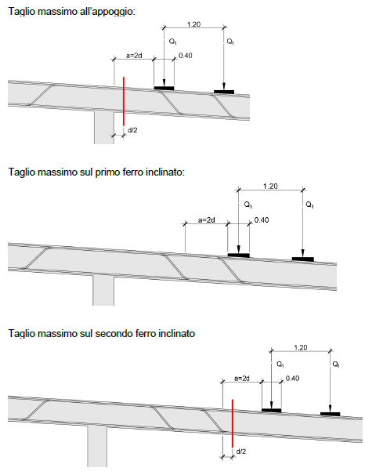
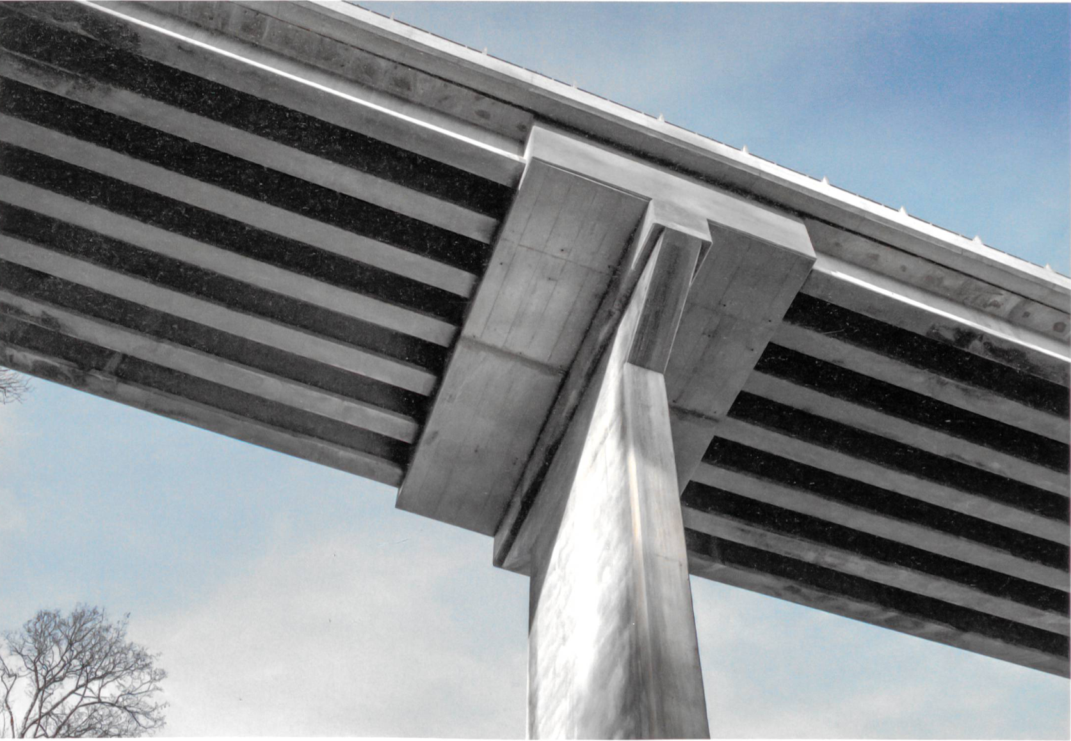
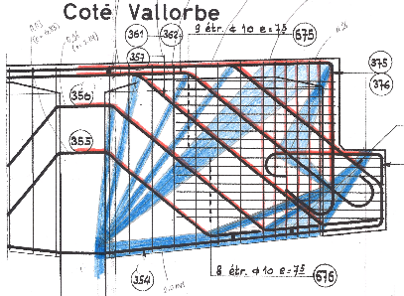
Critical verifications and potential failure modes
Flexure is in most cases not governing (reliable design methods in the past, redistribution capacity in statically indeterminate structures), retrofitting required only in cases of reinforcement corrosion, significantly increased loads and for statically determinate structures.
Shear and punching in members without shear reinforcement often critical (unconservative design rules in the past)
Shear in highly prestressed members very often not critical if more refined assessment methods are used
Half joints and diaphragms: result of assessment depends on detailing and corrosion

Slide 10
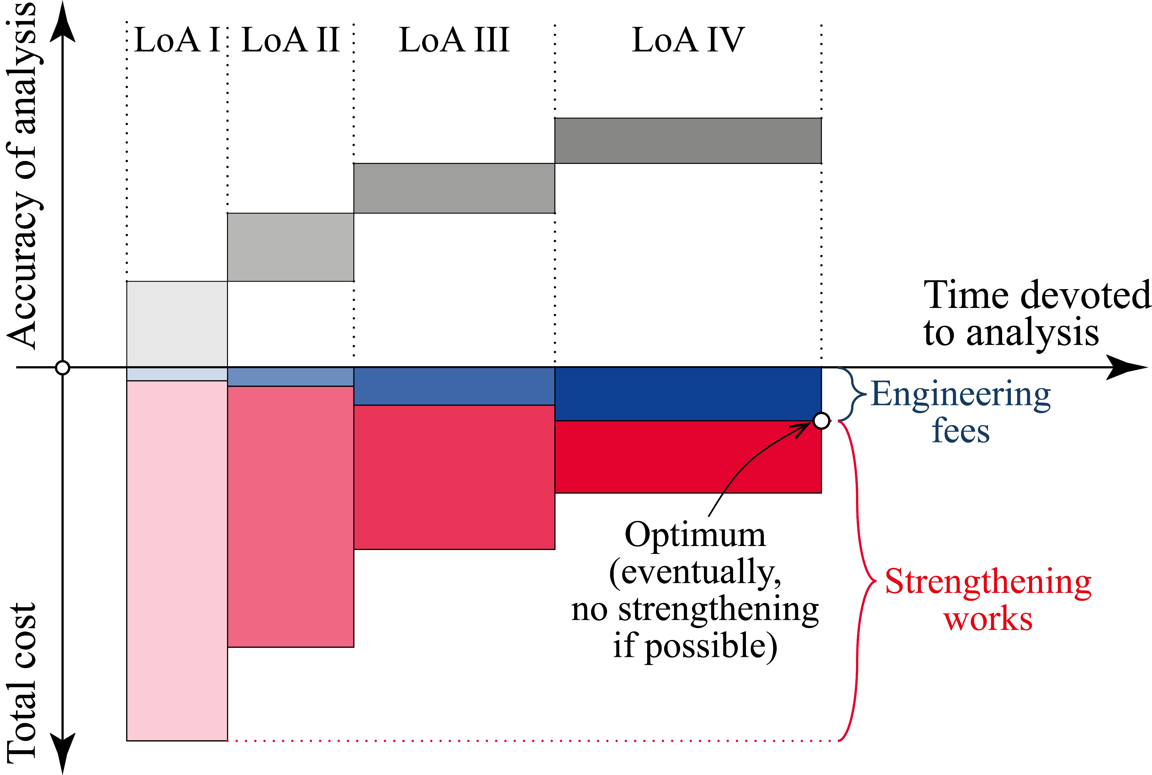
The idea of the Level of Approximation Approach
SIA 262:2003
fib MC 2010, fib MC 2020
EN 1992-1-1:2023 (2nd generation of Eurocode 2)
Design of very complex structures or with significant economic impact
Assessment of critical elements with expensive retrofitting
Design of very complex structures or with significant economic impact
Assessment of critical elements with expensive retrofitting
Design of more complex structures
Assessment of critical elements
Design of simple structures
Assessment of noncritical elements
Adapted from Muttoni, 2003

Slide 11
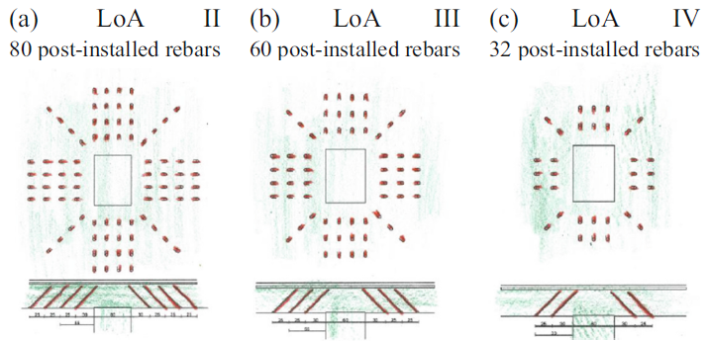
The idea of the Level of Approximation Approach
Muttoni et al., 2023

Slide 12
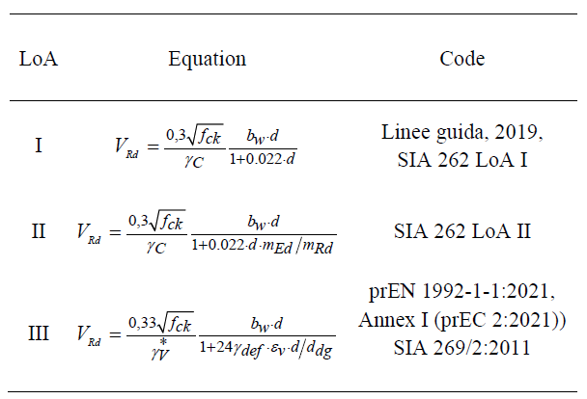
Shear in members without shear reinforcement, Levels of Approximation Approach
Governing in slabs of cut-and-cover tunnels, bridge deck slabs, girders with compact sections and footings, Approach according to the Critical Shear Crack Theory
EN 1992-1-1:2023,
(Eurocode 2:2023)
Muttoni 2003, Muttoni et al., 2023

Slide 13
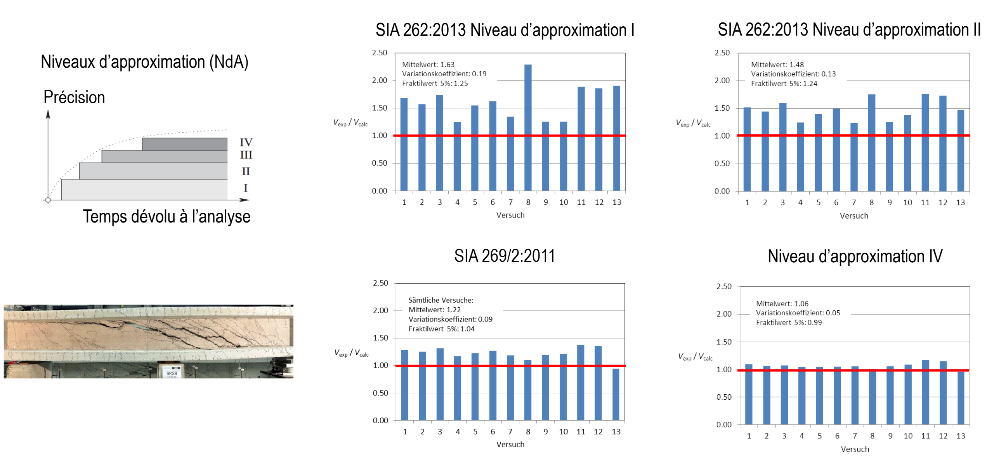
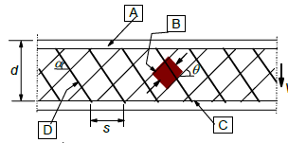
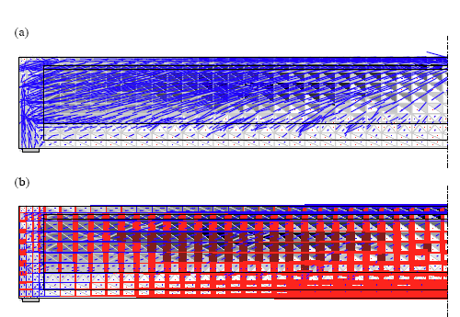
Shear in girders with shear reinforcement, Level of Approximation Approach
Comparison of shear tests by Rupf et al. 2013 on post-tensioned girders with predictions according to different LoAs (comparison with mean values and without partial safety factors)
LoA I (MC 2010 I)
LoA II (MC 2010 II)
μ = 1.63,
CoV=0.19
μ = 1.48,
CoV=0.13
LoA III (SIA 269/1:2011) LoA IV (EPSF)
μ = 1.22,
CoV=0.09
μ = 1.06,
CoV=0.05

Slide 14
Levels of Approximation Approach: Actions and related partial factors
LoA I
γ and actions as for new structures (γ_{G} = 1.35 for permanent actions, γ_{Q} =1.50 for variable actions as for European standards based on β_{tgt ,50} = 3.80)
LoA II
Permanents actions can be updated (assessment of dimensions)
=> in this case, γ_{G} may be reduced from 1.35 to 1.20 (SIA 269:2011)
Traffic loads may be taken from the code for existing structures as a function of the road type, bridge type and dimensions (SIA 269/1:2011)
LoA III
γ_{G} can be determined by a reliability analysis and measured dimensions
Traffic loads can be determined by measurements (Weight in Motion) and reliability analysis

Slide 15
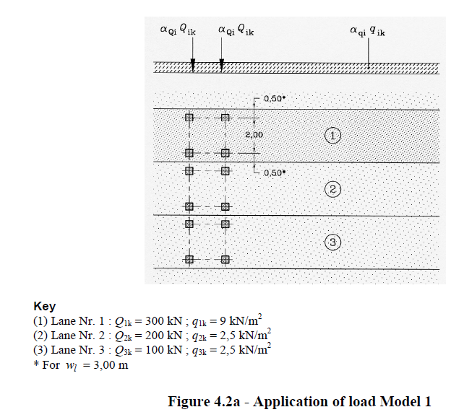
LoAA, Actions and related partial factors
LoA I, traffic loads for new bridges (SIA 261)
EN 1991-2:2003

Slide 16
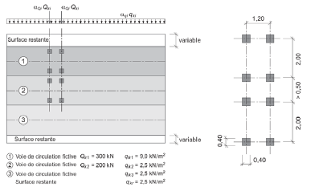
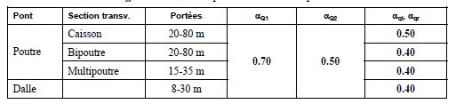
LoAA, Actions and related partial factors
LoA II, traffic loads for existing bridges (SIA 269/1)
Load model for typical bridge systems
Source: T. Meystre, M. Hirt, Evaluation de ponts routiers existants avec un modèle de charge de trafic actualisé, FEDRO Documentation, 2006

Slide 17
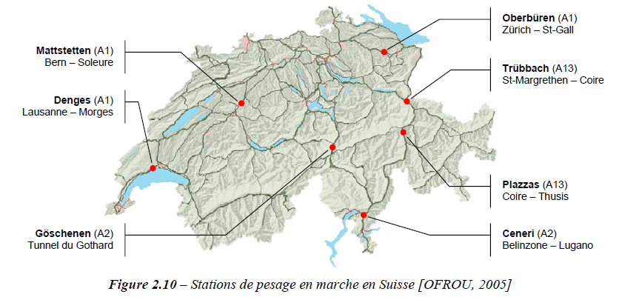
LoAA, Actions and related partial factors
LoA III, refined calculation of traffic loads based on traffic measurements
Source: T. Meystre, M. Hirt, Evaluation de ponts routiers existants avec un modèle de charge de trafic actualisé, FEDRO Documentation, 2006

Slide 18
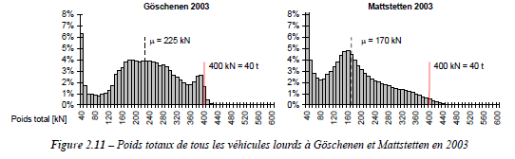
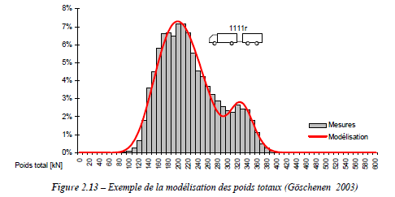
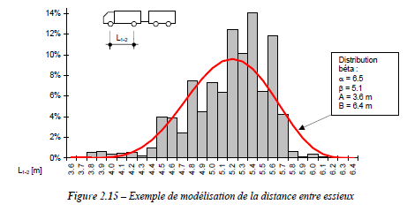
LoAA, Actions and related partial factors: LoA III, refined calculation of traffic loads
Source: T. Meystre, M. Hirt, Evaluation de ponts routiers existants avec un modèle de charge de trafic actualisé, FEDRO Documentation, 2006

Slide 19
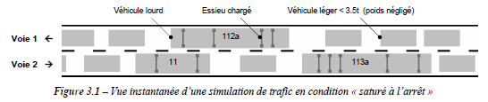
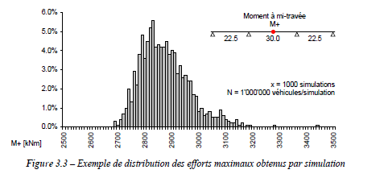
LoAA, Actions and related partial factors: LoA III, refined calculation of traffic loads
Source: T. Meystre, M. Hirt, Evaluation de ponts routiers existants avec un modèle de charge de trafic actualisé, FEDRO Documentation, 2006

Slide 20
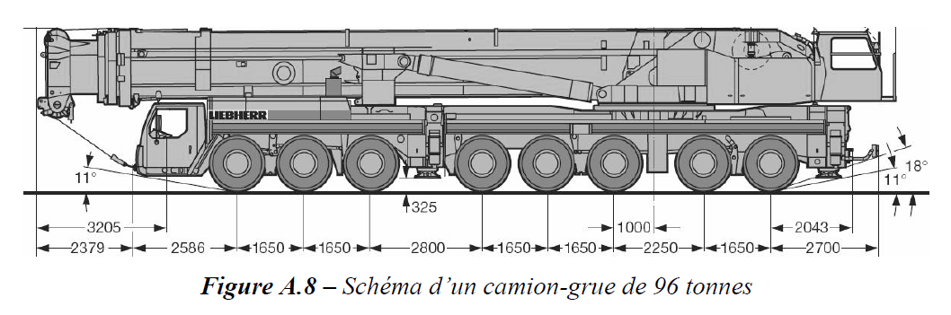
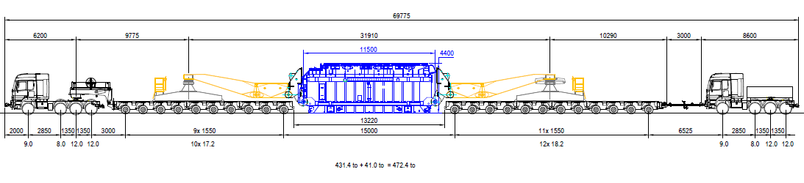
LoAA, Actions and related partial factors: Exceptional transports
Nominally 8x12 = 96 t
but significant scatter has been observed since some vehicles circulate with counterweights
470 t

Slide 21
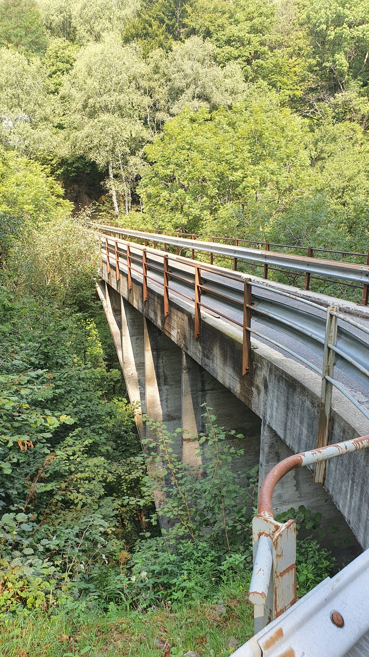
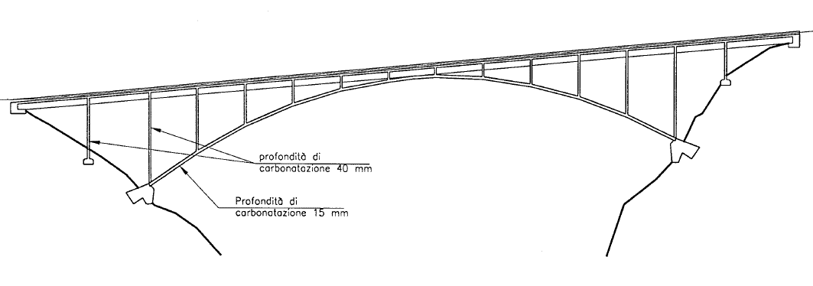
Assessment and retrofitting for bending
Ponte di Castello sul Vedeggio a Isone
Arch bridge, span = 37.95 m,
arch thickness = 0.20 – 0.21 m, piers 0.13 – 0.15 m, deck h = 0.80 m
built in 1950
Designed for a traffic load of 3.5 t (35 kN)
Expansion joints and movable bearings on both abutments
Without waterproofing membrane
(22-L01)

Slide 22
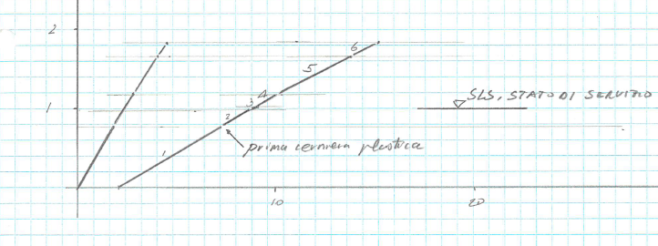
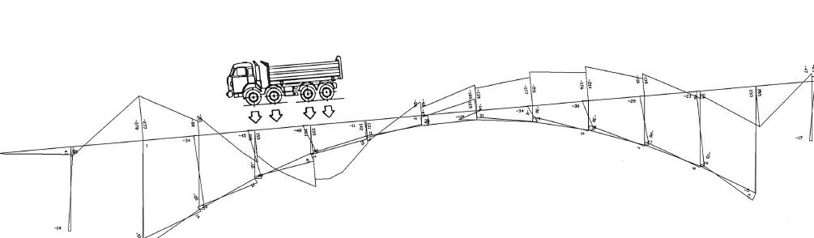
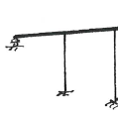

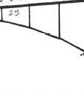

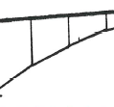
Assessment and retrofitting for bending
Verification in 1990 for a traffic load of 28 t (8 times the load used for design in 1950, road to be used as access to a construction site)
Elastic-plastic approach has shown that:
1st plastic hinge for ≃ 80% of characteristic traffic load
Safety level at ULS sufficient !
Load / 280 kN
Deflection under the load [mm]
Final mechanism according to limit analysis with 4 plastic hinges in the deck and 16 hinges in the piers and arch

Slide 23
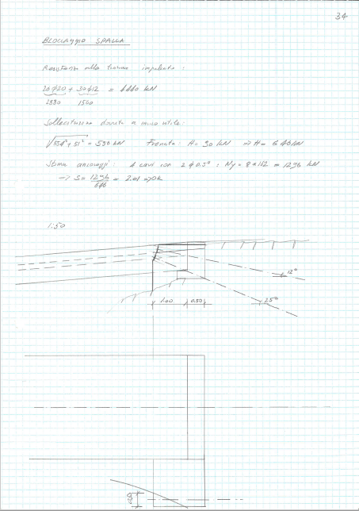
Assessment and retrofitting for bending
ULS criterion satisfied without strengthening
but
Potential yielding of reinforcement under nominal traffic load
=> It has been decided to retrofit the bridge by fixing one of the abutments
Strengthening reasonable, also because in this case, it can be done in a very simple manner

Slide 24
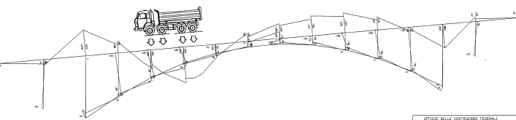
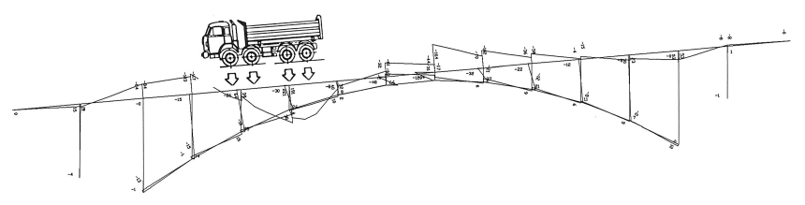
Assessment and retrofitting for bending
Strengthening by fixing one of the abutments
Before strengthening
48 kNm
383 kNm
After strengthening
30 kNm (62%)
221 kNm (58%)
Significant reduction of bending moments and increase of load-carrying capacity

Slide 25
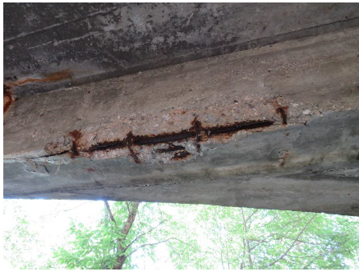
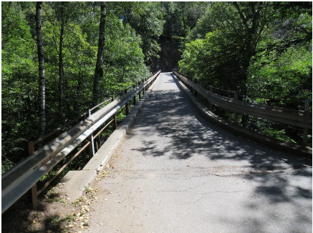
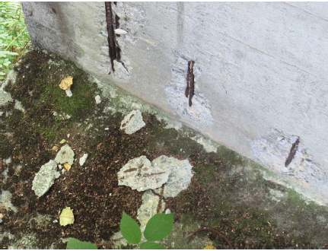
Assessment and retrofitting for bending
Current state : service life increased from 40 years (1950-1990) to 75 years (1950-2025)
2.40 m

Slide 26
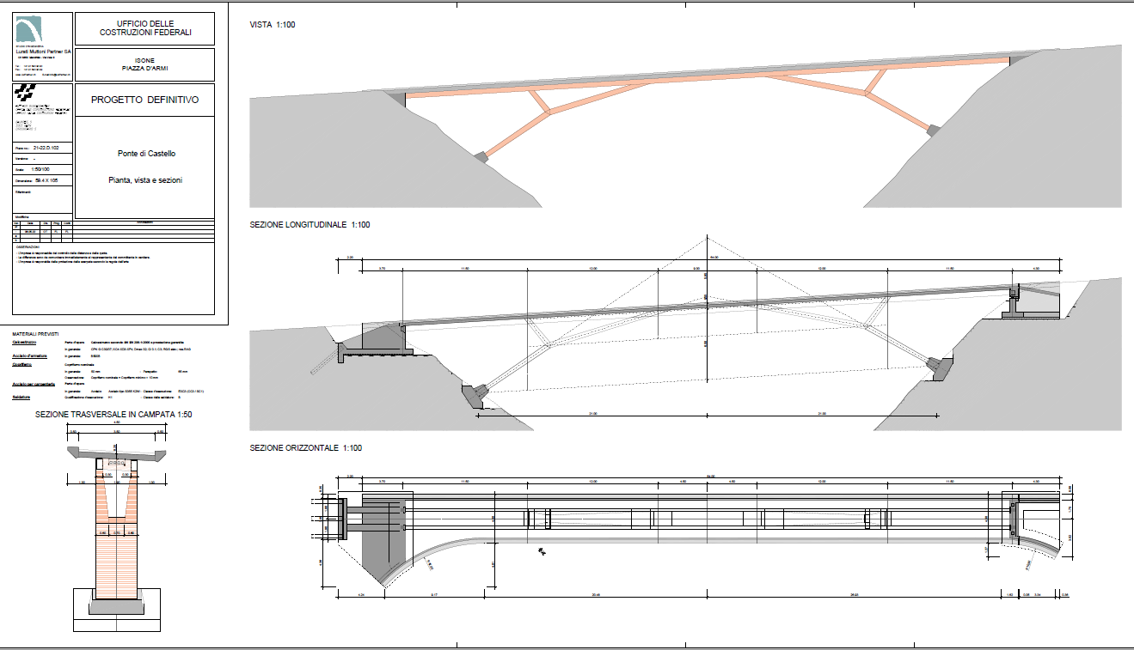
Assessment and retrofitting for bending
Replacement in 2025 after 75 years of service

Slide 27
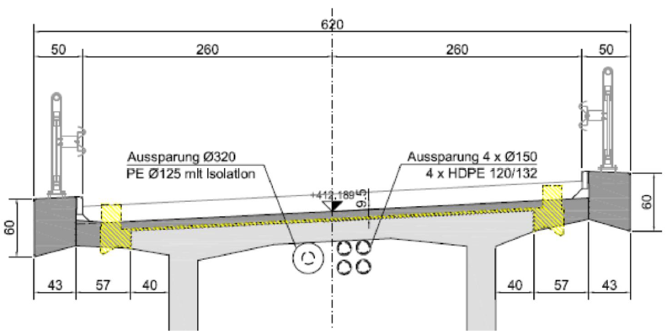
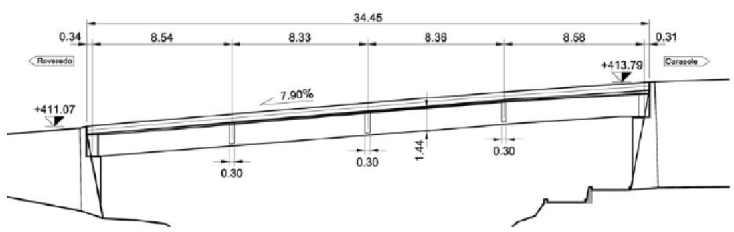
Assessment and retrofitting for bending
Bridge Val de Sott at Roveredo (GR), Switzerland
Simply supported post-tensioned girder with a span of 34.45 m
Built in 1964 for a traffic load of 16 t, to be increased to 40 t (2022)
Width of the carriageway 4.42 m to be increased to 5.20 m
(12-B11)

Slide 28
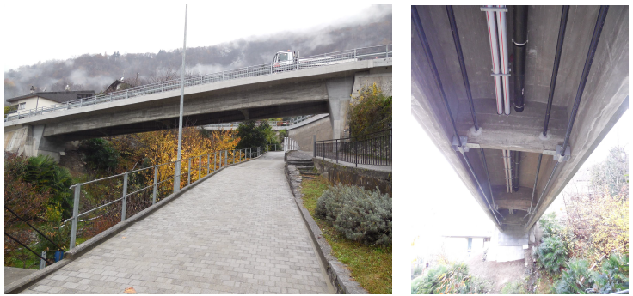
Assessment and retrofitting for bending
Main structural interventions:
Expansion joints and mechanical bearings removed; girder clamped into the two abutments (transformed into an integral bridge)
Additional external post-tensioning
Span slightly reduced

Slide 29
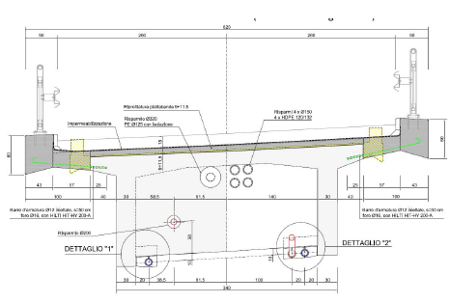
Assessment and retrofitting for bending
Main structural interventions:
Expansion joints and mechanical bearings removed;
Girder clamped into the two abutments (transformed into an integral bridge)
Additional external post-tensioning
Span slightly reduced

Slide 30
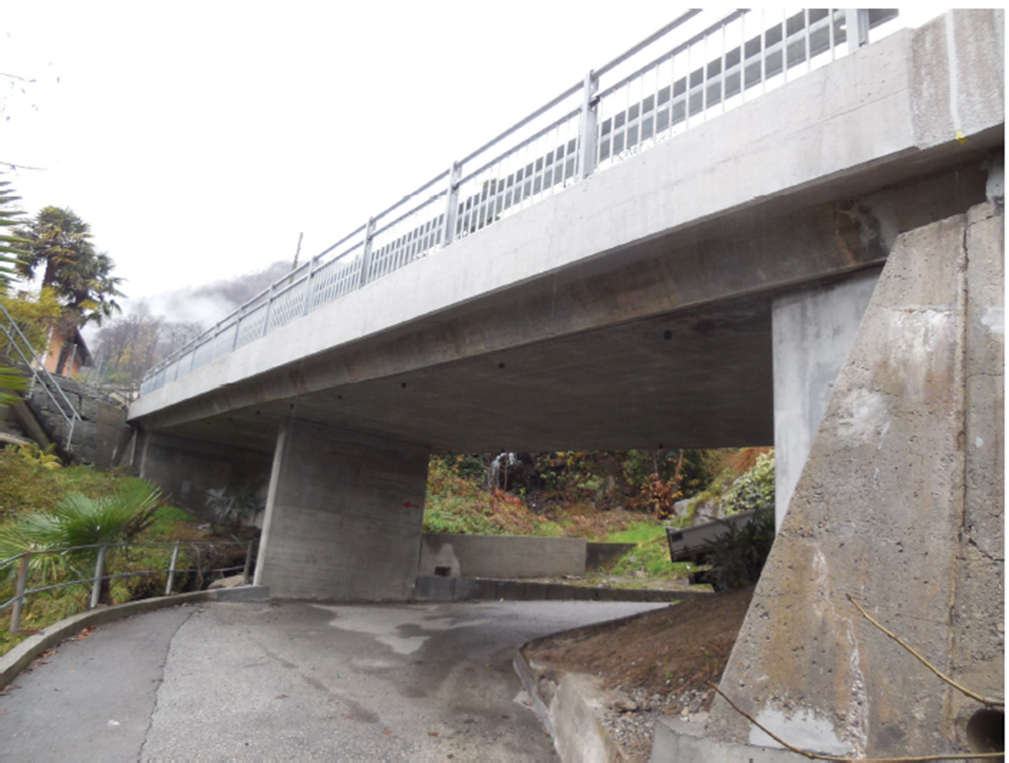
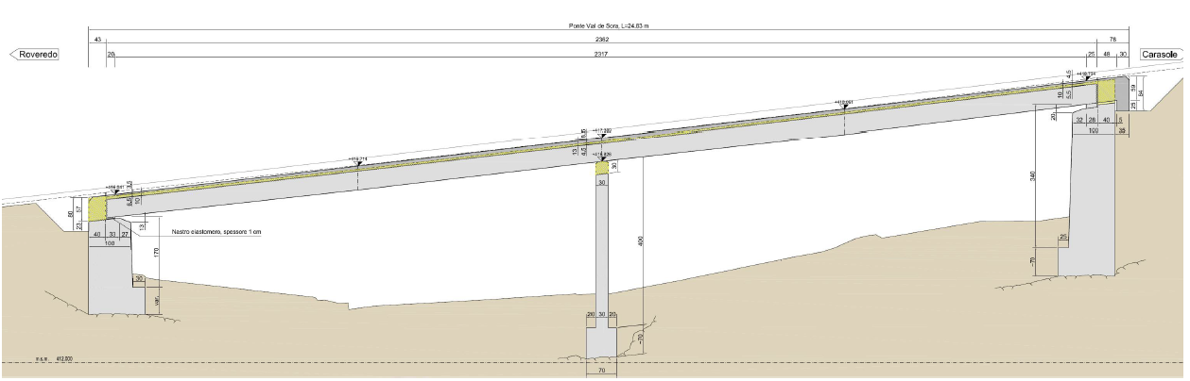
Assessment and retrofitting for bending
Bridge Val de Sora at Roveredo (GR), Switzerland
Two-spans non prestressed slab with spans 2 x 16.58 m
Elastomeric bearings with expansion joints
Built in 1964 for a traffic load of 16 t, to be increased to 40 t
Some AAR damages at the abutments detected

Slide 31


Assessment and retrofitting for bending
Main structural interventions:
New RC overlay (100-130 mm)
Flexural strengthening over the intermediate support with RC overlay,
Increase of deformation capacity in support region to allow for redistribution of internal forces and avoid strengthening for sagging moment
Shear strengthening of the slab and punching strengthening at column ends with inclined post-installed shear reinforcement in the region of the intermediate pier
Elastomeric bearings removed; deck slab clamped into the two abutments (transformed into an integral bridge)

Slide 32





Reliability analyses: probabilistic and semi-probabilistic approaches
In case the statistical values related to the uncertainties are known, partial factors may be calculated directly on the basis of 1st order reliability analysis (FORM):
For this purpose, the statistical data used for the calculation of partial factors typically used at LoA I (γ_{S} = 1.15, γ_{C} = 1.50 and γ_{V} = 1.40) are given in a table
Muttoni, 2023

Slide 33
Updated assumptions for justification and adjustment of γ_{S}
Coefficient of variation of the resistance
Geometrical uncertainty
Model uncertainty
Material uncertainty
Effective depth d [mm]
Muttoni, 2023

Slide 34
Alternative approach with updated partial factor γ_{S} according to EN 1992-1-1:2023
(2nd generation of Eurocode 2)
reliability level depends on effective depth, with higher required partial safety factor γ_{S} for thin members
Almost constant required γ_{S} with d_{d} = d_{nom} - 15 mm
=> it is allowed to work with γ_{S} =1.03 provided that the verification is conducted with the design value of the effective depth d_{d} = d_{nom} - 15 mm
Muttoni, 2023

Slide 35
Reliability analysis, case of punching
Contributions to total coefficient of variation of punching shear resistance (EN 1992-1-1:2023) as a function of the effective depth
Slabs without shear reinforcement Slabs with shear reinforcement
Position of 1st stud
Geometrical uncertainty (effective depth)
Variability of effective depth
Model uncertainty
Model uncertainty
Actual in-situ concrete strength (η_{is})
Actual in-situ concrete strength (η_{is})
Variability of f_{c,cyl} and D_{max}
Variability of f_{c,cyl} and D_{max}
Muttoni, 2023

Slide 36
Lessons learnt with respect to assessment for bending
Design methods used in the past are reliable and provide similar results compared to current standards
For statically indeterminate systems, increase in traffic loads and/or moderate corrosion can be compensated by accounting for increased resistance related to plastid redistribution of internal forces
In some cases, interventions to increase deformation capacity are needed
For statically determinate systems, or systems with limited redundancy, external posttensioning is an efficient tool to provide sufficient safety level
Reliability analysis, or verifications with the design value of the effective depth can also help avoiding or reducing the interventions in existing bridges.

Slide 37


Deck with solid cross section and insufficient shear strength Example :
Valserrheinbrücke Uors-Surcasti (GR), Switzerland
Designed by Christian Menn, built 1962

Slide 38

Deck with solid cross section and insufficient shear strength Example :
Valserrheinbrücke Uors-Surcasti (GR), Switzerland
Arch bridge built in 1962, solid slab with insufficient shear reinforcement, intervention in 2001 (deck widened, with an asymmetric carriageway)

Slide 39








Deck with solid cross section and insufficient shear strength Example :
Valserrheinbrücke Uors-Surcasti (GR), Switzerland
Assessment and strengthening proposal, 2021

Slide 40
Deck with solid cross section and insufficient shear strength Example :
Valserrheinbrücke Uors-Surcasti (GR), Switzerland
Assessment using the Levels of Approximation Approach
Capacity / demand ratios:
LoA II: n = V_{Rd} / V_{Ed} = 0.72
LoA III: n = V_{Rd} / V_{Ed} = 0.80

Slide 41



Deck with solid cross section and insufficient shear strength Example :
Valserrheinbrücke Uors-Surcasti (GR), Switzerland
Proposed alternative in 2021:
Inclined post-installed shear reinforcement

Slide 42


Deck with solid cross section and insufficient shear strength Example :
Valserrheinbrücke Uors-Surcasti (GR), Switzerland
Strengthening June-July 2022
Combination of boreholes from the bottom and from the top

Slide 43





Shear resistance of bridge deck slabs
LoA I: elastic calculation of internal forces, shear verification (LoA I and II)
LoA II: elastic calculation of internal forces cutting the peak (average over 4d), shear verification LoA II and III
LoA III: nonlinear calculation of internal forces accounting for nonlinear flexural and shear deformations, shear verification LoA III
Vaz Rodrigues et al., 2008, Natário et al., 2015, Cantone et al. 2022

Slide 44

IBRACON, 2023

Slide 45

Shear in girders with shear reinforcement, Levels of Approximation Approach
accuracy
Time devoted to analysis
LoA I : Shear according MC 2020 LoA I or EN 1992-1-1:2023 (constant ν values and cotθ_{min})
LoA II : Shear according MC 2020 LoA II or EN 1992-1-1:2023 (ν values and cotθ_{min} calculated as a function of the longitudinal strain in the web)
LoA III : ~ LoA II, but without accounting for cotθ_{min} in case of sufficient ductility of shear reinforcement ductility and adapted failure criterion
LoA IV : elastic – plastic stress field accounting for strain compatibility

Slide 46



Precast girders with thin webs
Example: Pont de la Tuffière sur la Sarine, Arconciel (FR), Switzerland
Construction 1970,
Simply supported girders with 3 spans of 32.30 m
Webs 170 mm + posttensioning ducts f = 85 mm
(11-A23)

Slide 47


Precast girders with thin webs
Example: Pont de la Tuffière sur la Sarine, Arconciel (FR), Switzerland
Compliance factor (capacity/demand ratio)
V_{Rd} / V_{Ed} = 1.16
ν
Compression field
Steel stresses
Tension
Compression
Yielding
Efficiency factor ν
Changes of forces in tendon
ν = 0.47

Slide 48
Half joints (Gerber hinges) and diaphragms, Levels of Approximation Approach
LoA I : Strut-and-tie models
LoA II : Rigid plastic stress fields
LoA III : Elastic – plastic stress field accounting for strain compatibility

Slide 49



Half joints (Gerber hinges), Example LoA I and II:
Pont des Grand Crêts, Vallorbe (VD), Switzerland
Reinforced concrete bridge built in 1958 without waterproofing membrane
Half-joints combined with expansion joints

Slide 50


Half joints (Gerber hinges), Example LoA I and II:
Pont des Grand Crêts, Vallorbe (VD), Switzerland
LoA I: n = V_{Rd} / V_{Ed} > 1.00
LoA II: n = V_{Rd} / V_{Ed} > 1.00
(19-A02)

Slide 51


Half joints (Gerber hinges), Example LoA III:
Pont de la Chocolatière, built 1964, Lausanne (VD), Switzerland

Slide 52



Half joints (Gerber hinges), Example LoA III:
Pont de la Chocolatière, 1964, Lausanne (VD), Switzerland
Compression field, stresses in the reinforcement and concrete utilization ratio at member resistance V_{Rd} = 1.15V_{Ed}

Slide 53
Main conclusions based on the personal experience of the last four decades
The Level of Approximation Approach is an extremely efficient approach for the assessment of existing structures.
Higher Levels of Approximation (refined calculations) allow often avoiding unnecessary strengthening or can significantly reduce amount and cost of interventions.
Reliability analysis can also help in reducing structural interventions to the minimum or even avoiding them.
If interventions are really necessary, avoid too invasive interventions and respect the original esthetics, preserving the cultural heritage of the infrastructure, or even improve it with minor adjustments if possible !

Slide 54




Presented by:
Aurelio Muttoni
aurelio.muttoni@mpic.ch
Prof. Dr. A. Muttoni
Muttoni Partners Ingénieurs Conseils SA
Route du Bois 17
CH-1024 Ecublens
Switzerland

